Slide 1
Locally Developed Career Connected Learning
Employment Security Advisory Committee
April 25, 2018

Slide 2
Presenter: Anna Nikolaeva, Career Connect WA Manager Employment Security Department

Slide 3
Two-year goal: • 217 youth apprenticeships • 4,301 internships • 29,000 other career connected learning experiences Long-term goal: • Make apprenticeship and internship a routine part of high school for all students

Slide 4
Interrelated problems: • Washington employers have 260,000 job openings per year paying $35,000 or more • 73% require some postsecondary education • Skill gaps slow economic growth and job creation • Young adult unemployment is 12.4% • 5-year high school graduation rate is 81.9% - 18,000 young people per year do not graduate within 5 years of starting school

Slide 5
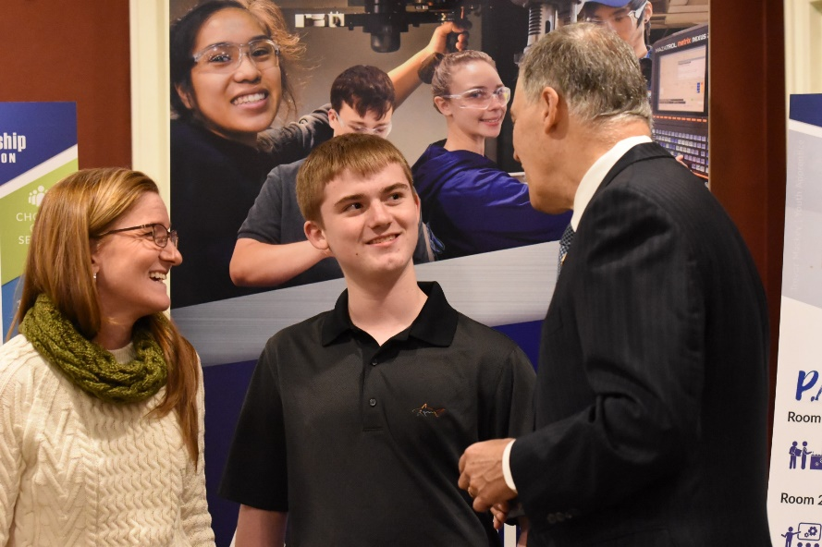
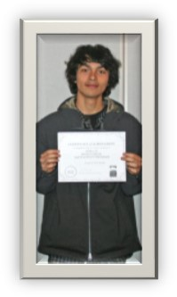
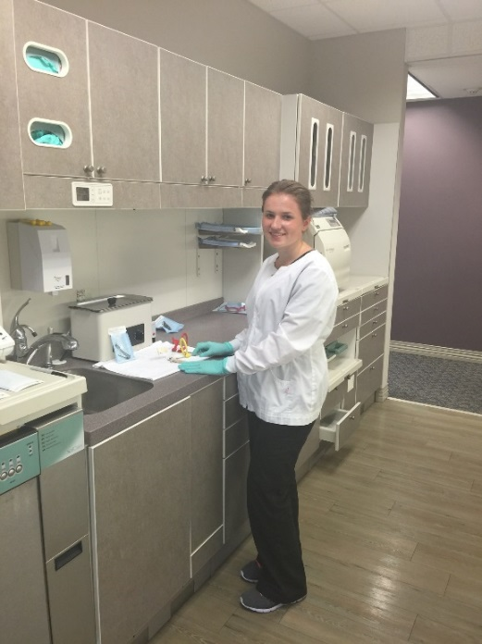
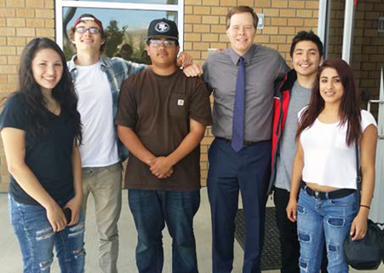
What if we could change more lives

Slide 6
What if we could grow more businesses

Slide 7
What if we could engage whole communities

Slide 8
Don’t create a ‘new program’!
Build a funding mechanism that creates a system
Empower existing programs to work together
Fund them to do so
Increase collective capacity of existing programs to reach specific goals of Career Connect Washington… together
Make sure the state-level agencies and private sector organizations are sending the same message together to their local programs

Slide 9
Working backwards from the Swiss model:
70% of high school students do employer apprenticeship 3 days a week, traditional school 2 days a week
Teachers have massive community support
Fully permeable, no tracking
Youth and adult unemployment are both at 3%

Slide 11
Career Connect Washington Potential Long-Term Model:
There are 11 local Career Connect teams in communities across Washington, including leadership from business, labor, schools, apprenticeship, workforce development councils, colleges, dropout re-engagement programs, STEM networks, and community organizations. We are asking all to work together to build Career Connect Washington over the long term.
Grades K-6
Grades 7-8
Grade 9
Grade 10
Grades 11-12
12 and beyond
STEM Experiences
Future Day – visit an employer to learn about work
Light career exploration
Develop online career plan, updated each year
Job shadows to explore career options
Practice online job search
Write resume
All students choose 3 main career options in their online career plan
Indicate where they would apply to pursue each one
All students indicate in their career plan where they have applied and what pathway they will pursue for grades 11-12*
Paid Youth Registered Apprenticeship – weekly paid work combined with related supplemental instruction counting towards HS completion.
Comprehensive Internship – paid internship or pre-apprenticeship that aligns with career plan and includes mentoring.
Traditional – High School Skills Center (may include dual credit models such as Running Start or College in the High School).
Attain Journey-level credential
Earn college degree (Associate’s or Bachelor’s)
Achieve industry certificate
Complete vocational education
Enter gainful employment
Pursue military career
DRAFT
All students indicate in their online career plan where they have applied and will go for their post-secondary skills training, employment, and/or education*.
*No student leaves this blank. Mentor, job coach, or counselor calls any as needed to ensure they make a choice, enroll, show up, and succeed.

Slide 12
We’ve had some prior successes

Slide 13
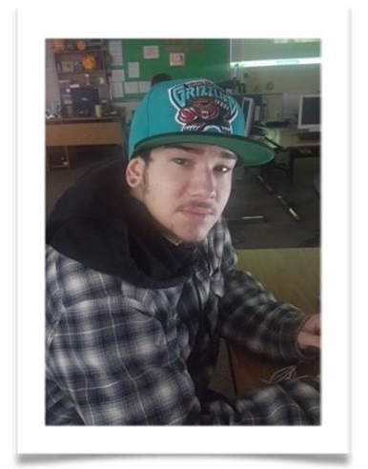
Beyond statistics
Tanner
Irina
Braythen

Slide 14
Governor’s WIOA Reserve Funding
$6.4 million
"We are going to stop telling our kids that a four-year degree is the only path to success. Most of them will require education and training after high school, but that doesn’t necessarily mean a four-year college degree. Through registered apprenticeships, technical training programs, and other career connected learning opportunities, we’ll give students all kinds of ways to fulfill their dreams of helping build airplanes, cure diseases, or design innovative new software."
-Governor Jay Inslee

Slide 15
Request for Proposals
Expand internships
Build youth apprenticeships
Help us work toward making this a routine part of high school for all
Do it with broad local buy-in
Increase local collective capacity
Bring local leveraging money

Slide 16
Guiding Principles

Slide 17
It’s not easy, but it’s worth it
Strains staff resources
Strains local relationships
Adults have to work together
Adults have to put kids first
Risk of failure

Slide 18
New partnerships
+ 7 more

Slide 19
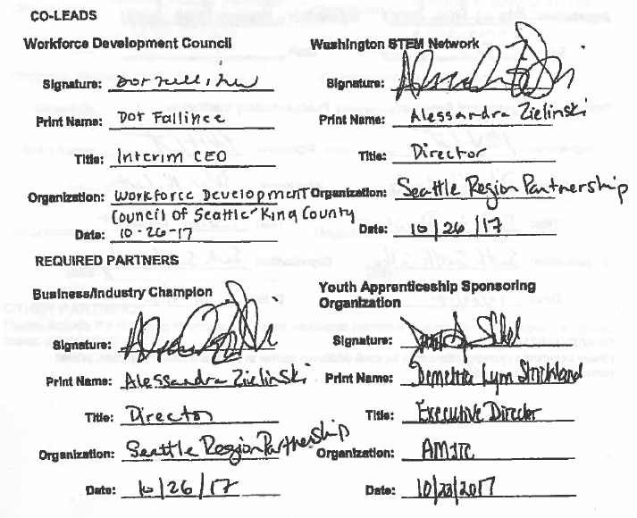
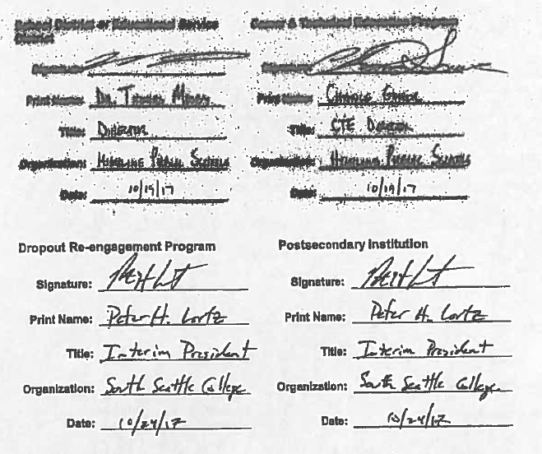
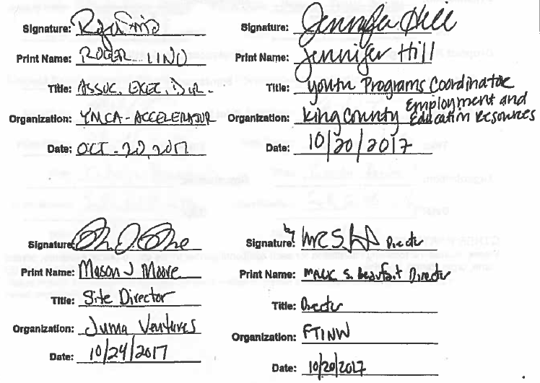
Assurances of commitment from partners

Slide 20
Technical Assistance: Quarterly Performance Tracking & Peer-to-Peer Learning

Slide 22
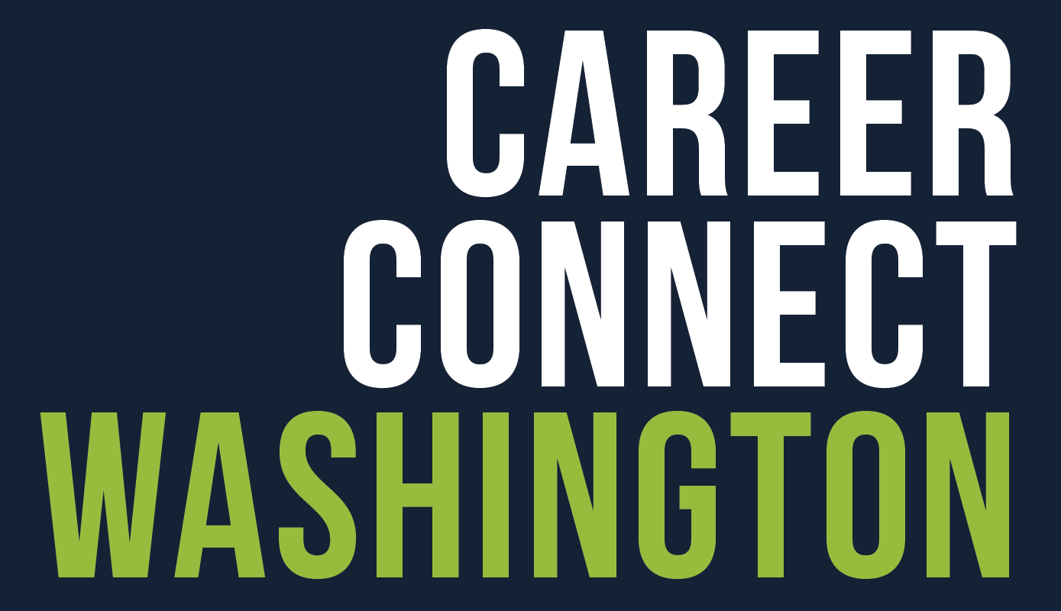
Coordinated State-Wide Efforts
“As a business person and Chair of the Workforce Board, I’m committed to strengthening the connection between Washington employers and our young people. We need business and industry at the table to make this work. We need business to be engaged and truly excited about helping create these opportunities."
- Perry England, Workforce Board Chair, VP Building Performance, MacDonald-Miller
Task Force
Strategic Planning
"A career connected learning system that includes apprenticeships, mentorships, job shadows, and hands-on learning will allow businesses to meet their workforce needs and youth in our state to be prepared for great careers."
- Brad Smith, President of Microsoft

Slide 23
Two year goal:
29,000 career connected learning experiences
Five year goal:
100,000 career connected learning experiences

Slide 24
Thank you!

