Slide 1
Paid Family & Medical Leave
ESAC Meeting
April 25, 2018

Slide 2
Presentation Overview
General Program Update
Our Team
Outreach & Communication Update
Policy & Rule Making Update
Questions

Slide 3
General Program Update
Over 50 people strong
Operations Team Staffing Up
Operations Manager
PFML Specialists
Technology
Envisioning
Fit Gap
Development
Welcome!

Slide 4
Our Team

Slide 5
Communications & Outreach Update
“All-employer email”
Delivered to 123,117 employers throughout the state
105,626 total opens
10,137 clicks on embedded links (including 224 to the Spanish version of the email)
Reaching more people each day
4,100+ general listserv subscribers (+1,300 since April 3)
1,350+ subscribed to the small businesses listserv
New subscribers to the voluntary plan listserv

Slide 6
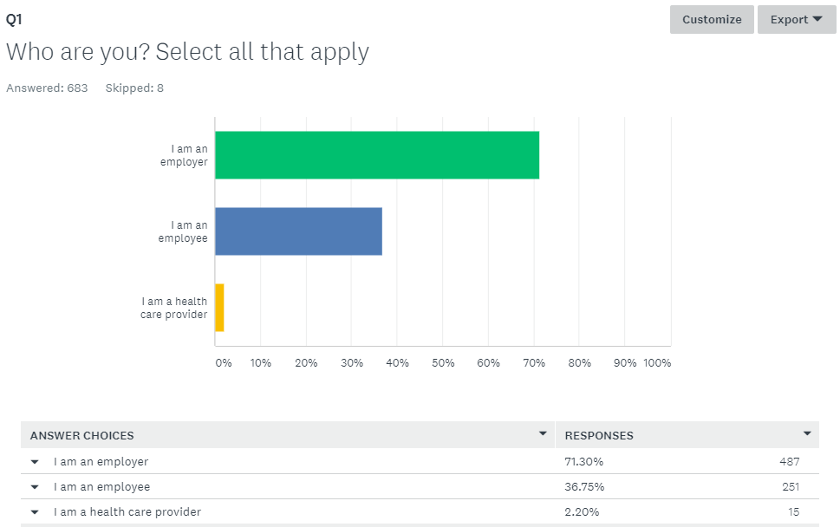
Communications & Outreach Update
Basic awareness survey
Nearly 700 responses
Following the “all-employer email,” employer responses now double those of employees
Noticeable change in associations with program

Slide 7
Communications & Outreach Update
Next Up
Focus groups
Employee email
Presentations
New employee onboarding
Small business outreach planning
Small business listserv (150 employees or fewer)
Small business toolkit
Presentations

Slide 8
Rules Update
Phase 1 (Premium liability, CBAs, voluntary plans):
CR-102 filed on April 4
Public hearing scheduled May 23
Targeting July 1 effective date
Phase 2 (Employer responsibilities, grants, penalties):
Filed CR-101 on April 12
Conducted 2 listening sessions
Policy team drafting rules
Pre-102 meetings scheduled May 14 and June 25

Slide 9
Phase 2 Rulemaking Timeline
Employer Responsibilities ♦ Small Business Assistance Grants ♦ Penalties
March 26, 2018
May 8, 2018
June 19, 2018
First Listening Session
Post Draft 1 of Rules
Post Draft 2 Rules
March 1
April 2, 2018
May 14, 2018
Second Listening Session
First Stakeholder Meeting
June 25, 2018
October 24, 2018
November 2, 2018
Second Stakeholder Meeting
Formal Rules Hearing (Western Washington)
File Proposed Rules (CR103)
December 3
Rules Take Effect
August 17, 2018
October 29, 2018
File Proposed Rules (CR102)
Formal Rules Hearing (Eastern Washington)
This timeline is an approximate timeframe for completion of draft rules for Phase 2 of the Paid Family and Medical Leave rulemaking process. Dates subject to change.

Slide 10
Questions?
?

Slide 11
Continue the Conversation
Visit us online at
www.esd.wa.gov/paid-family-medical-leave
Join our listserv at
bit.ly/PaidLeaveList
Ask questions and make comments on our public forum at bit.ly/CommentForum
Presenter Name
Presenter Email

