Slide 1
Washington State Employment Security Department
Unemployment Insurance Trust Fund
Cynthia Forland, CIO and Assistant Commissioner
Workforce Information and Technology Services
Employment Security Advisory Council
April 25, 2018

Slide 2
Unemployment benefit payments
Source: Employment Security Department, March 2011 UI Trust Fund Forecast, 5/23/2011
Source: Employment Security Department, March 2011 UI Trust Fund Forecast, 5/23/2011
Source: Employment Security Department/WITS, February 2018 UI Trust Fund Forecast
Notes:
Unemployment Rate by %
February 2018
2017 4.62%
2018 4.34%
2019 4.06%
4.11%
4.11%
4.13%
4.21%
Overall, Cumulative Projected benefit payments increase steadily between 2018 and 2023 (+$204.2m).

Slide 3
Average duration of benefits
Source: Employment Security Department, March 2011 UI Trust Fund Forecast, 5/23/2011
Source: Employment Security Department, March 2011 UI Trust Fund Forecast, 5/23/2011
Source: Employment Security Department/WITS; U.S. Department of Labor, ETA 5159
Notes:
Average duration of benefits is currently at 14.7 weeks (February 2018)

Slide 4
Unemployment taxes
Source: Employment Security Department, March 2011 UI Trust Fund Forecast, 5/23/2011
Source: Employment Security Department, March 2011 UI Trust Fund Forecast, 5/23/2011
Projected
Source: Employment Security Department/WITS, February 2018 UI Trust Fund Forecast
Notes:
Overall Experience Tax Collections for 2018-2023 are projected to fall by $24.6m
Overall Social Tax Collections for 2018-2023 are projected to increase by $20.5m

Slide 5
Historical and projected UI tax rates
1986: 4.03%
2020: 0.85%
1996: 1.88%
2016: 1.20%
Source: Employment Security Department/WITS; U.S. Department of Labor, ETA, UI data summary handbook

Slide 6
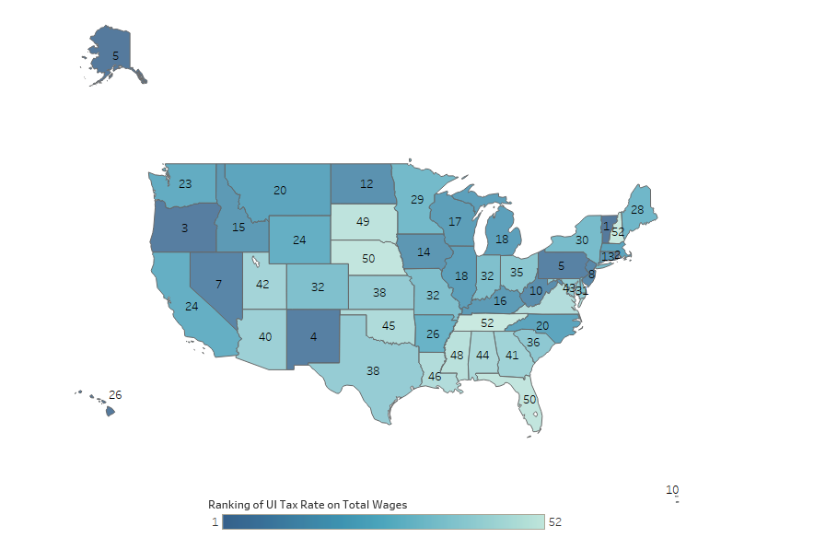
State rankings on average UI tax rate
Source: Employment Security Department/WITS; U.S. Department of Labor, ETA, UI data summary handbook
Notes:
Based upon the UI tax rate on total wages as of 2017 Q 4
Source: US Department of Labor; UI Data Summary – Average Tax Rate on Total Wages

Slide 7
Unemployment trust fund balance & months of benefits
Source: Employment Security Department/WITS, February 2018 UI Trust Fund Forecast
Notes:
MOB from the February 2018 forecast:
2018 – 16.6 MOB
2019 – 16.6 MOB
2020 – 16.5 MOB
2021 – 16.5 MOB
2022 – 16.3 MOB
2023 – 16.3 MOB

Slide 8
UI trust fund solvency
Great Recession posed most serious challenge to UI financing in the system’s history
36 states borrowed from the U.S. Treasury to pay UI benefits from 2009 through 2013, totaling $93 billion
Employers in states with federal loans were faced with risk of increased federal FUTA taxes
Washington state’s UI trust fund went from a balance of $4 billion at the start of the recession to a balance of $2.3 billion at the end of 2013, allowing us to continue paying benefits without borrowing federal funds
Notes:
After a state has passed two January 1’s with an outstanding loan in each
successive year it will begin to lose a portion of its FUTA credit which will go towards repayment of the loan.

Slide 9
Any questions?
Cynthia Forland
CIO and Assistant Commissioner
Workforce Information and Technology Services
Employment Security Department
(360) 507-9501
CForland@esd.wa.gov

