Slide 1
Washington’s Trust Fund and
State of the labor market
August 17, 2020
Employment Services Advisory Committee

Slide 2
Overview
Breakout of Federal and State Benefits
Unemployment Insurance (UI) Trust Fund Update
State of the Labor Market

Slide 3
Unemployment Benefits During Crisis
State funded
  Unemployment Insurance
Federally funded
  Pandemic Unemployment Assistance (PUA): the expansion to those previously ineligible.
  Federal Pandemic Unemployment Compensation (FPUC): Additional $600/week
  Pandemic Emergency Unemployment Compensation (PEUC): Additional 13 weeks
  Extended Benefits (Up to 20 weeks)
  100% SharedWork Reimbursement
  100% Waiting Week Reimbursement
  50% of Reimbursable Employers Reimbursement

Slide 4
$9.2 Billion paid out in benefits since 3/7
Since the week ending 3/7: $9.2 billion has been paid out in benefit payments between March 7 and August 1st.
  $2.9 billion paid out in state benefits – from the UI trust fund
  $6.3 billion paid out in federal benefits (PUA, PEUC, FPUC)
  444,580 claims received a benefit payment during the most recent week (week ending 8/1/2020)
  985,689 individuals who have filed an initial claim have been paid
Notes:
Mar 7th – August 1st
State benefits: $2.9b
Federal benefits $6.3b
A total of 1,287,949 distinct individuals have filed for unemployment benefits since March 7th
ESD has paid out over $9.2 billion in benefits
985,689 individuals who have filed an initial claim have been paid
Claims paid if for all entitlement programs –Source: UI dashboard – payments by issued date
Benefit Paid by entitlement (March 7th – August 1st)
-UI $2,881,473,323
-FPUC $5,497,258,955
-PEUC $147,725,794
-PUA $732,640,371
-RTAA $20,382
-TB $2,459,837
-TRA $4,005,980
-PEB (ExtendedBenefits) $ 7,458,418

Slide 5
Unemployment Insurance Trust fund
As of August 5th, the UI trust fund balance was at $2.6 billion
Notes:
Source: ETA 2112
August 5th was the unofficial trust fund balance provided by Treasury - $2.6 billion
Total CARES Act Payments 3-7 to 8-1
$2.9 billion paid out of UI trust fund between March 7th and August 1st
Benefit Paid by entitlement
-UI $2,881,473,323
-FPUC $5,497,258,955
-PEUC $147,725,794
-PUA $732,640,371
-RTAA $20,382
-TB $2,459,837
-TRA $4,005,980
-PEB (ExtendedBenefits) $ 7,458,418
UI Trust Fund balance as of August 5th was $2.6 billion.
The state portion of the UI that has been paid from 3/1 until 5/20 was $1,428,692,833.01. *This does not include the file that was released last night (since I report as of the previous day). Last night’s file adds an additional $119,791,842.34 – which will be on tomorrow’s report.

Slide 6
A sense of scale: claims and trust fund projections
Currently UI is experiencing unprecedented claim volume with over 320,000+ paid claims per week.
This is currently 650% higher than the average number of weekly claims paid in 2020 prior to COVID-19.
State UI initial claims are down from roughly 139,000 a month to approximately 25,000 for the week ending August 1st.
Due to the uncertain future impacts of COVID-19, a lot of uncertainty remains around how long we will continue to experience the high volume of claims.
For this reason it is difficult to project when the UI Trust Fund will need to borrow from the federal government in order to remain solvent and continue paying benefits.
June trust fund forecast is projecting a UI trust fund loan will be required before the end of 2020.
Notes:
650% higher now (1,000% higher at peak)

Slide 7
Trust fund solvency options
If a state recognizes that it does not have sufficient funds to pay UI benefits over 3 months, the mechanism for receiving a loan from the Department of Labor is straightforward. The state's governor (or the governor's designee) must submit a letter requesting that the U.S. Labor Secretary advance funds to the state account within the Unemployment trust fund. Once the loan is approved by the U.S. Labor Secretary, the funds are placed into the state account in monthly increments.
The Department of Labor is currently waiving interest payments and the accrual of interest on federal advances (loans) to states to pay unemployment benefits through December 2020.
If a state does not repay a loan by November 10 of the second year after the loan, the state becomes subject to a reduction in the amount of the tax credit applied against the federal unemployment tax beginning with the preceding January 1 until the state repays the loan fully.

Slide 8
Annual Unemployment taxes
Four components to state UI tax
    Experience rate tax
    Social tax
    Solvency surcharge
    Employment Administrative Fund Tax
Experience rate tax is an annual tax calculation based on a ratio of:
  Benefit claims charged to the employer over the preceding four years (July through June), and “Taxable wages” reported by the employer.
Experience tax rates for 2021 will be based upon the experience rating between July 2016 through June of 2020.
Benefits charged during CY 2020 will remain as part an employers experience rated tax calculation until June 2024.

Slide 9
Annual Unemployment taxes
A “flat social tax” is annual tax calculation determined by subtracting total taxes paid by employers for the four consecutive quarters preceding the computation date from total unemployment benefits paid to claimants over those same quarters (i.e. July 2019 – June 2020 time period is used to calculate the 2021 calendar year flat social tax factor).
Social tax is further adjusted based upon the trust fund balance and then set for each rate class.
Social tax ceiling of 1.22% passed during the 2010 legislative session.
Solvency tax - Additional tax rate added to guarantee the health of the trust fund. Assigned when the trust fund balance has less than seven months of benefits (Solvency surcharge is up to two-tenths of one percent).
Unemployment insurance tax due dates:
Notes:
In addition the maximum tax cap is 6.0% for most employers.

Slide 10
Washington’s Labor Market
From February 2020 through April 2020 554,000 nonfarm jobs have been lost.
217,400 jobs were gained between April2020 and June 2020
The accommodation and food services sector has lost the most jobs over the year (-93,200 jobs).
Divergent unemployment trends across the state.
Washington Unemployment rate tracking lower than the U.S.
Notes:
Now a look at different segments of WA labor market :
554,00 jobs were lost between February 2020 and April 2020.
217,400 jobs were gained between April2020 and June 2020
Accommodation and food services (down 93,200 jobs Y/Y)
WA unemployment rate – June 2020 (9.8% -SA)
US unemployment rate – June 2020 (11.1% - SA)

Slide 11
Nonfarm employment in Washington
Source: Employment Security Department/WITS, U.S. Bureau of Labor Statistics, Current Employment Statistics, Seasonally Adjusted
Notes:
Our primary measure of state economic conditions is the number of jobs across the state in businesses and government.
On a monthly basis, business establishments and governments are surveyed to generate these estimates.
On several charts you will see the words seasonally adjusted. This is done to account for events that regularly occur that influence employment, such as holidays, schools in session and weather.
key points to be gathered from the chart.
554,00 jobs were lost between February 2020 and April 2020.
217,400 jobs were gained between April2020 and June 2020
Number of nonfarm jobs stands at 3,176,900 as of JUNE 2020
Source: Seasonally adjusted CES

Slide 12
Employment rates
Employment rates for both the nation and Washington dropped below 60 percent
Source: Employment Security Department/LMPA; U.S. Bureau of Labor Statistics, Local Area Unemployment Statistics – Seasonally Adjusted. U.S. recessions are shaded in gray.
Notes:
Employment rate = Employment as a percent of the civilian non-institutional population – How much of the population is employed?
Since 2014 we have seen the employment rate slowly increasing until February 2020. Between February and April the employment rate for WA has dropped from 62.8% to 55.0%. As of June 2020 the employment to population ratio for WA is at 58.4% compared to 54.6% for the nation.

Slide 13
Current Employment Statistics
Year over year employment change by industry
Source: Employment Security Department/WITS, U.S. Bureau of Labor Statistics, Current Employment Statistics, Seasonally Adjusted
Notes:
June 2019 to June 2020 the state has lost 290,700 nonfarm jobs
The CES nonfarm employment information is released every month. Y/Y = June 2020 to June 2019
Accommodation and food services (down 93,200 jobs Y/Y) and Government (down 39,300 Y/Y) experienced the largest over the year decreases
Professional, scientific and technical services was the only super sector with a increase in employment year over year (+3,900)

Slide 14
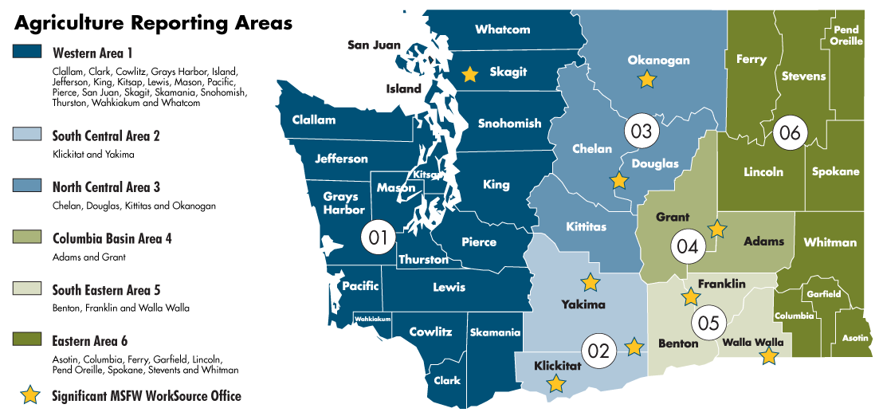
Washington state agricultural reporting areas

Slide 15
Agricultural employment in Washington state and reporting areas
Source: Employment Security Department/LMEA; U.S. Bureau of Labor Statistics, QCEW
Notes:
Slide shows:
historical average annual area covered employment levels from 2007 to 2019
Agricultural reporting area employment aggregates to the statewide total.
Average annual agricultural employment has a very slight linear trend.
Since 2007, total average annual agricultural covered employment in Washington state has grown from 75,756 to 96,047 in 2019.
Beginning in 2011, agricultural reporting area South Central area 2 (an aggregation of Yakima and Klickitat counties) has increased the magnitude of it’s employment share of the statewide agricultural sector over time, while the other reporting area’s agricultural employment shares have remained relatively constant. The agricultural sector in South Central Area 2 has increased average employment by around 10,000 since 2017, an increase of over 43% between 2007 and 2019.

Slide 16
Agricultural industry employment in Washington state
Source: Employment Security Department/LMEA; U.S. Bureau of Labor Statistics, QCEW
Notes:
Slide shows:
Historical statewide covered average annual industry employment of the top five largest agricultural industries in Washington state with regard to employment levels.
All of the industries presented have seen as least some historical growth with Apple Orchards having the largest historical level of employment,
Other food crops grown under cover shows a steep rise in average annual employment beginning in 2014. This rise could be due to the legalization of recreational marijuana use, which occurred during 2012.

Slide 17
Unemployment rates
Source: Employment Security Department/LMEA; U.S. Bureau of Labor Statistics; Local Area Unemployment Statistics
Notes:
The data in this chart compare the unemployment rates for the U.S., the state of Washington and the Seattle-Bellevue-Everett MSA
The unemployment rate more than doubled for the state from February2020 to April 2020 and have reverted back since April but still remain above unemployment rates during the prior recession, going from a high of 16.3% in April20 to 9.8% in June20.
State Unemployment Rate (June 2020) = 9.8%
Seattle MSA (Apr20) = 9.3%
U.S. (Jun20) = 11.1%

Slide 18
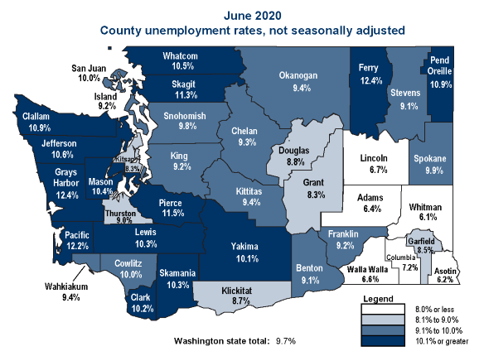
Unemployment around the state
Source: Employment Security Department/LMPA; U.S. Bureau of Labor Statistics, LAUS not seasonally adjusted.
Notes:
Divergent unemployment trends across the state. In June 2020, there were 14 counties in April with a UI rate above 10% (not seasonally adjusted) – 6 counties had unemployment rates below 8%. Eastern counties have not experienced the big increases around the unemployment rate that the westside counties are experiencing
Whitman county had the lowest rate (6.1%)
Grays Harbor and Ferry county had the highest unemployment rates (12.4%)

Slide 19
Beyond the unemployment rate
Alternative measures of labor underutilization
Source: U.S. Bureau of Labor Statistics, Alternative measures of labor underutilization by state
Notes:
Six alternative measures of labor underutilization – These broader unemployment rate measures look at different segments of unemployed workers over the past 12 months compared to the same measure over the previous period.
Definitions for the economic characteristics underlying three broader measures of labor underutilization are worth mentioning here.
Discouraged workers (U-4, U-5, and U-6 measures) are persons who are not in the labor force, want and are available for work, and had looked for a job sometime in the prior 12 months. They are not counted as unemployed because they had not searched for work in the prior 4 weeks, for the specific reason that they believed no jobs were available for them.
The marginally attached (U-5 and U-6 measures) are a group that includes discouraged workers. The criteria for the marginally attached are the same as for discouraged workers, with the exception that any reason could have been cited for the lack of job search in the prior 4 weeks. Persons employed part time for economic reasons (U-6 measure) are those working less than 35 hours per week who want to work full time, are available to do so, and gave an economic reason (their hours had been cut back or they were unable to find a full-time job) for working part time. These individuals are sometimes referred to as involuntary part-time workers.
Generally, all six measures of labor underutilization move together over time, including across business cycles. Similarly, states that have low unemployment rates tend to have low values for the other five measures; the reverse is true for states with high unemployment rates.

Slide 20
Continue the Conversation
Labor Market Information Director Steven Ross
Steven.ross@ESD.WA.GOV

