Slide 1
Employment Security Advisory Committee
Diane Rosado, Sam Virgil, Alexander Wolter
Unemployment Insurance Customer Support
Employment Security Department
August 17, 2020

Slide 2
Reflections – Operation 100%
Positives
July 31 goal was met
Staff were committed to the goal
Adjustments were made quickly when needed
Resolved claims for more than 81,000 people between end of May and July 31
Lessons learned
Need strong data analysis
Need to utilize the system for assigning work rather than manual assignments

Slide 3
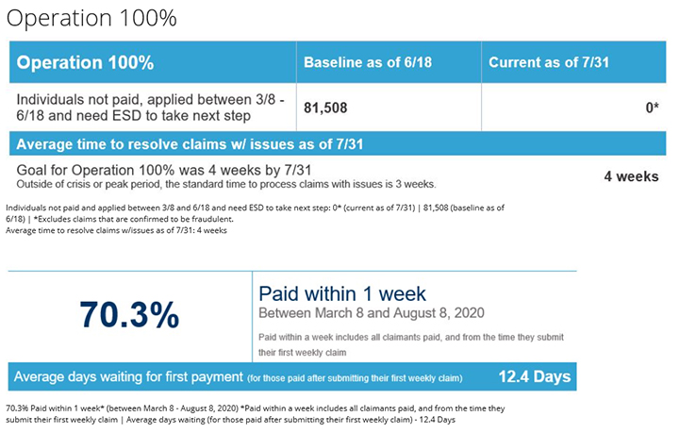
Dashboard Data
Operation Accomplished
Source: https://esd.wa.gov/unemployment/dashboard

Slide 4
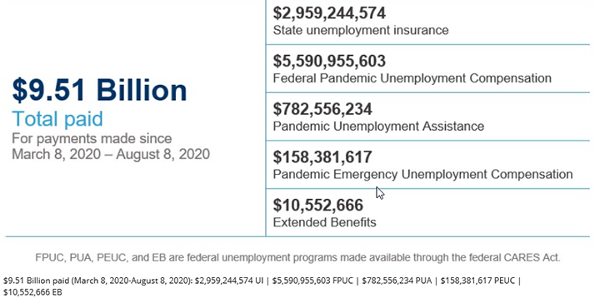
Dashboard Data
Giant numbers, giant response for COVID-19
Source: https://esd.wa.gov/unemployment/dashboard

Slide 5
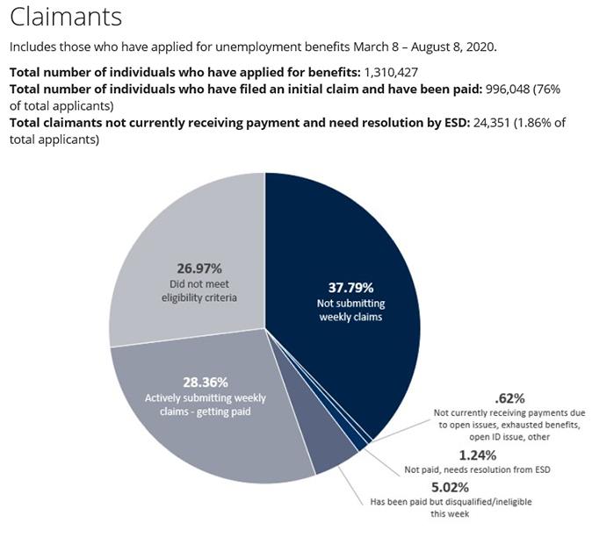
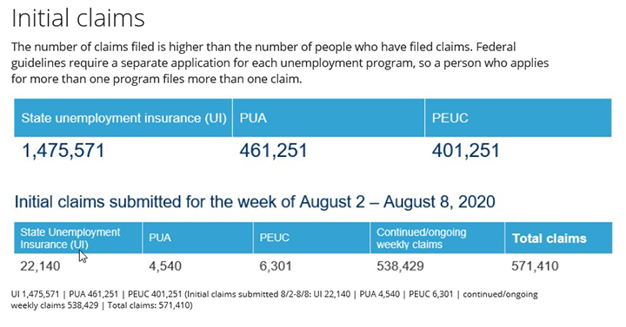
Dashboard Data
Other Data
Source: https://esd.wa.gov/unemployment/dashboard

Slide 6
The Path Ahead
Our main priorities
Eliminate backlog of appeal requests within the next 45 days
Resolve issues on claims where claimants are not receiving payment. These are prioritized by working the oldest waiting first.

Slide 7
Our Focus Moving Forward
Skills
Expand skillset of current call agents to resolve claimant issues without transferring to another agent
Train issue writers on additional matters so they can assist in areas they had not previously worked
Staffing
We have hired hundreds of staff at the call agent level and more than doubled our adjudication staff, with more hiring occurring at all levels
Utilized staff from other areas within the agency to various workloads
Contracted with vendors to work on document backlogs and answer phones.
Efficiency
Streamlined processes wherever possible, allowing for determinations to be made quickly with the information available
Assign and shift staff to workloads that are high priority and/or high volume based on the need that day.
Technology
Partnered with IT to automatically process cases where there is high confidence in decision results

Slide 8
Thank you!

