Slide 1
Washington’s Trust Fund and
State of the labor market
June 15, 2020
Employment Services Advisory Committee

Slide 2
Overview
Breakout of Federal and State Benefits
Unemployment Insurance (UI) Trust Fund Update
Unemployment Tax Rate Calculation Overview
State of the Labor Market

Slide 3
Unemployment Benefits During Crisis
State funded
  Unemployment Insurance
Federally funded
  Pandemic Unemployment Assistance (PUA): the expansion to those previously ineligible.
  Federal Pandemic Unemployment Compensation (FPUC): Additional $600/week
  Pandemic Emergency Unemployment Compensation (PEUC): Additional 13 weeks
  Extended Benefits (Up to 20 weeks)
  100% SharedWork Reimbursement
  100% Waiting Week Reimbursement
  50% of Reimbursable Employers Reimbursement

Slide 4
$5.4 Billion paid out in benefits since 3/7
Since the week ending 3/7: $5.4 billion has been paid out in benefit payments between March 7 and June 6th.
  $1.9 billion paid out in state benefits – from the UI trust fund
  $3.5 billion paid out in federal benefits (PUA, PEUC, FPUC)
  420,786 claims received a benefit payment during the most recent week (week ending 6/6/2020)
  844,077 individuals who have filed an initial claim have been paid
Notes:
Mar 7th – June 6th
State benefits: $1.9b
Federal benefits $3.5b
A total of 1,152,516 distinct individuals have filed for unemployment benefits since March 7th
ESD has paid out over $5.4 billion in benefits
826,123 individuals who have filed an initial claim have been paid
Claims paid if for all entitlement programs –Source: UI dashboard – payments by issued date
Benefit Paid by entitlement
-UI $1,678,123,854
-FPUC $2,330,326,082
-PEUC $36,023,180
-PUA $337,517,081
-RTAA $13,988
-TB $1,718,310
-TRA $ 2,268,160

Slide 5
Unemployment Insurance Trust fund
As of June 12th, the UI trust fund balance was at $3.1 billion
Notes:
Source: ETA 2112
April 30th was the unofficial trust fund balance provided by Treasury
Total CARES Act Payments 4-19 to 4-20
PUA -- $324,365,369
PEUC – 35,801,302.86
PFUC – 2,291,961,738.28
UI Trust Fund balance as of June 12 was $3.1 billion.
The state portion of the UI that has been paid from 3/1 until 5/20 was $1,428,692,833.01. *This does not include the file that was released last night (since I report as of the previous day). Last night’s file adds an additional $119,791,842.34 – which will be on tomorrow’s report.

Slide 6
A sense of scale: claims and trust fund projections
Currently UI is experiencing unprecedented claim volume with over 450,000+ paid claims per week.
This is 1100% higher than the average number of weekly claims paid in 2020 prior to COVID-19.
Weekly state UI initial claims are down from roughly 139,000 the week ending May 16 to 30,000 for the week ending June 6.
Due to the uncertain future impacts of COVID-19, it is unknown if Washington will continue to experience this high volume of claims and for how long this may occur.
For this reason it is difficult to project when or even if the UI Trust Fund may exhaust and if Washington will need to borrow from the federal government in order to pay benefits.
We will develop an updated forecast by the end of the month based on the Economic and Revenue Forecast Council (ERFC) June forecast.

Slide 7
Trust fund solvency options
If a state recognizes that it does not have sufficient funds to pay UI benefits over 3 months, the mechanism for receiving a loan from the Department of Labor is straightforward. The state's governor (or the governor's designee) must submit a letter requesting that the U.S. Labor Secretary advance funds to the state account within the Unemployment trust fund. Once the loan is approved by the U.S. Labor Secretary, the funds are placed into the state account in monthly increments.
The Department of Labor is currently waiving interest payments and the accrual of interest on federal advances (loans) to states to pay unemployment benefits through December 2020.
If a state does not repay a loan by November 10 of the second year after the loan, the state becomes subject to a reduction in the amount of the tax credit applied against the federal unemployment tax beginning with the preceding January 1 until the state repays the loan fully.

Slide 8
Annual Unemployment taxes
Four components to state UI tax
    Experience rate tax
    Social tax
    Solvency surcharge
    Employment Administrative Fund Tax
Experience rate tax is an annual tax calculation based on a ratio of:
  Benefit claims charged to the employer over the preceding four years (July through June), and “Taxable wages” reported by the employer.
Experience tax rates for 2021 will be based upon the experience rating between July 2016 through June of 2020.
Benefits charged during CY 2020 will remain as part an employers experience rated tax calculation until June 2024.

Slide 9
Annual Unemployment taxes
A “flat social tax” is annual tax calculation determined by subtracting total taxes paid by employers for the four consecutive quarters preceding the computation date from total unemployment benefits paid to claimants over those same quarters (i.e. July 2019 – June 2020 time period is used to calculate the 2021 calendar year flat social tax factor).
Social tax is further adjusted based upon the trust fund balance and then set for each rate class.
Social tax ceiling of 1.22% passed during the 2010 legislative session.
Solvency tax - Additional tax rate added to guarantee the health of the trust fund. Assigned when the trust fund balance has less than seven months of benefits (Solvency surcharge is up to two-tenths of one percent).
Unemployment insurance tax due dates:

Slide 10
Washington’s Labor Market
From February 2020 through April 2020 552,400 nonfarm jobs have been lost.
Leisure and Hospitality sector has lost the most jobs since February
(-196,400).
Divergent unemployment trends across the state.
Washington Unemployment rate tracking higher than the U.S.
Notes:
552,400 nonfarm jobs lost since February 2020 (Feb20-Apr 2020)
Over the year (Apr20/Apr19) nonfarm employment is down (-485,800).
Leisure and Hospitality (-196,400) (2digit NAICS level) has lost the most jobs since February 2020;
followed by:
Construction– (-78,700)
Education and Health services (-69,700)
WA unemployment rate – April 2020 (15.4% -SA)
US unemployment rate – April 2020 (14.7% - SA)

Slide 11
Nonfarm employment in Washington
Source: Employment Security Department/WITS, U.S. Bureau of Labor Statistics, Current Employment Statistics, Seasonally Adjusted
Notes:
Our primary measure of state economic conditions is the number of jobs across the state in businesses and government.
On a monthly basis, business establishments and governments are surveyed to generate these estimates.
On several charts you will see the words seasonally adjusted. This is done to account for events that regularly occur that influence employment, such as holidays, schools in session and weather.
Several key points to be gathered from the chart.
The jobs recession started later in Washington relative to rest of nation.
Peak Employment – 3,008,000 (March 2008)
The number of jobs lost during official recession (Dec07-Jun09) was 150,400, compared to 552,400 jobs lost since February 2020.
Number of nonfarm jobs stands at 2,961,100 as of April 2020
Source: Seasonally adjusted CES

Slide 12
Employment rates
Employment rates for both the nation and Washington dropped below 60 percent
Source: Employment Security Department/LMPA; U.S. Bureau of Labor Statistics, Local Area Unemployment Statistics – Seasonally Adjusted. U.S. recessions are shaded in gray.
Notes:
Employment rate = Employment as a percent of the civilian non-institutional population – How much of the population is employed?
Since 2014 we have seen the employment rate slowly increasing until February 2020. Since February the employment rate has dropped from 62.8% to 55.0% as of April 2020

Slide 13
Current Employment Statistics
Year over year employment change by industry
Source: Employment Security Department/WITS, U.S. Bureau of Labor Statistics, Current Employment Statistics, Seasonally Adjusted
Notes:
April 2019 to April 2020 the state has lost 552,400 nonfarm jobs
The CES nonfarm employment information is released every month. Y/Y = April 2020 to April 2019
The Leisure and Hospitality sector, which includes accommodation and food services (down 152,600 jobs Y/Y) and Arts, Entertainment and Recreation (down 38,100 Y/Y) experienced the largest over the year decreases
Information was the only super sector with a increase in employment year over year (+5,700)

Slide 14
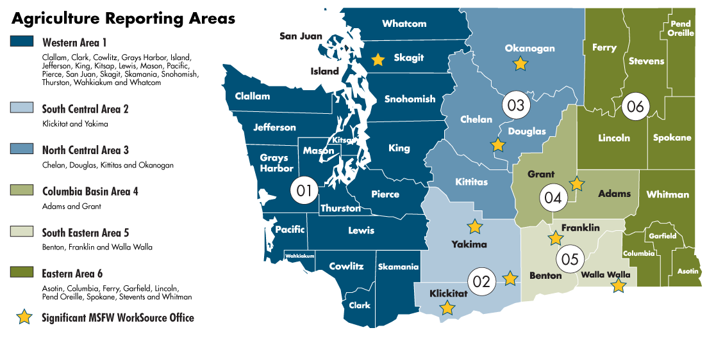
Washington state agricultural reporting areas

Slide 15
Agricultural employment in Washington state and reporting areas
Source: Employment Security Department/LMEA; U.S. Bureau of Labor Statistics, QCEW
Notes:
Slide shows:
historical average annual area covered employment levels from 2007 to 2019
Agricultural reporting area employment aggregates to the statewide total.
Average annual agricultural employment has a very slight linear trend.
Since 2007, total average annual agricultural covered employment in Washington state has grown from 75,756 to 96,047 in 2019.
Beginning in 2011, agricultural reporting area South Central area 2 (an aggregation of Yakima and Klickitat counties) has increased the magnitude of it’s employment share of the statewide agricultural sector over time, while the other reporting area’s agricultural employment shares have remained relatively constant. The agricultural sector in South Central Area 2 has increased average employment by around 10,000 since 2017, an increase of over 43% between 2007 and 2019.

Slide 16
Agricultural industry employment in Washington state
Source: Employment Security Department/LMEA; U.S. Bureau of Labor Statistics, QCEW
Notes:
Slide shows:
Historical statewide covered average annual industry employment of the top five largest agricultural industries in Washington state with regard to employment levels.
All of the industries presented have seen as least some historical growth with Apple Orchards having the largest historical level of employment,
Other food crops grown under cover shows a steep rise in average annual employment beginning in 2014. This rise could be due to the legalization of recreational marijuana use, which occurred during 2012.

Slide 17
Unemployment rates
Source: Employment Security Department/LMEA; U.S. Bureau of Labor Statistics, QCEW
Notes:
The data in this chart compare the unemployment rates for the U.S., the state of Washington and the Seattle-Bellevue-Everett MSA
The unemployment rate more than doubled for all areas from February2020 to April 2020.
State Unemployment Rate (April 2020) = 15.4%
Seattle MSA (Apr20) = 14.5%
U.S. (Apr20) = 14.7%

Slide 18
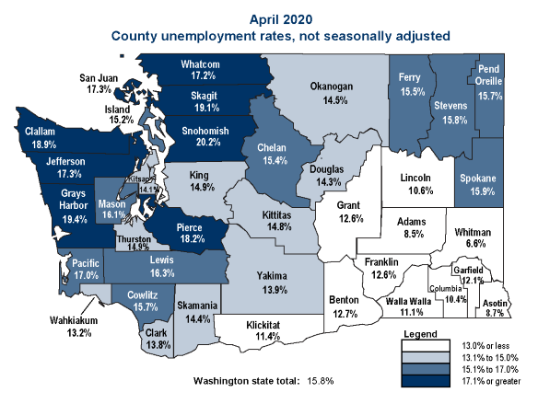
Unemployment around the state
Source: Employment Security Department/LMPA; U.S. Bureau of Labor Statistics, LAUS not seasonally adjusted.
Notes:
In April 2020, there were 8 counties in April with a UI rate above 17% (not seasonally adjusted)
Divergent unemployment trends across the state. Eastern counties have not experienced the big increases on the unemployment rate that the westside counties are experiencing
Whitman county had the lowest rate (6.6%)
Snohomish county had the highest rate (20.2%)

Slide 19
Beyond the unemployment rate
Alternative measures of labor underutilization
Source: Employment Security Department/LMPA; U.S. Bureau of Labor Statistics, Alternative measures of labor underutilization by state, 2018 and 2019 annual averages.
Notes:
Six alternative measures of labor underutilization –
Definitions for the economic characteristics underlying the three broader measures of labor underutilization are worth mentioning here. Discouraged workers (U-4, U-5, and U-6 measures) are persons who are not in the labor force, want and are available for work, and had looked for a job sometime in the prior 12 months. They are not counted as unemployed because they had not searched for work in the prior 4 weeks, for the specific reason that they believed no jobs were available for them. The marginally attached (U-5 and U-6 measures) are a group that includes discouraged workers. The criteria for the marginally attached are the same as for discouraged workers, with the exception that any reason could have been cited for the lack of job search in the prior 4 weeks. Persons employed part time for economic reasons (U-6 measure) are those working less than 35 hours per week who want to work full time, are available to do so, and gave an economic reason (their hours had been cut back or they were unable to find a full-time job) for working part time. These individuals are sometimes referred to as involuntary part-time workers.
Generally, all six measures of labor underutilization move together over time, including across business cycles. Similarly, states that have low unemployment rates tend to have low values for the other five measures; the reverse is true for states with high unemployment rates.
U-3 is the official unemployment rate

