Slide 1
Washington’s labor market
& Unemployment Insurance Trust fund
March 14, 2019
Employment Services Advisory Committee

Slide 2
Washington’s Labor market
Washington has gained over 591,100 jobs since the end of the recession.
Health services have created the most jobs since the recovery.
Divergent unemployment trends across the state.
Unemployment rate tracking with U.S.
Notes:
150,300 jobs lost during recession (Dec07-June09): – Have regained all the jobs lost during recession plus 440,800 more through January 2019
Over the year (Jan19/Jan18) nonfarm employment is up 83,700
Education and health services have added the most jobs since the recovery (Jun2009) – 91,700 followed by:
Leisure and hospitality – 80,200
Retail trade – 80,000
The King County metro region has experienced less unemployment than all other areas of the state during the recovery period

Slide 3
Nonfarm employment in Washington
Source: Employment Security Department/WITS, U.S. Bureau of Labor Statistics, Current Employment Statistics, Seasonally Adjusted
Notes:
Our primary measure of state economic conditions is the number of jobs across the state in businesses and government.
On a monthly basis, business establishments and governments are surveyed to generate these estimates.
On several charts you will see the words seasonally adjusted. This is done to account for events that regularly occur that influence employment, such as holidays, schools in session and weather.
Several key points to be gathered from the chart.
The jobs recession started later in Washington relative to rest of nation.
Peak Employment – 3,008,000 (March 2008)
The number of jobs during official recession (Dec07-Jun09) was 150,300, compared with Peak to trough (Mar08 – Feb10) employment losses of 183,900.
Number of nonfarm jobs stands at 3,448,100 as of January 2019
Source: Seasonally adjusted CES

Slide 4
Current Employment Statistics Year over year employment change by industry
Source: Employment Security Department/WITS, U.S. Bureau of Labor Statistics, Current Employment Statistics, Seasonally Adjusted
Notes:
The CES nonfarm employment information is released every month. Y/Y = January 2019 to January 2018
Over the year Health services and social assistance has created the most jobs (+16,700 y/y) followed by Construction (+13,500) and Manufacturing (+11,400)
Government is down -8,800 over the year with the bulk of job losses occurring in State Government Education Services (-8,300)

Slide 5
Washington state agricultural reporting areas

Slide 6
Agricultural employment in Washington state and reporting areas
Source: Employment Security Department/LMEA; U.S. Bureau of Labor Statistics, QCEW
Source: Employment Security Department/LMEA; U.S. Bureau of Labor Statistics, QCEW
Notes:
Slide shows:
historical average annual area covered employment levels from 2007 to 2017
Agricultural reporting area employment aggregates to the statewide total.
Average annual agricultural employment has a very slight linear trend.
Since 2007, total average annual agricultural covered employment in Washington state has grown from 75,763 to 97,810 in 2017.
Beginning in 2011, agricultural reporting area 2 (an aggregation of Yakima and Klickitat counties) has increased the magnitude of it’s employment share of the statewide agricultural sector over time, while the other reporting area’s agricultural employment shares have remained relatively constant.

Slide 7
Agricultural industry employment in Washington state
Source: Employment Security Department/LMEA; U.S. Bureau of Labor Statistics, QCEW
Source: Employment Security Department/LMEA; U.S. Bureau of Labor Statistics, QCEW
Notes:
Slide shows:
Historical statewide covered average annual industry employment of the top five largest agricultural industries in Washington state with regard to 2017 employment levels.
All of the industries presented have seen as least some historical growth with Apple Orchards having the largest historical level of employment, however, Other non-citrus fruit farming (mainly houses cherry orchards, pear orchards and stone fruit orchards), in 2017, reached it’s lowest level of employment since 2008.
Other food crops grown under cover shows a steep rise in average annual employment beginning in 2014. This rise could be due to the legalization of recreational marijuana use, which occurred during 2012. The market most likely reacted two years later after regulations and infrastructure for recreational marijuana were implemented.

Slide 8
Unemployment rates
Source: Employment Security Department/LMPA; U.S. Bureau of Labor Statistics, Local Area Unemployment Statistics, Current Population Survey. U.S. recessions are shaded in gray.
Notes:
The data in this chart compare the unemployment rates for the U.S., the state of Washington and the Seattle-Bellevue-Everett MSA
The unemployment rate more than doubled during the recession, peaking at 10.4% (Dec09).
Since then the unemployment rate for the state has tracked that with the U.S.
The decline has not been uniform across the state.
The Seattle-Bellevue-Everett MSA unemployment rates dropped more quickly than overall state total.
State Unemployment Rate (Jan19) = 4.5%
Seattle MSA (Jan19) = 3.4%
U.S. (Jan19) = 4.0%

Slide 9
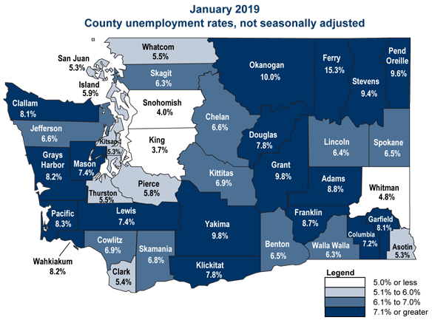
Unemployment around the state
Source: Employment Security Department/LMPA; U.S. Bureau of Labor Statistics, LAUS not seasonally adjusted.
Notes:
In January 2019, there were 3 counties (King, Snohomish, Whitman) with a UI rate below 5% (not seasonally adjusted), and 36 counties with UI rate above 5%.
King county had the lowest rate (3.7%)
Ferry county had the highest rate (15.3%)

Slide 10
Employment rates
Employment rates have been increasing slowly since 2014
Source: Employment Security Department/LMPA; U.S. Bureau of Labor Statistics, Local Area Unemployment Statistics – Seasonally Adjusted. U.S. recessions are shaded in gray.
Notes:
Employment rate = Employment as a percent of the civilian non-institutional population
Employment rates for both WA and the U.S. dropped sharply during the recession and remained flat from 2010 until 2014. Since 2014 we have seen the employment rate slowly increasing
61.0% of Civilian population employed in WA as of Jan 2019, 60.7% for the U.S.

Slide 11
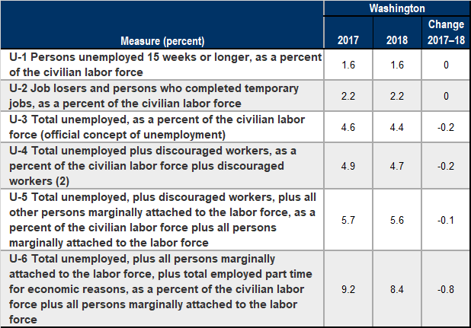
Beyond the unemployment rate Alternative measures of labor underutilization
Source: Employment Security Department/LMPA; U.S. Bureau of Labor Statistics, Alternative measures of labor underutilization by state, 2017 and 2018 annual averages.
Notes:
Six alternative measures of labor underutilization –
Definitions for the economic characteristics underlying the three broader measures of labor underutilization are worth mentioning here. Discouraged workers (U-4, U-5, and U-6 measures) are persons who are not in the labor force, want and are available for work, and had looked for a job sometime in the prior 12 months. They are not counted as unemployed because they had not searched for work in the prior 4 weeks, for the specific reason that they believed no jobs were available for them. The marginally attached (U-5 and U-6 measures) are a group that includes discouraged workers. The criteria for the marginally attached are the same as for discouraged workers, with the exception that any reason could have been cited for the lack of job search in the prior 4 weeks. Persons employed part time for economic reasons (U-6 measure) are those working less than 35 hours per week who want to work full time, are available to do so, and gave an economic reason (their hours had been cut back or they were unable to find a full-time job) for working part time. These individuals are sometimes referred to as involuntary part-time workers.
Generally, all six measures of labor underutilization move together over time, including across business cycles. Similarly, states that have low unemployment rates tend to have low values for the other five measures; the reverse is true for states with high unemployment rates.
U-3 is the official unemployment rate

Slide 12
Washington’s Unemployment Insurance Trust fund
As of February 28, 2019, the Washington state Unemployment Insurance (UI) trust fund ending balance was $4.56 billion.
Unemployment benefit payments for the 12 months ending September 2018 totaled $947 million.
Revenues generated to fund for the 12 months ending September 2018 totaled $1.1 billion.
Based upon current economic conditions, it is projected that the UI trust balance will remain solvent, with the months of benefits available in the fund projected to be between 15.7 and 16.4 months of benefits.

Slide 13
Unemployed Beneficiaries
Unemployment recipients down to historical low
Source: Employment Security Department/LMPA; Unemployment Insurance Data Warehouse
Notes:
Source: Monthly
Benefits Reports “Benefit Entitlements by County” table, UI Data Warehouse
Peak – 314,473 (Jan-2010)
Latest - 73,688 (Feb-2019)

Slide 14
Unemployment benefit payments
Projected
Source: Employment Security Department/WITS, November 2018 UI Trust Fund Forecast
Notes:
Unemployment benefit payments for the 12 months ending Sept 2018 totaled $947 million.
Benefit payments for 2019 are projected to be slightly lower than payments in 2018.

Slide 15
Average duration of benefits
Source: Employment Security Department/WITS; U.S. Department of Labor, ETA 5159
Notes:
Average duration of benefits is currently at 15.8 weeks (Jan 2019)
During the great recession the average duration of benefits had reached 42.0 weeks for all benefit entitlements
Currently, only regular benefit entitlements are available.

Slide 16
Unemployment taxes
Projected
Source: Employment Security Department/WITS, November 2018 UI Trust Fund Forecast
Notes:
Revenues generated to fund for the 12 months ending September 2018 totaled $1.1 billion
Experience tax collections for 2018 are anticipated to be $870.3 million versus an estimated $163.2 million in Social tax collections.
Experience-rated taxes are directly linked to employer benefit charges
Social taxes are based upon the aggregate level differences between benefit paid and taxes collected and the balance in the UI trust fund.
(i.e. First a “flat social tax” is determined by subtracting total taxes paid by employers for the four consecutive quarters preceding the computation date from total unemployment benefits paid to claimants over those same quarters. This amount is then divided by total taxable payrolls and expressed as a percentage. The flat social tax is then adjusted if the trust fund balance is above a certain level or if the rate is less than the minimum set in law :
Months of benefits available in Trust fund versus flat social tax rate.
<=10 months min. rate = .50%
<11 months min. rate = .45%
<12 months min. rate = .40%
<13 months min. rate = .35%
<15 months min. rate = .25%
<17 months min. rate = .15%
>18 months min. rate = 0%

Slide 17
Unemployment trust fund balance & months of benefits
Projected
Source: Employment Security Department/WITS, November 2018 UI Trust Fund Forecast
Notes:
The simplest solvency measure called the Reserve Ratio is derived by taking the trust fund balance and dividing by the state’s total wages
paid for the year . This measure can be compared against the level of benefits paid in the year divided by the same yearly wages- this ratio is referred to as the Benefit Cost Rate.
A common comparison is to take the highest Benefit Cost Rate in the state’s history and compare it to the Reserve Ratio, or to take the average of the three highest Benefit Cost Rates in the last twenty years and compare that to the Reserve Ratio (this is called the Average High Cost Multiple).
The Months of benefits calculation is the Average High Cost Multiple annualized to months (AHCR * 12)

Slide 18
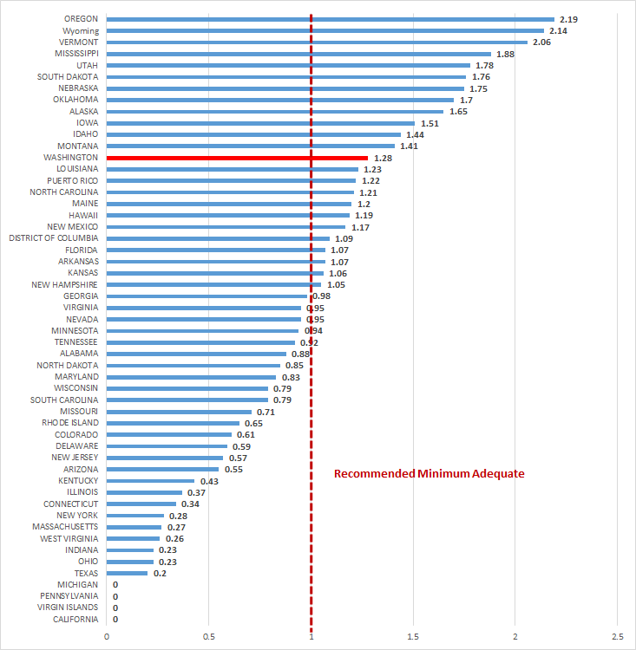
Summary of State Trust Fund Status Average High Cost Multiple as of 9/30/2018
Notes:
Source: U.S. Department of Labor – 2018 State Unemployment Insurance Trust fund Solvency Report (https://oui.doleta.gov/unemploy/solvency.asp)
AHCM (Average High cost Multiple) is the Calendar Year Reserve Ratio (or “TF balance as a % of Total Wages for the calendar year”); divided
by the Average High Cost Rate. Average High cost rate is the average of the three highest calendar year benefit cost rates in the last 20 years (or a period including three
recessions, if longer).
Recommended Minimum Solvency Level - Advisory Council on Unemployment Insurance (1996) recommendation 95-2.
WA has a AHCM of 1.28 as of 9/30/2018, which ranks 13th in the nation.

Slide 19
UI trust fund solvency
Great Recession posed most serious challenge to UI financing in the system’s history
36 states borrowed from the U.S. Treasury during the Great Recession to pay UI benefits from 2009 through 2013, totaling $93 billion
Employers in states with federal loans were faced with risk of increased federal FUTA taxes
A large amount of states have not rebuild their trust funds from the last recessions and are unprepared for a recession

Slide 20
Continue the Conversation
Labor Market Information Director Steven Ross
Steven.ross@ESD.WA.GOV

