Slide 1
Paid Family and Medical Leave
Carla Reyes, Program Director
May 13, 2019
Molly Moon’s Homemade Ice Cream
Notes:
I’m Carla Reyes and I serve as the Director of the Paid Family and Medical Leave Division. Thank you for the opportunity to present about the progress of our Paid Family and Medical Leave program.
Throughout my presentation today you will see the faces of Washington employers and their employees from different industries and communities across Washington. They have joined us to help tell the story about the importance of this program. Here you can see an employee at Molly Moon’s Homemade Ice Cream in Seattle.
Other businesses include:
HD Fowler—facilities statewide; LSW Architects—Vancouver; Grocery Outlet (Spanish and English)—primarily in Vancouver but with franchises statewide; Sound Native Plants—South Puget Sound; Well 80 Brewing—Olympia
Lava Java coffeeshop--Ridgefield

Slide 2
Agenda
Mission
Provide an easily accessible benefit that helps employees and employers maintain economic stability and peace of mind in challenging times.
Vision
Washingtonians are able to take the time to care for themselves and the people they love.
Timeline
Beta
Voluntary Plans
Partnership opportunity
Questions and discussion
Notes:
Today, my goal is to provide you with information about:
Our journey to make Paid Family and Medical Leave available in Washington state;
Give you an update on where our program is today
Lastly—perhaps most importantly, to enlist your partnership in making this program and its benefits available to the people in Washington state.
In support of Employment Security Department’s Vision and Mission, in the Paid Family and Medical Leave division we strive to provide an easily accessible benefit that helps employees and employers maintain economic stability and peace of mind in challenging times SO THAT Washingtonians are able to take the time to care for themselves and the people they love.
The spirit behind Paid Family and Medical Leave is one of understanding that at some time we all need to give or receive care.

Slide 3
Paid Family and Medical Leave timeline
2015
Governor Inslee receives a federal grant to begin designing a Paid Family and Medical Leave program for Washington
2007
First Paid Family Leave bill passes the Legislature but does not include a funding mechanism
2017
Council Member González released proposed policy model for Paid Family and Medical Leave
Paid Family and Medical Leave bill passes the Legislature with funding
2018
Rapid program implementation; voluntary plan applications become available in September
2019
Premiums begin on January 1
2020
Employees can begin filing for benefits
2019
July first reporting for employers.
Beta 1 & 2
Notes:
Employers began collecting premiums 1/1/19 & most will begin submitting premiums 7/1/19. I’m excited to say that in about a year we built and beta launched our platform last week. Up next: we are building the systems and processes to begin offering benefits in January 2020.
Resources + creativity = success: We’re rising to the challenge of developing this program by being thoughtful, nimble and customer-centric. We integrate customer input into the program build often, and though we are working on very tight timelines the Paid Family and Medical Leave team has the support, resources and creativity necessary to make what can seem impossible, possible. Just as we learned from the states that came before us, other states looking to implement Paid Family and Medical Leave have been in contact with my team to learn our best practices.

Slide 4
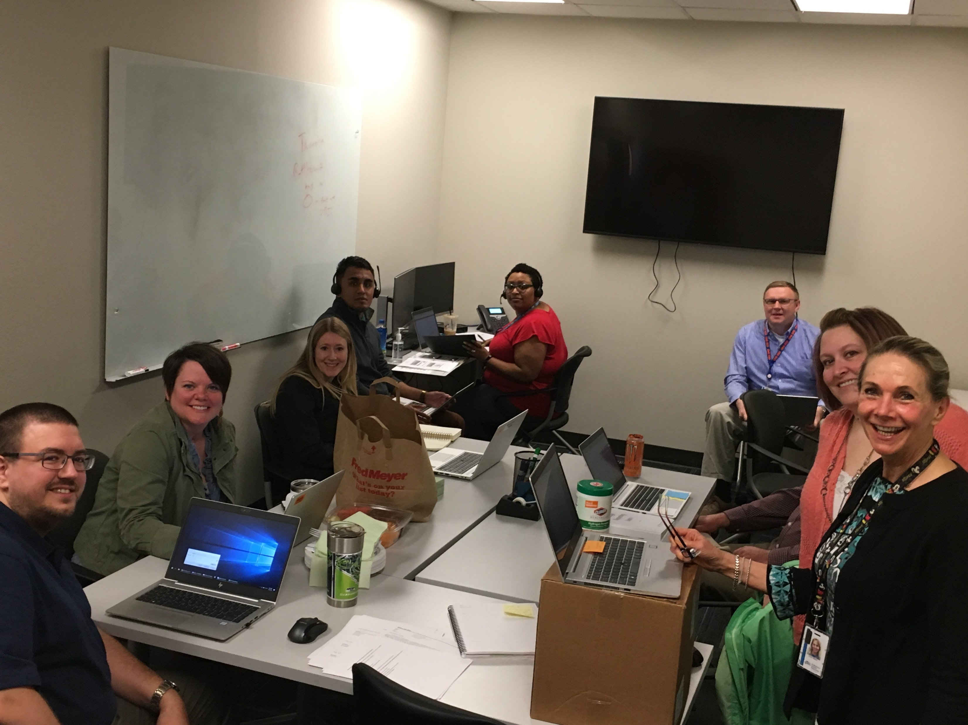
Beta
Beta 1: April 30 – May 21, 2019
Large employers that conduct their own reporting and payments.
Beta 2: June 1 – June 21, 2019
Large payroll and accounting companies that conduct reporting and payment on behalf of other employers
A select number of small businesses
A select number of employers that have active voluntary plans will submit wage reports
All-employer launch: July 1- July 31, 2019
Day one beta team
Notes:
Washington’s new Paid Family and Medical Leave program launched a beta version of its technology platform in April 2019 and will go live to the general public July 1, 2019. This approach will extend the timeline for reporting and premium payments for most employers while keeping the program on track to pay back the startup loan as required by June 30, 2019. The project will also continue its trajectory to begin processing benefit claims in Jan. 2020.
Launching with a “beta” is a technology industry best practice that utilizes a phase-in approach to launching a new technology system.
Identify employers interested in participating in a beta in early March 2019: The department has been connecting with employers and employer agents that participated in previous usability tests, have opted into our mailing lists, have requested presentations, or have otherwise indicated interest in providing feedback and guidance to the department on implementation.

Slide 5
Beta dashboard

Slide 6
Voluntary Plans As of 17 April 2019
329 voluntary plan applications received
40 medical
21 family
268 both
278 application payments received
269 applications fully processed
220 approved
28 denied
21 withdrawn

Slide 7
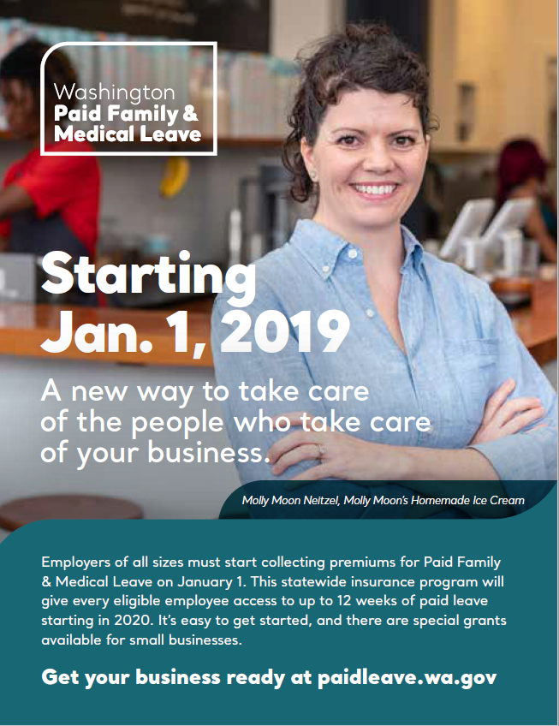
Communications
Paid ads
Outreach
Direct communication
Shareable tools
Over 88% of employers are familiar with Paid Family and Medical Leave
Notes:
Raising awareness to encourage use:
We’ve learned from other states that low awareness or confusing messages about their programs has led to low usage rates, particularly among communities most likely to benefit from the program.^{[3]}.
Washington’s Paid Family and Medical Leave statute established an expectation to implement an outreach program to ensure both employers and employees know their rights and responsibilities under the law.
We have taken these lessons to heart and are investing in outreach and communications that are research-based and timely. We have conducted surveys of employers and employees, are holding focus groups within key communities and deploying a variety of communications tactics using messages that have been tested with customers.
Our goal is to reach the broadest audience, with targeted messages that encourage them to capture the program’s full benefit – whether they are an employer or an employee.
^{[3]} A guide to implementing paid family leave: lessons from California

Slide 8
What a partnership looks like
Program ambassadors:
Receive training to give presentations
Have access to sharable content and updated information
Help our customers
Notes:
As we embark on communication and outreach to make sure people know about and benefit from the program, we are looking to partner in many communities and many ways.
We have done many focus groups, community and association presentations. These are fine for outreaching to our employer communities but we know we will need to engage with other partners in communities to reach the people most likely to benefit from the program.
We are interested in establishing something like an ambassador program. This would consist of providing training and materials that could be used to help share information and connect those we are mutually serving to this important resource.

Slide 9
Partnership
We need your partnership to:
Connect us with your networks
Messengers in the community
Convene a meeting with key stakeholder groups
Small business
Human services groups
Medical providers and community health networks
Notes:
Here is where we could really use your help.
You are leaders in the community. We could learn from you and benefit from your ideas, information and suggestions.
We identified a few ideas here about opportunities for us to partner to help take this program from a dream to a reality to help the people and businesses we both represent and serve—what other thoughts or ideas do you have?

Slide 10
Questions?
paidleave.wa.gov
paidleave@esd.wa.gov
833-717-2273
@PaidLeaveWA
Notes:
In closing, I want to thank you again for allowing me the opportunity to discuss this important program and to explore a bit how we might partner to successfully implement it for the people of Seattle and Washington state.
I am happy to answer any questions you may have.
Please keep in touch—there are many ways to reach us!
Our website has many resources—and I hear often that our customers find it informative and useful.
Our customer care team is standing by to assist as well—and they can be reached by email at paidleave@esd.wa.gov or by phone at

