Slide 1
Washington’s labor market
& Unemployment Insurance Trust fund
October 24, 2018
Employment Services Advisory Committee

Slide 2
Washington’s Labor market
Washington has gained over 580,000 jobs since the end of the recession.
Retail trade and health services have created the most jobs since the recovery.
Divergent unemployment trends across the state.
Unemployment rate tracking with U.S.
Washington’s workforce continues to age.
Notes:
150,400 jobs lost during recession (Dec07-June09): – Have regained all the jobs lost during recession plus 430,000 more through August 2018
Over the year (Aug18/Aug17) nonfarm employment is up 105,900
Retail has added 90,300 jobs since the recovery began (July 2009)
Health services has added 65,400 jobs since the recovery began
The King County metro region has less unemployment than all other areas of the state
Workforce in Washington state continues to age

Slide 3
Nonfarm employment in Washington
Source: Employment Security Department/WITS, U.S. Bureau of Labor Statistics, Current Employment Statistics, Seasonally Adjusted
Notes:
Our primary measure of state economic conditions is the number of jobs across the state in businesses and government.
On a monthly basis, business establishments and governments are surveyed to generate these estimates.
On several charts you will see the words seasonally adjusted. This is done to account for events that regularly occur that influence employment, such as holidays, schools in session and weather.
Several key points to be gathered from the chart.
The jobs recession started later in Washington relative to rest of nation.
Peak Employment – 3,008,000 (March 2008)
The number of jobs lost was 185,1000 (Peak to trough Mar08 – Feb10), through August 2018 was up 580,000
Number of nonfarm jobs stands at 3,436,900 as of August 2018
Source: Seasonally adjusted CES

Slide 4
Current Employment Statistics Year over year employment change by industry
Source: Employment Security Department/WITS, U.S. Bureau of Labor Statistics, Current Employment Statistics, Seasonally Adjusted
Notes:
The CES nonfarm employment information is released every month.
Over the year Construction has created the most jobs (+14,900 y/y) followed by Professional , Scientific and Technical services

Slide 5
Unemployment rates
Source: Employment Security Department/LMPA; U.S. Bureau of Labor Statistics, Local Area Unemployment Statistics, Current Population Survey. U.S. recessions are shaded in gray.
Notes:
The data in this chart compare the unemployment rates for the U.S., the state of Washington and the Seattle-Bellevue-Everett MSA
The unemployment rate more than doubled during the recession, and peaked near 10%.
Since then the unemployment rate for the state has tracked that with the U.S.
The decline has not been uniform across the state.
The Seattle-Bellevue-Everett MSA unemployment rates dropped more quickly than overall state total.
State Unemployment Rate (Sept18) = 4.4%
Seattle MSA (Sep18) = 3.4%
U.S. (Sep18) = 3.7%

Slide 6
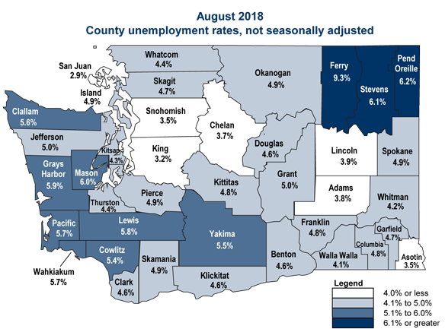
Unemployment around the state
Source: Employment Security Department/LMPA; U.S. Bureau of Labor Statistics, LAUS.
Notes:
In August 2018, there were 3 counties (Pend Oreille, Ferry, Stevens) with UI rate at or above 6% (not seasonally adjusted), and 36 counties with UI rate at or below 6%.
Lowest unemployment rate was in King (3.2%) and Snohomish county (3.5%)

Slide 7
Employment rates
Employment rates have been flat since 2013
Source: Employment Security Department/LMPA; U.S. Bureau of Labor Statistics, Local Area Unemployment Statistics – Seasonally Adjusted. U.S. recessions are shaded in gray.
Notes:
Employment rate = Employment as a percent of the civilian non-institutional population
63.3% of Civilian population employed as of August 2018

Slide 8
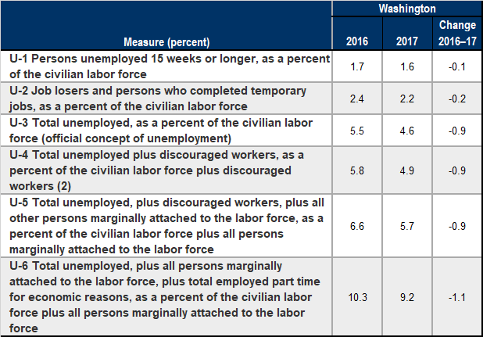
Beyond the unemployment rate Alternative measures of labor underutilization
Source: Employment Security Department/LMPA; U.S. Bureau of Labor Statistics, Alternative measures of labor underutilization by state, 2016 and 2017 annual averages.
Notes:
Six alternative mea
Definitions for the economic characteristics underlying the three broader measures of labor underutilization are worth mentioning here. Discouraged workers (U-4, U-5, and U-6 measures) are persons who are not in the labor force, want and are available for work, and had looked for a job sometime in the prior 12 months. They are not counted as unemployed because they had not searched for work in the prior 4 weeks, for the specific reason that they believed no jobs were available for them. The marginally attached (U-5 and U-6 measures) are a group that includes discouraged workers. The criteria for the marginally attached are the same as for discouraged workers, with the exception that any reason could have been cited for the lack of job search in the prior 4 weeks. Persons employed part time for economic reasons (U-6 measure) are those working less than 35 hours per week who want to work full time, are available to do so, and gave an economic reason (their hours had been cut back or they were unable to find a full-time job) for working part time. These individuals are sometimes referred to as involuntary part-time workers of labor underutilization have long been available on a monthly basis from the Current Population Survey
Generally, all six measures of labor underutilization move together over time, including across business cycles. Similarly, states that have low unemployment rates tend to have low values for the other five measures; the reverse is true for states with high unemployment rates.

Slide 9
Washington’s workforce is aging
Source: Employment Security Department/LMPA; U.S. Census Bureau, LEHD.
Notes:
Graph shows percent of the workforce by age cohort over the last 17 year.
Those over 55+ years of age makeup 22.3% of the workforce in 2017, compared to 11.5% in 2000
2017
14-24: 369,040 -11.6%
25-34: 736,911 -23.1%
35-44: 714,128 –22.4%
45-54: 660,782 – 20.7%
55-64: 528,401 –16.6%
65+: 182,693- 5.7%

Slide 10
Washington’s Unemployment Insurance Trust fund
As of September 30, 2018, the Washington state Unemployment Insurance (UI) trust fund ending balance was $4.59 billion.
Unemployment benefit payments for the 12 months ending June 2018 totaled $1.02 billion.
Revenues generated to fund for the 12 months ending June 2018 totaled $1.1 billion.
Based upon current economic conditions, it is projected that the UI trust balance will remain solvent, with the months of benefits available in the fund projected to be between 15.7 and 16.3 months of benefits.

Slide 11
Unemployed Beneficiaries
Unemployment recipients down to historical low
Source: Employment Security Department/LMPA; Unemployment Insurance Data Warehouse
Notes:
Source: Monthly
Benefits Reports “Benefit Entitlements by County” table, UI Data Warehouse
Peak – 314,473 (Jan 2010)
Latest - 40,331 (September 2010)

Slide 12
Unemployment benefit payments
Projected
Source: Employment Security Department/WITS, June 2018 UI Trust Fund Forecast
Notes:
Unemployment benefit payments for the 12 months ending June 2018 totaled $1.02 billion.
Benefit payments for 2019 are projected to be slightly lower than payments in 2018.

Slide 13
Average duration of benefits
Source: Employment Security Department/WITS; U.S. Department of Labor, ETA 5159
Notes:
Average duration of benefits is currently at 15.3 weeks (September 2018)
During the great recession the average duration of benefits had reached 42.0 weeks for all benefit entitlements
Currently, only regular benefit entitlements are available.

Slide 14
Unemployment taxes
Projected
Source: Employment Security Department/WITS, June 2018 UI Trust Fund Forecast
Notes:
Revenues generated to UI trust fund for the 12 months ending June 2018 totaled $1.1 billion.
Experience tax collections for 2018 are anticipated to be $870.3 million versus an estimated $163.2 million in Social tax collections.
Experience-rated taxes are directly linked to employer benefit charges
Social taxes are based upon the aggregate level differences between benefit paid and taxes collected and the balance in the UI trust fund.

Slide 15
Unemployment trust fund balance & months of benefits
Projected
Source: Employment Security Department/WITS, June 2018 UI Trust Fund Forecast
Notes:
The simplest solvency measure called the Reserve Ratio is derived by taking the trust fund balance and dividing by the state’s total wages
paid for the year . This measure can be compared against the level of benefits paid in the year divided by the same yearly wages- this ratio is referred to as the Benefit Cost Rate.
A common comparison is to take the highest Benefit Cost Rate in the state’s history and compare it to the Reserve Ratio, or to take the average of the three highest Benefit Cost Rates in the last twenty years and compare that to the Reserve Ratio (this is called the Average High Cost Multiple).
The Months of benefits calculation is the Average High Cost Multiple annualized to months (AHCR * 12)

Slide 16
Summary of State Trust Fund Status Average High Cost Multiple as of 1/1/2018
Notes:
Source: U.S. Department of Labor – 2018 State Unemployment Insurance Trust fund Solvency Report (https://oui.doleta.gov/unemploy/solvency.asp)
Recommended Minimum Solvency Level - Advisory Council on Unemployment Insurance (1996) recommendation 95-2.
WA has a AHCM of 1.25 as of 1/1/2018, which ranks 13th in the nation.
A common comparison is to take the highest Benefit Cost Rate in the state’s history and compare it to the Reserve Ratio (trust fund balance and dividing by the state’s total wages), or to take the average of the three highest Benefit Cost Rates in the last twenty years and compare that to the Reserve Ratio (this is called the Average High Cost Multiple).

Slide 17
UI trust fund solvency
Great Recession posed most serious challenge to UI financing in the system’s history
36 states borrowed from the U.S. Treasury during the Great Recession to pay UI benefits from 2009 through 2013, totaling $93 billion
Employers in states with federal loans were faced with risk of increased federal FUTA taxes
Majority of states have not rebuild their trust funds from the last recessions and are unprepared for a recession

Slide 18
Continue the Conversation
Workforce Information Operations Manager: Steven Ross
SRoss@ESD.WA.GOV

