Slide 2
Why Paid Family and Medical Leave
An essential benefit that gives every Washingtonian support when they need it most.
Strengthens companies of every size by making it possible to give every employee a way to be there for care.
Share the costs associated with leave among employers and workers.

Slide 3
Paid Family and Medical Leave
Family Leave
Medical Leave
Caring for family members
Birth or placement of a child
Certain military-related events
Your own medical condition
Be there for care.

Slide 4
Benefits
Weekly wage replacement Proportion of weekly wages from $100 to $1,000
Typical leave of up to 12 weeks, 18 weeks in exceptional circumstances.

Slide 5
Agile: Implementing in Phases
MILESTONE 3: Benefits
Jan. 1, 2020
Benefits claims may begin to be filed
MILESTONE 2: Premiums
Jan. 1, 2019
Premiums begin to be assessed – opt-in available
MILESTONE 1: Voluntary Plans
April 30, 2019
Q1 premium submission
July 2019
Phase 4 rules in effect:
Continuation of benefits
Fraud
Late 2019
Phase 6 rules in effect:
Appeals
November 2018
Phase 2 rules in effect:
Employer responsibilities
Small business assistance
Penalties
April 2019
Phase 3 rules in effect:
Benefit applications
Benefit eligibility
Late 2019
Phase 5 rules in effect:
Job protection
Benefit overpayments
Miscellaneous
This timeline is an approximate timeframe for the implementation of the Paid Family and Medical Leave.
5
Notes:
The PFML project will establish a new division with ESD that will manage the program. This will include infrastructure and IP procurement on a massive level. It will also require policy development, a customer support plan, and a foundation for constant statewide outreach to employers and employees.
Establish a new operating division
HR, Communications, Policy
Open a new operating facility and/or workspace strategy
Develop formal rules, policies, and standard work
Build out all necessary supporting technology for program administration
Develop and implement a customer support plan including staffing
Conduct outreach statewide to employers and employees

Slide 6
Participating
Phase 2 | Phase 3 | Phase 4
Formal Rules Hearing | Stakeholder Meeting | Stakeholder Meeting
Oct. 24, 2018 | Nov. 2, 2018 | Nov. 27, 2018
Oct. 29, 2018 |  | Jan 16, 2019
 | Rules Hearing
 | Mar. 13, 2019 | Formal Rules Hearing
 | Mar. 18, 2019 | May 22, 2019
 |  | May 29, 2019

Slide 7
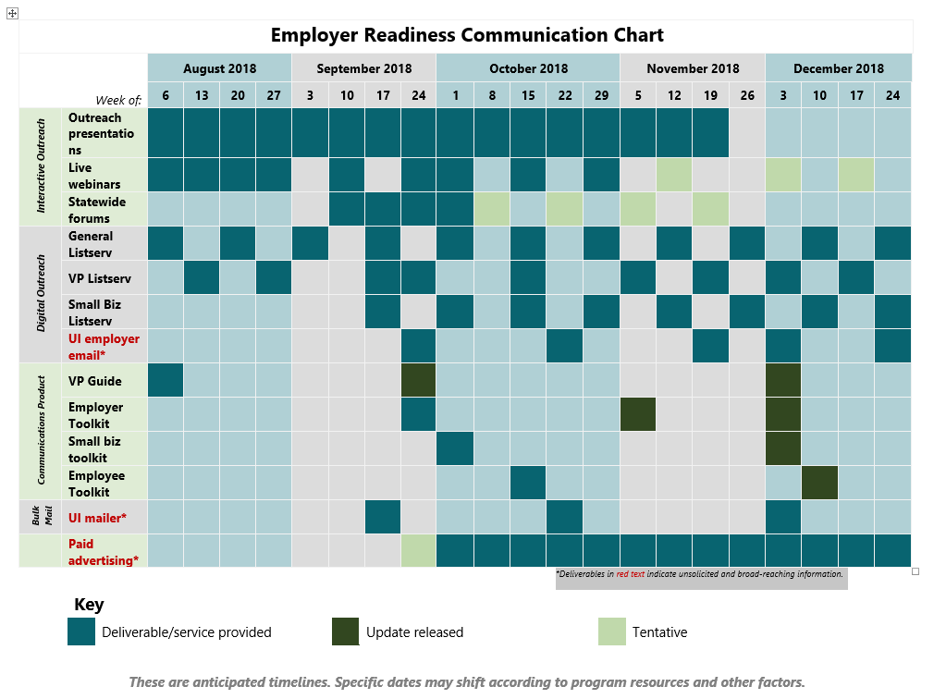
Employer Readiness Communication
Mailer to 180k employers in WA
State agency assistance
Advertise to their networks
Paid media
Print and social media ads
Earned media
Contributed content from employers
Do you know an employer who wants to share their story?

Slide 8
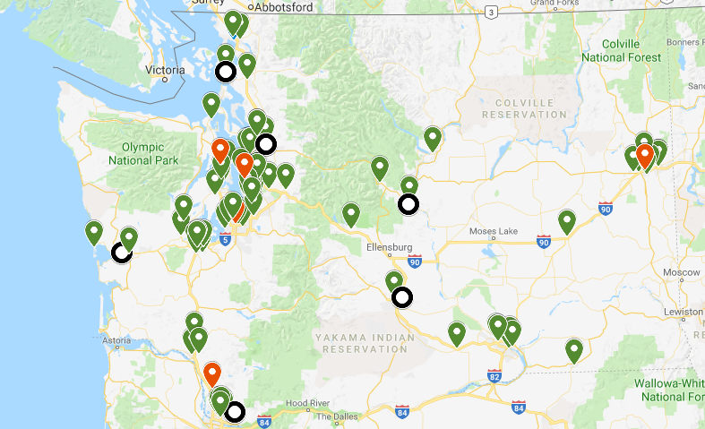
Outreach
Chambers of Commerce
Society for Human Resource Management
Employer Associations
Do you know a group we should be presenting to?
KEY
– In-person presentation
– Forum
– Webinar

Slide 9
Paid Family and Medical Leave:
Customer Care Center Implementation Timeline
July 2, 2018
October 1, 2018
Temporary Customer Care Center Operational
Customer Care Center Operational
January 1
April 1
Premium Assessment Begins
June 18, 2018
August 31, 2018
October 15, 2018
Customer Care Center Staff Onboarding
(First Group)
Staff Ready for Milestone One: Voluntary Plans “Go Live”
Staff Onboarding for Milestone Two: Premium Assessment
June 18 – July 27, 2018
Customer Care Center Staff Training & Development
(First Group)
This timeline is an approximate timeframe for the implementation of the Paid Family and Medical Leave Customer Care Center. Dates subject to change.

Slide 10
Continue the Conversation
Email us:
paidleave@esd.wa.gov
Call us:
833-717-2273
Our Website:
paidleave.wa.gov
Follow us:
@PaidLeaveWA
Sign up for Newsletter:
bit.ly/PaidLeaveList
Public Comment Forum:
bit.ly/CommentForum

