Slide 1
Washington’s State Labor Market &
Unemployment Trust Fund Update
October 26, 2020
Employment Services Advisory Committee

Slide 2
Overview
State of the Labor Market
Unemployment Insurance (UI) Trust Fund Update

Slide 3
Washington’s Labor Market
From February 2020 through April 2020 559,000 nonfarm jobs were lost.
332,500 jobs were gained between April 2020 and September 2020
The accommodation and food services sector has lost the most jobs over the year (-66,700 jobs).
Divergent unemployment trends across the state.
Washington Unemployment rate tracking lower than the U.S.
Notes:
Now a look at different segments of WA labor market since the pandemic :
556,900 jobs were lost between February 2020 and April 2020.
332,500 jobs were regained between April2020 and September 2020
Accommodation and food services (down 66,700 jobs Y/Y)
WA unemployment rate – Sep 2020 (7.8% -SA)
US unemployment rate – Sep 2020 (7.9% - SA)

Slide 4
Nonfarm employment in Washington
Source: Employment Security Department/WITS, U.S. Bureau of Labor Statistics, Current Employment Statistics, Seasonally Adjusted
Notes:
One of the primary measure of state economic conditions is the number of jobs across the state.
On a monthly basis, business establishments and governments are surveyed to generate these estimates.
Key points to be gathered from the chart.
556,000 jobs were lost between February 2020 and April 2020.
332,500 jobs were gained between April2020 and September 2020
Number of nonfarm jobs stands at 3,260,700 as of Sept 2020
Source: Seasonally adjusted CES

Slide 5
Employment rates
Employment rates for both the nation and Washington dropped below 60 percent
Source: Employment Security Department/LMPA; U.S. Bureau of Labor Statistics, Local Area Unemployment Statistics – Seasonally Adjusted. U.S. recessions are shaded in gray.
Notes:
Employment rate = Employment as a percent of the civilian non-institutional population – How much of the population is employed?
Since 2014 we have seen the employment rate slowly increasing until February 2020. Between February and April 2020 the employment rate for WA dropped from 62.8% to 54.5%. As of September 2020 the employment to population ratio has rebounded for WA is at 58.8% compared to 56.6% for the nation.

Slide 6
Current Employment Statistics
Year over year employment change by industry
Source: Employment Security Department/WITS, U.S. Bureau of Labor Statistics, Current Employment Statistics, Seasonally Adjusted
Notes:
Sept 2019 to Sept 2020 the state has lost 290,700 nonfarm jobs
The CES nonfarm employment information is released every month. Y/Y = Sep 2020 to Sep 2019
Accommodation and food services (down 66,700 jobs Y/Y) and Manufacturing (down 29,400 Y/Y) experienced the largest over the year decreases
Finance and Insurance, Retail trade and Professional, scientific and technical services were the only super sectors with an increase in employment year over year

Slide 7
Unemployment rates
Source: Employment Security Department/LMEA; U.S. Bureau of Labor Statistics; Local Area Unemployment Statistics
Notes:
The data in this chart compare the unemployment rates for the U.S., the state of Washington and the Seattle-Bellevue-Everett MSA
The unemployment rate more than doubled for the state from February2020 to April 2020 and have reverted back since April but still remain above unemployment rates during the prior recession, going from a high of 16.3% in April20 to 7.8% in September 2020.
State Unemployment Rate (Sep 2020) = 7.8%
Seattle MSA (Sep20) = 7.4%
U.S. (Sep20) = 7.9%

Slide 8
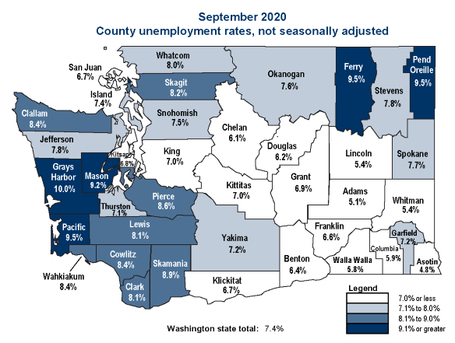
Unemployment around the state
Source: Employment Security Department/LMPA; U.S. Bureau of Labor Statistics, LAUS not seasonally adjusted.
Notes:
Divergent unemployment trends across the state. In September 2020, there were 5 counties in April with a UI rate above 9% (not seasonally adjusted) – 14 counties had unemployment rates below 7%.
Asotin county had the lowest unemployment rate (4.8%)
Grays Harbor had the highest unemployment rates (10.0%)

Slide 9
Unemployment Insurance Trust fund
As of October 21, the UI trust fund balance was at $2.13 billion
Notes:
ESD entered this crisis with roughly $4.7 billion in the trust fund, one of the strongest trust funds in the nation. As for 10/21/2020 the trust fund balance stands at $2.13 billion.

Slide 10
UI Trust Fund Forecast (September 2020)
The report provides the status and updated projections of the state’s unemployment insurance (UI) trust fund for 2020 through 2025.
The report is based upon the September 2020 economic forecast released by the state’s Economic and Revenue Forecast Council (ERFC).
The report uses quarterly forecast information and trust fund actuals through June 2020 (Q2 2020).
The final 2020 report will be released in November using ERFC forecast information and trust fund actuals through September 2020 (Q3 2020).

Slide 11
Trust Fund Projections

Slide 12
Experience Rate Tax
The experience rate tax is an annual calculation based on the ratio of benefit claims charged to the employer and “taxable wages” reported by the employer over the preceding four fiscal years.
Per state statute, the taxable wage base was $52,700 in 2020 and is $56,500 in 2021.
Experience tax rates for 2021 will be based upon the experience rating between July 2016 through June of 2020.
The UI trust fund balance has no impact on the experience rate tax.
 | June Forecast | September Forecast
Experience rate contributions 2020 | $826.7 | $909.7
Experience rate contributions 2021 | $1.081 | $1.096

Slide 13
Social Tax
The July 2019-June 2020 time period is used to calculate the 2021 calendar year flat social tax rate.
The “flat social tax” is an annual tax calculation subtracting total experience rated taxes paid by all employers over four consecutive quarters from total unemployment benefits paid to all claimants over those same quarters.
This amount is then divided by total taxable payrolls and expressed as a percent.
The flat social tax rate has a maximum tax cap of 1.22%. Tax would be 1.58% in 2021 without the cap.
The tax is adjusted for each rate class.

Slide 14
Components of Annual Tax calculation – Social tax
Notes:
The tax is adjusted for each rate class.

Slide 15
Projected Trust Fund Balances
Approximately $1.2 billion (CY 2020); $316 million (CY 2021); $2 billion (CY 2022); $3.8 billion (CY 2023); $5.5 billion (CY 2024); and $6.8 billion (CY 2025)

Slide 16
UI Trust Fund: Federal Advance Request
Federal law requires the trust fund to be able to pay three months of projected benefit payments.
When a state projects it does not have enough funds to pay benefits for 3 months, the state’s governor (or the governor’s designee) submits a letter requesting that the U.S. Secretary of Labor advance funds to the state.
 | June Forecast | September Forecast
Timing for a Federal advance | Q4CY2020 | Q1CY2021
Amount needed for 3 months of benefits | $900 Million/3 months | $819 Million/3 months
Timing for drawing on that advance | Q1CY2021 | Never

Slide 17
UI Trust Fund: Federal Borrowing
Once the advance is approved by the U.S. Department of Labor, the funds serve as a line of credit and are placed into the state’s account to draw from as needed. Title XII advances are available to states only when the fund can no longer make any benefit payments.
Accordingly, it is currently projected that Washington will not need to borrow (take out loans) from the federal government.
 | June Forecast | September Forecast
Timing for when borrowing would be needed | Q1CY2021 | Never
Amount of borrowing needed | $97 million | $0

Slide 18
Continue the Conversation
Labor Market Information Director Steven Ross
Steven.ross@ESD.WA.GOV
Employment System Policy Director Dan Zeitlin
Dzeitlin@esd.wa.gov

