Slide 1
Unemployment Insurance
Access this PowerPoint presentation online at https://esd.wa.gov/uiwebinars

Slide 2
Topics we will cover
Reemployment Services that are available
How to file an unemployment insurance initial claim
For those that have worked for employers in Washington State
For those that have worked in Washington plus –
another state,
for the military, or
for the federal government
Our screens may change from time to time, but the concept will still apply. Read the questions carefully
Always check esd.wa.gov for the most up to date information

Slide 3
What you will need
Logged in and on the Internet, www.esd.wa.gov
Create a Secure Access Washington account
Access to your email
SSN, address, Date of birth
WA Drivers License or WA ID if you have one
Employer names, addresses, and dates of employment for past 18 months
For direct deposit – If you would like to receive benefits through direct deposit, you will need your bank routing and account numbers
If you are not a US citizen – Permanent Residence or Authorization to Work Permit

Slide 4
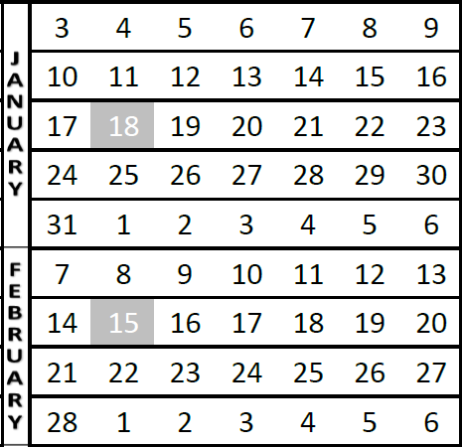
Lets talk about when your claim starts -
Don’t delay. Start your claim as soon as you are no longer working or when your hours are reduced.
The start date of your claim must always be a Sunday.
Example 1 - If your last day of work is late in the week (January 14-16), you can file your initial claim/application anytime during that following week. The claim start date will be that Sunday, January 17th.
Example 2 – If your last day of work is early in the week (January 24-27), you can file your initial claim/application anytime during that week and your claim start date will be Sunday, January 24th.
If you request to start your claim prior to the week you are in, we will need to decide to allow or deny that request based on your reasons for the delayed start.
Example 1
Example 2

Slide 5
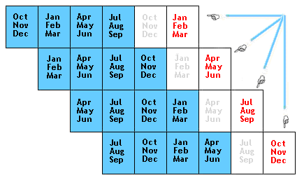
What is your “Base Year”?
Your earnings and hours worked during your base year will be used to determine if you are monetarily eligible for unemployment and how many dollars you would get each week.
Your base year is the 12-month period of time that is used to establish your unemployment claim.
It is the first four of the last five completed quarters.
If you start your claim in January-March 2021, then your base year will be October 2019 through September 2020.
For more information - https://esd.wa.gov/unemployment/calculate-your-benefit
Base year period is in blue
For claims started in months in red

Slide 6
What are the work search requirements -
It depends on the individual’s circumstances.
Making work search contacts is optional until after COVID or until legislative action is taken.
Normally it is a requirement to make at least 3 work search contacts each week.
Some things that could change that –
Standby
Full referral union membership
Approved for training
Receiving “Extended Benefits”
Check ESD’s website at www.esd.wa.gov for the latest information.
We encourage you using WorkSource for assistance

Slide 7
Reemployment Services
Being laid off can be painful
WorkSource is here to help
Thousands of jobs on WorkSourceWA.com
Veteran services
Retraining services

Slide 8
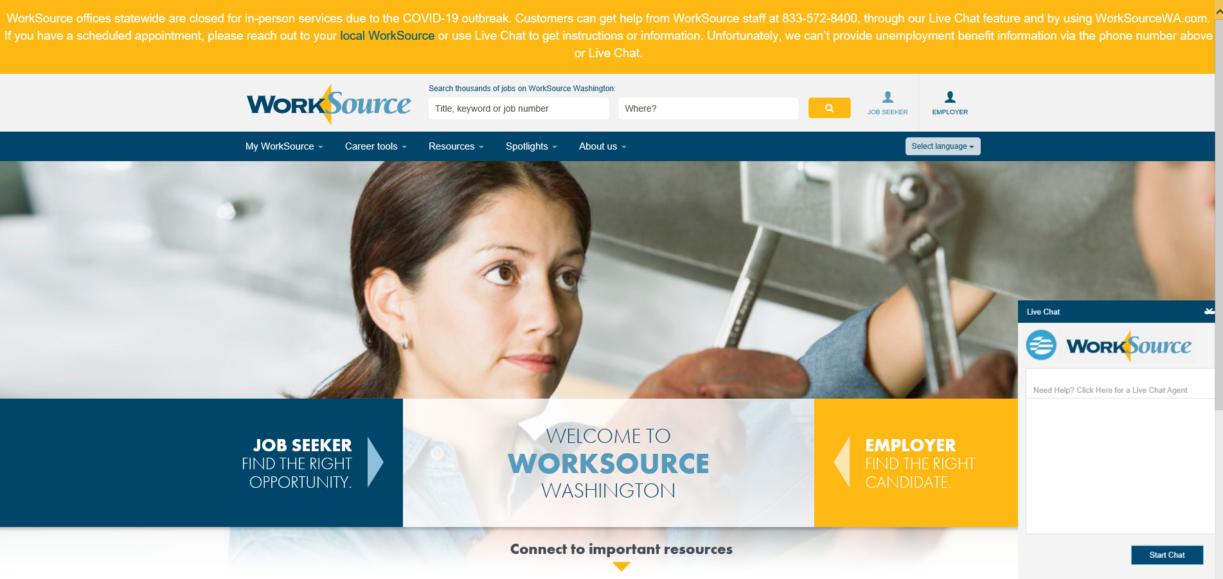
WorkSourceWA.com

Slide 9
Filing an Unemployment Insurance Claim

Slide 10
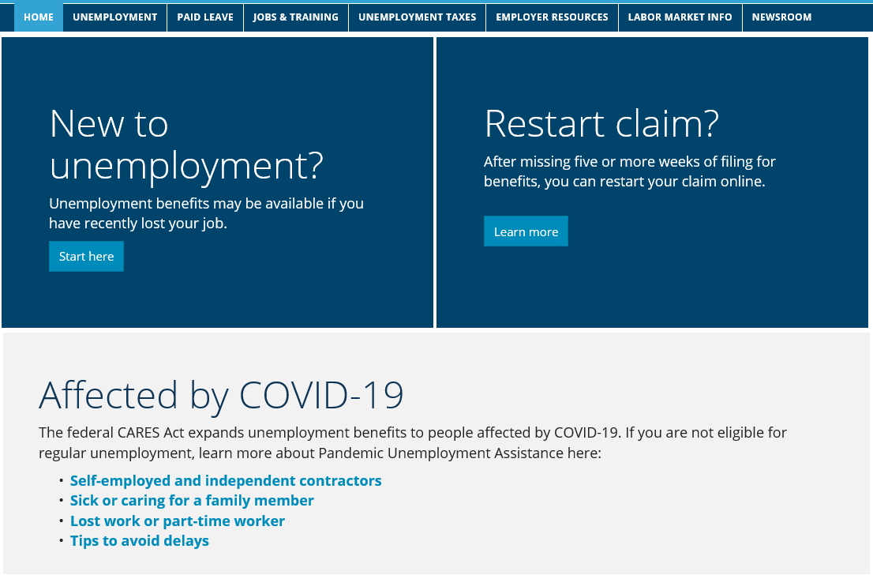
ESD.WA.GOV

Slide 11
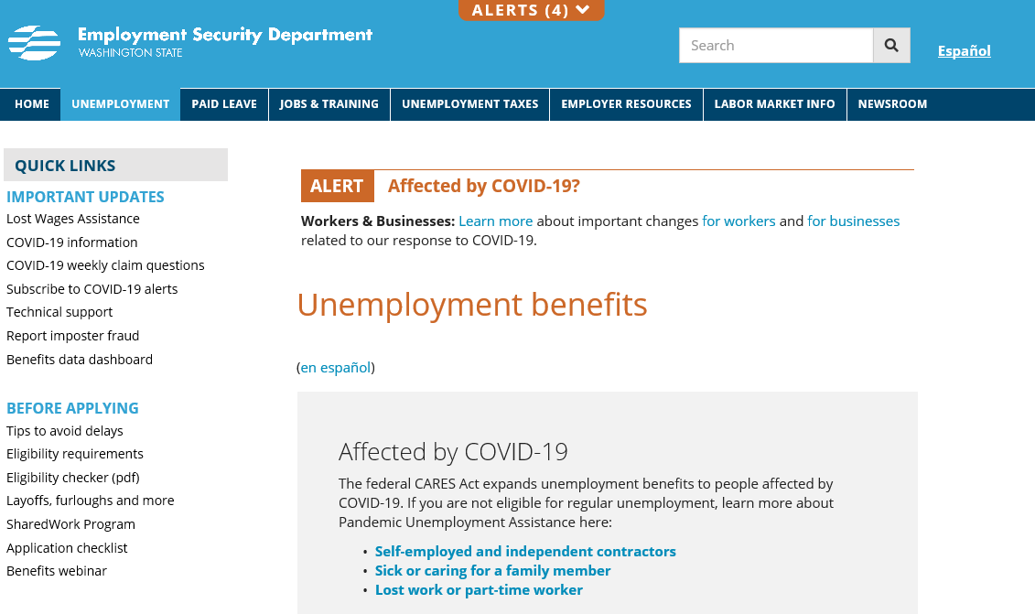
Scroll down on this page to find out how to apply. Click on the link “Apply online now” to get to the sign in page.

Slide 12
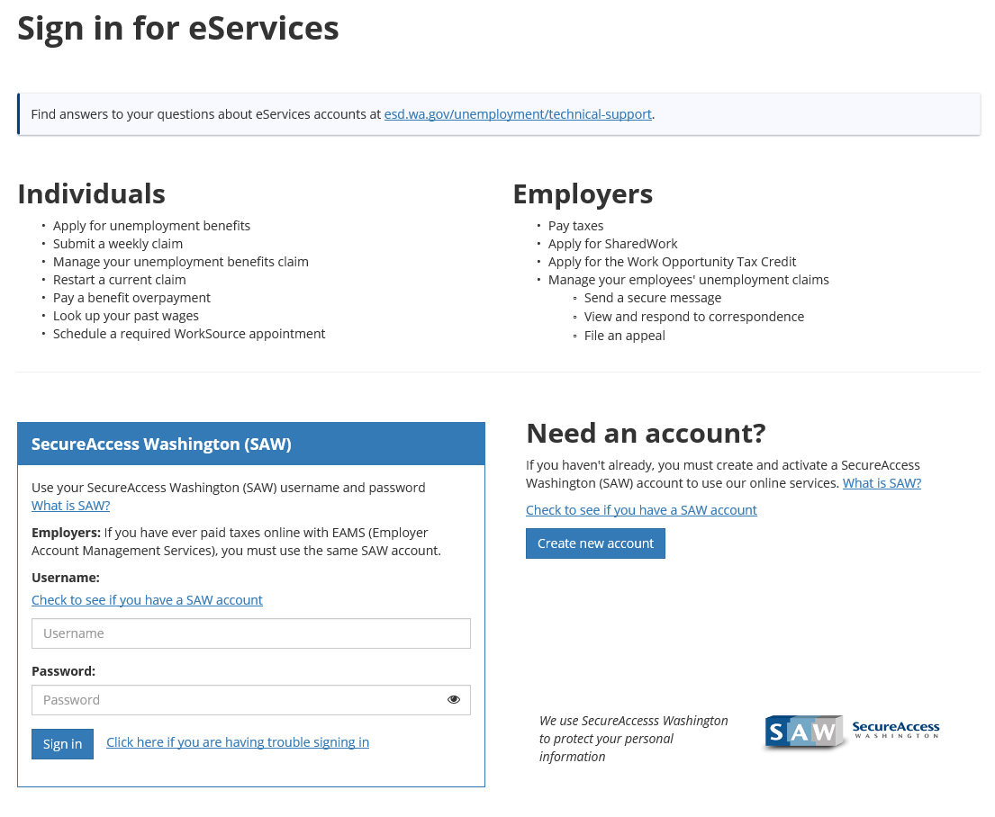

Slide 13
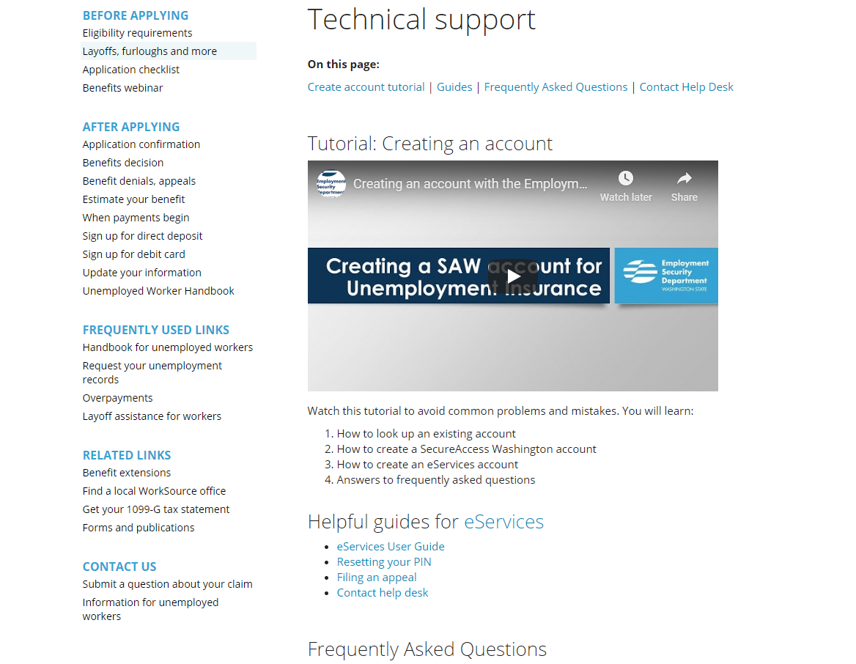

Slide 14
Type your Username and Password and click Sign in

Slide 15
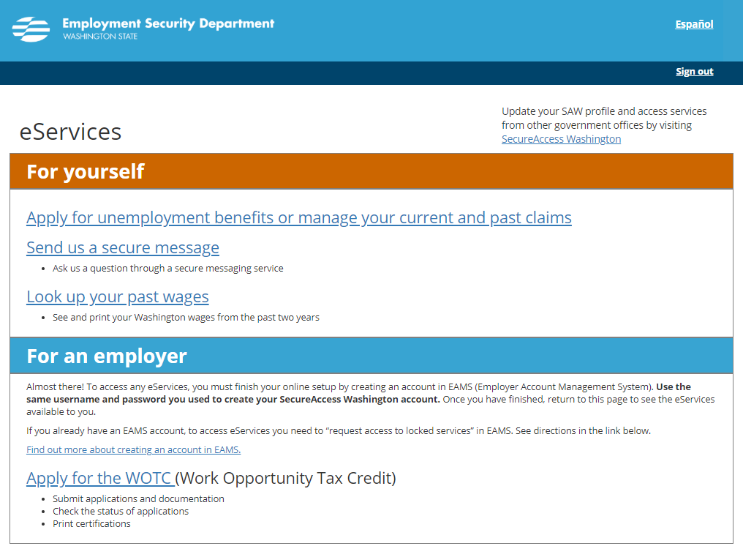

Slide 16
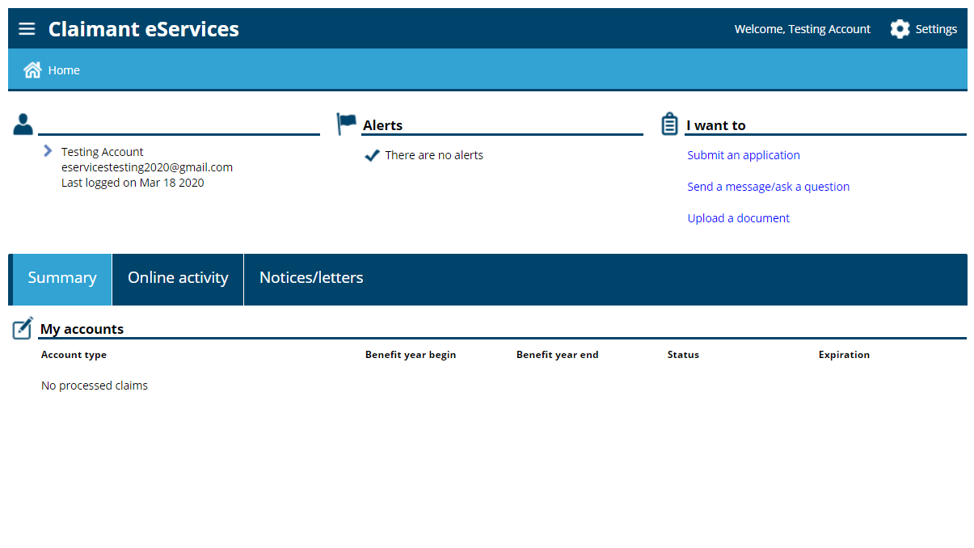

Slide 17
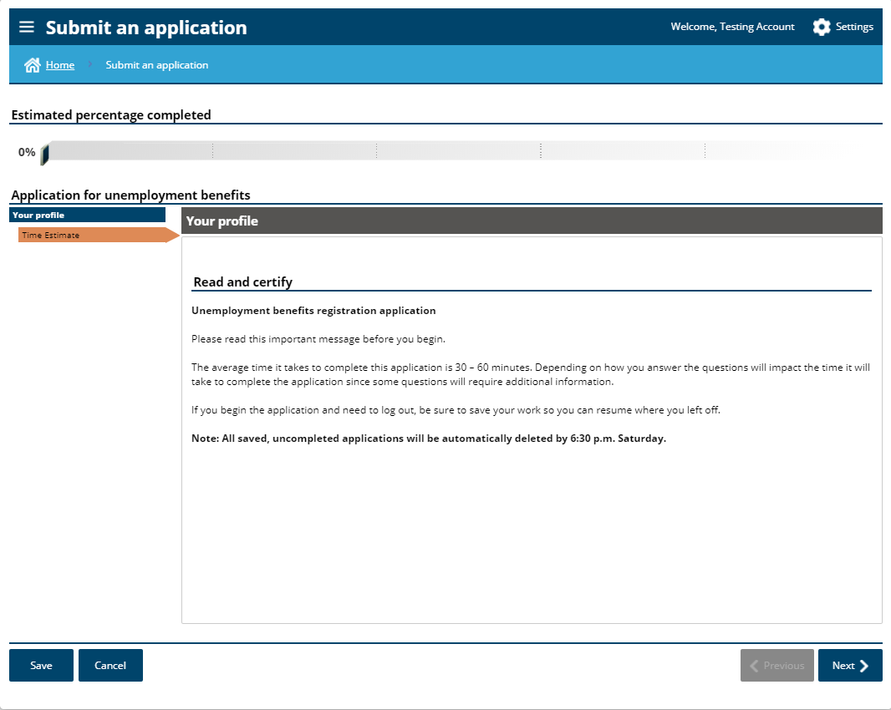

Slide 18
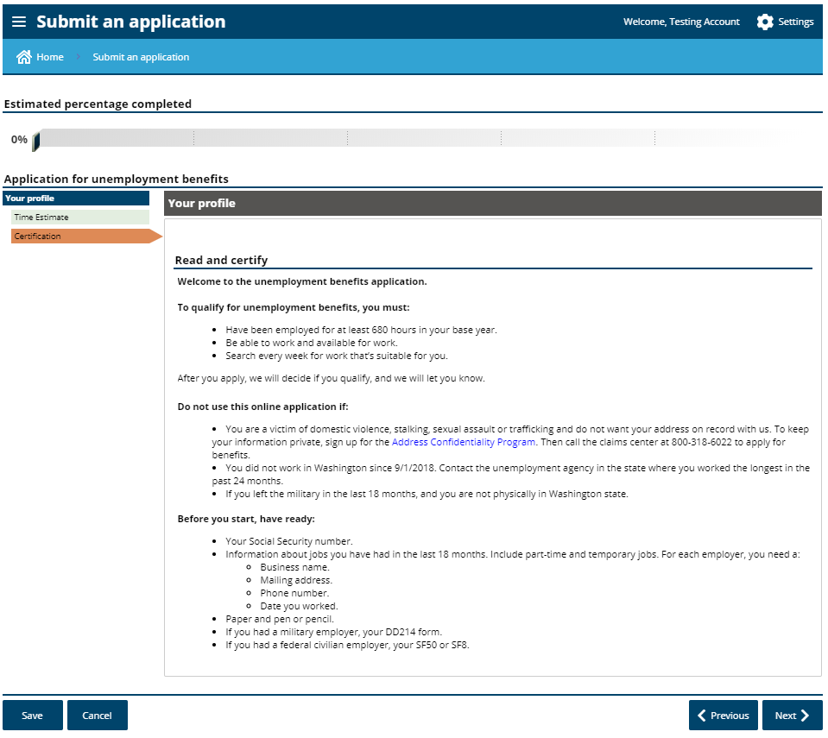

Slide 19
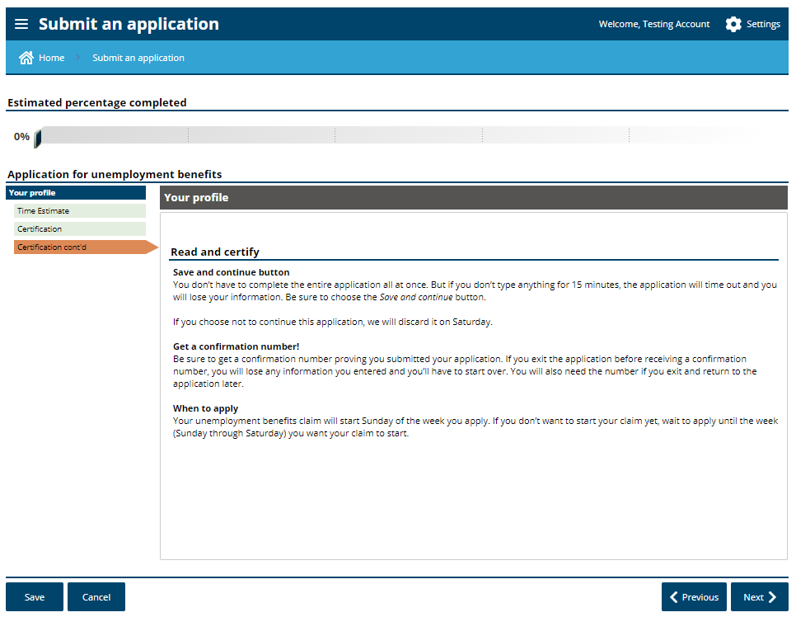

Slide 20
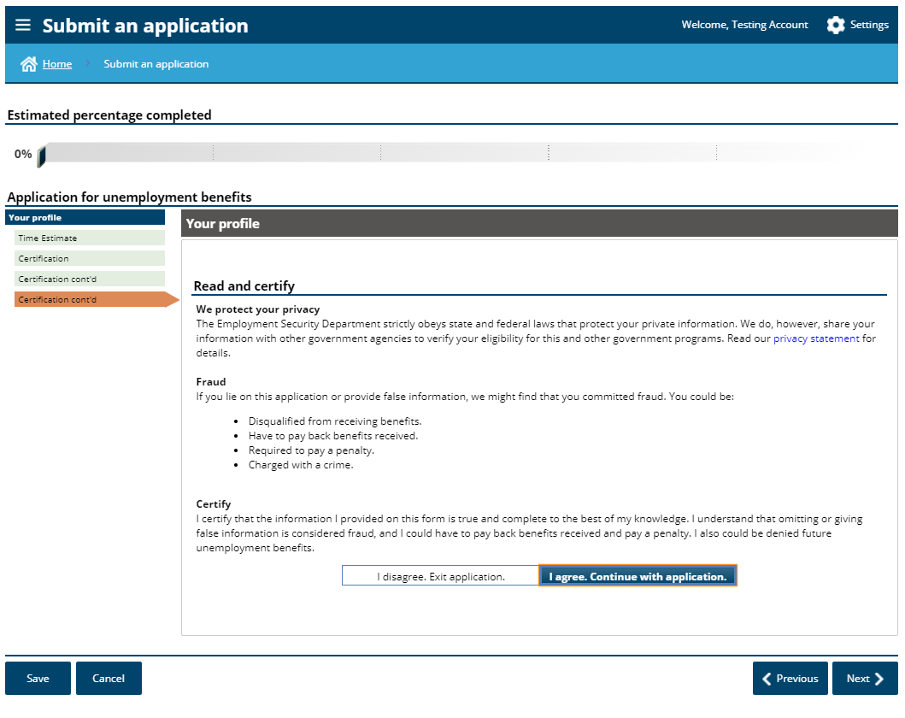

Slide 21
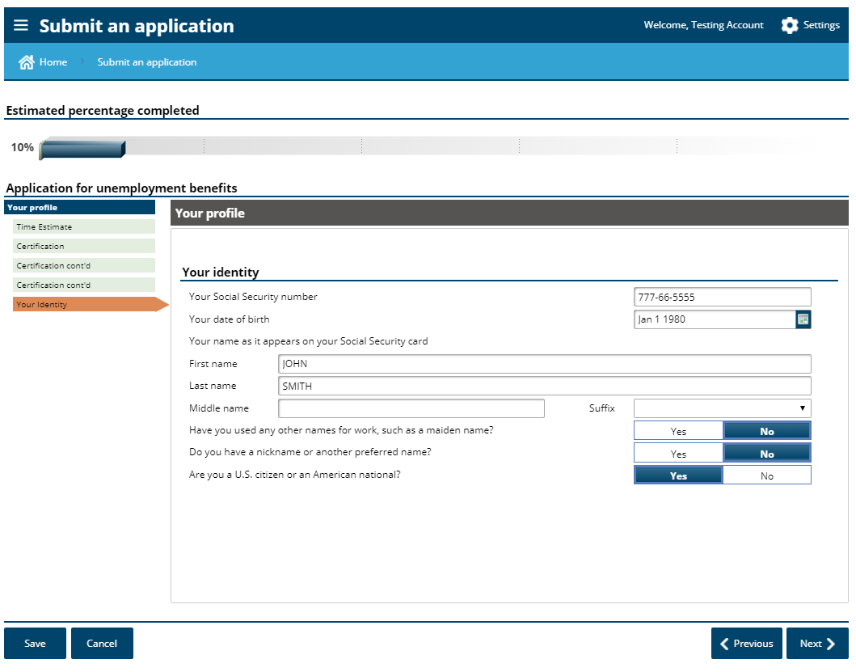
Read this question carefully

Slide 22
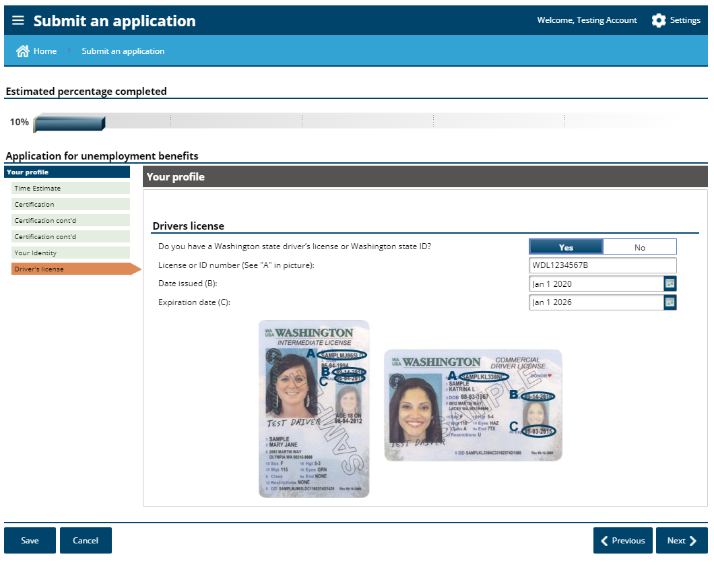
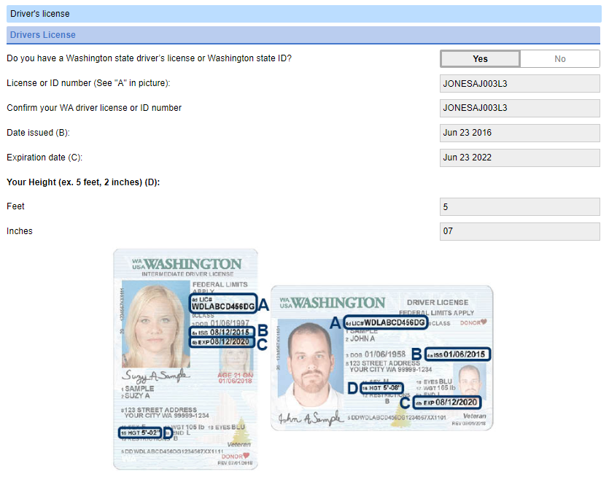
It is not a requirement to have a Wa State drivers license. But if you do, you must enter the information

Slide 23
If you answer “yes” to any of these question, you will be presented with some additional questions specific to that topic

Slide 24
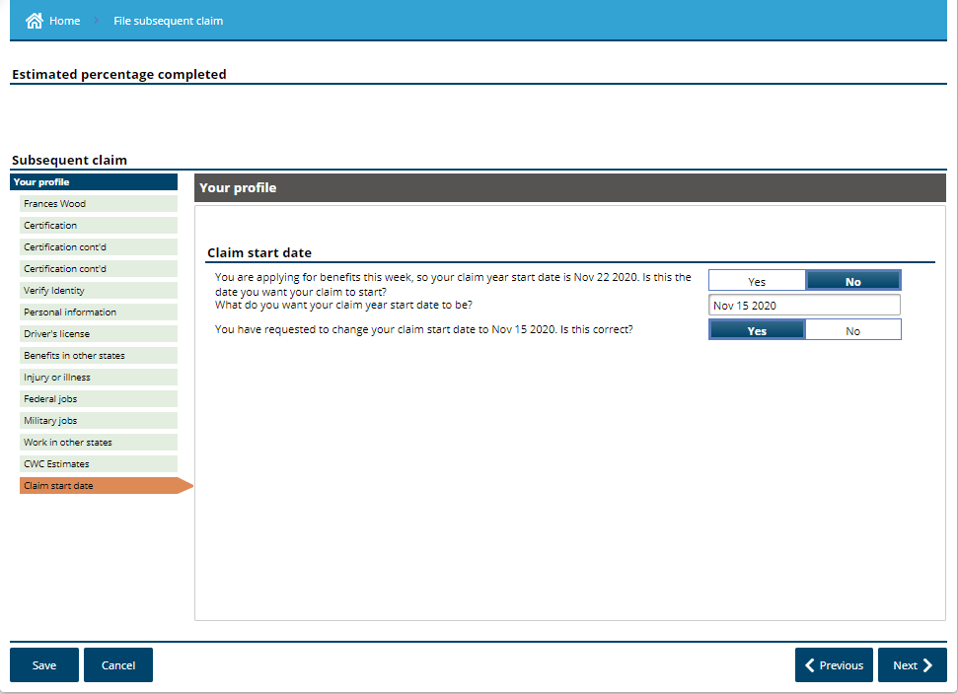
Claim start date should be determined by your last paid/working date.
Requesting to backdate your claim start date requires a formal determination to allow or deny benefits. Until that determination has been made, you will only be able to get benefits from the current week forward.

Slide 25
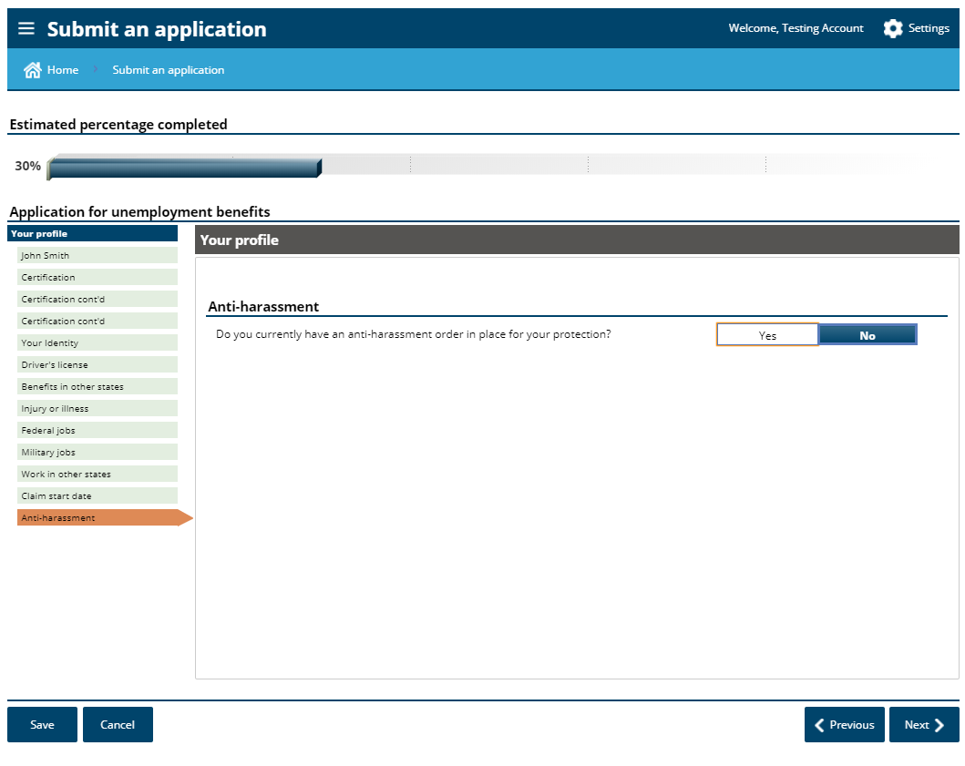

Slide 26
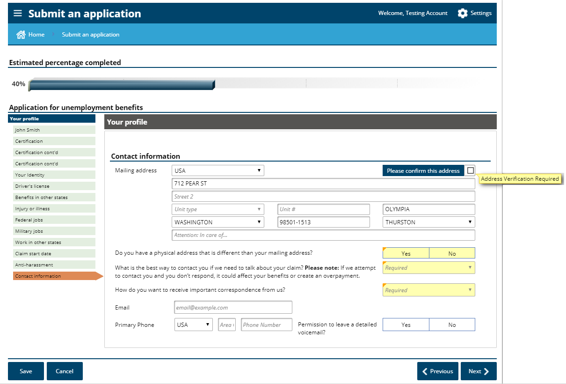

Slide 27
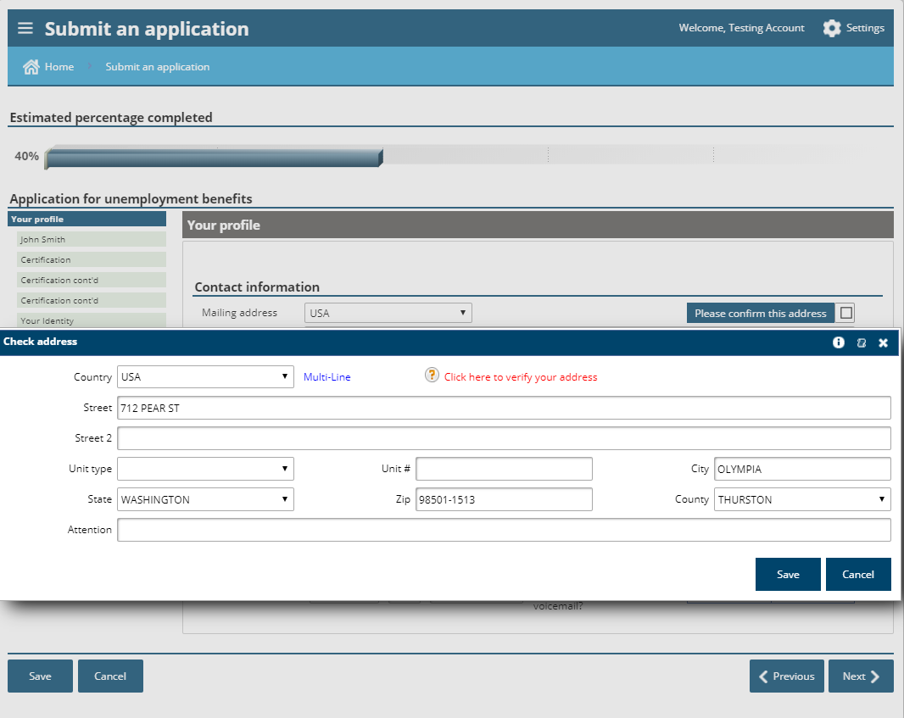

Slide 28
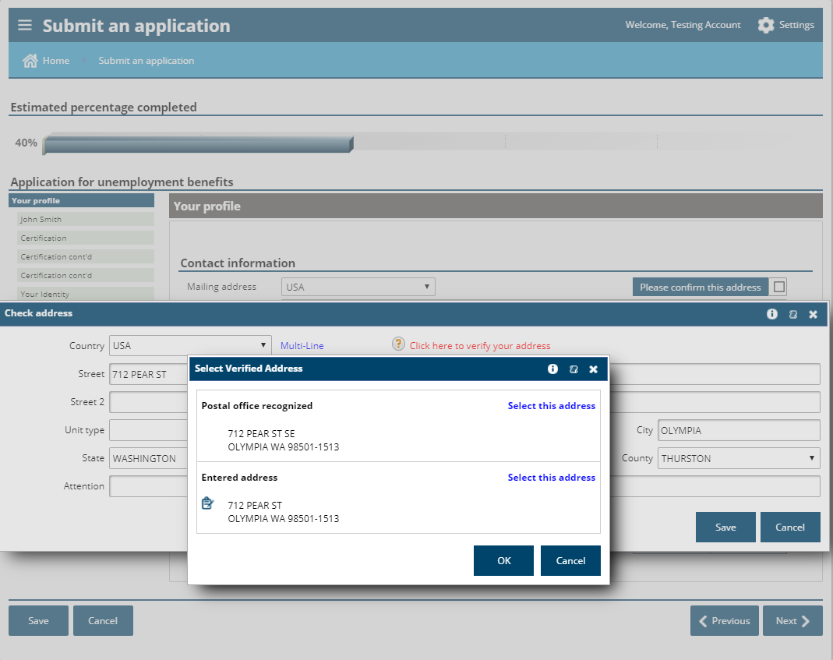

Slide 29
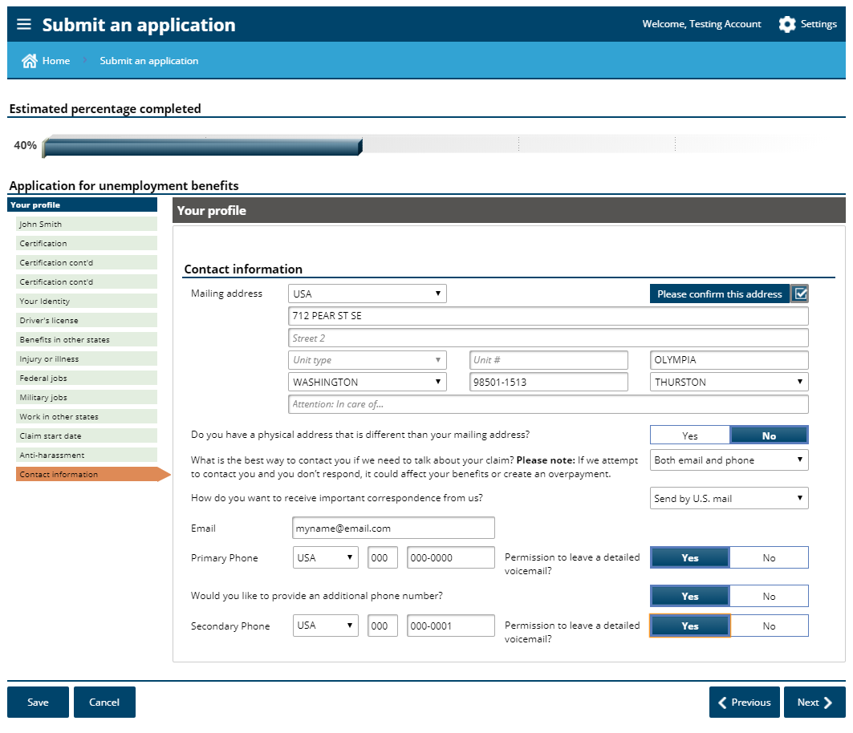

Slide 30
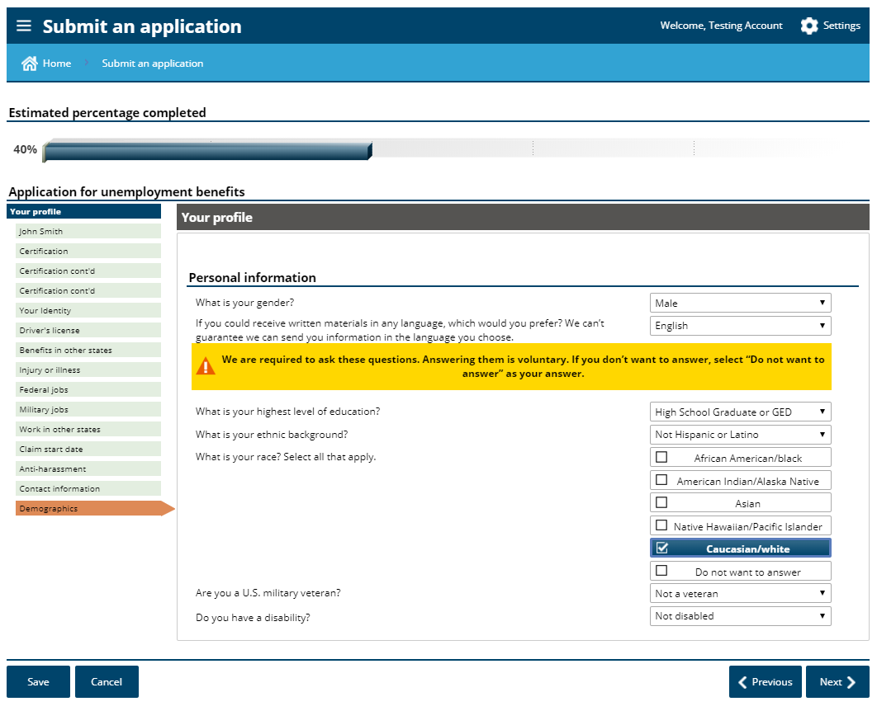

Slide 31
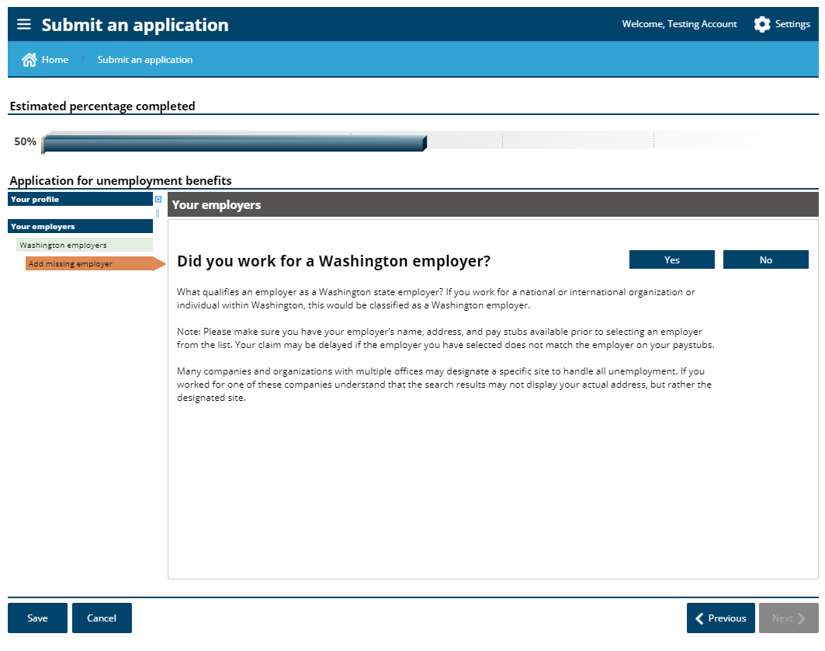
If you only had self employment, choose “no”.
If you worked for an employer in Washington in the past 18 months, and it is not automatically presented to you, choose “yes”.

Slide 32
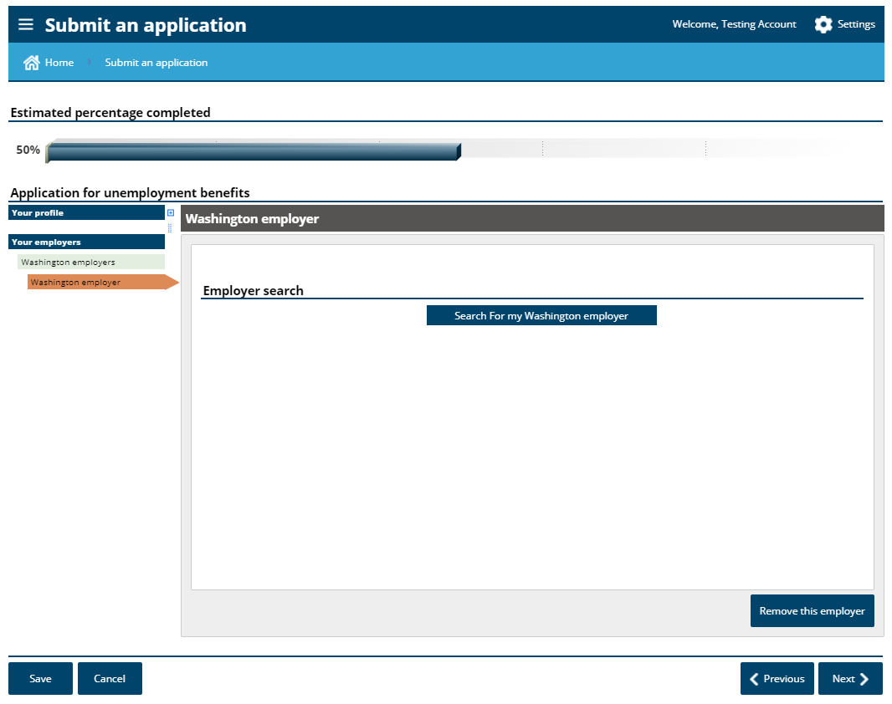

Slide 33
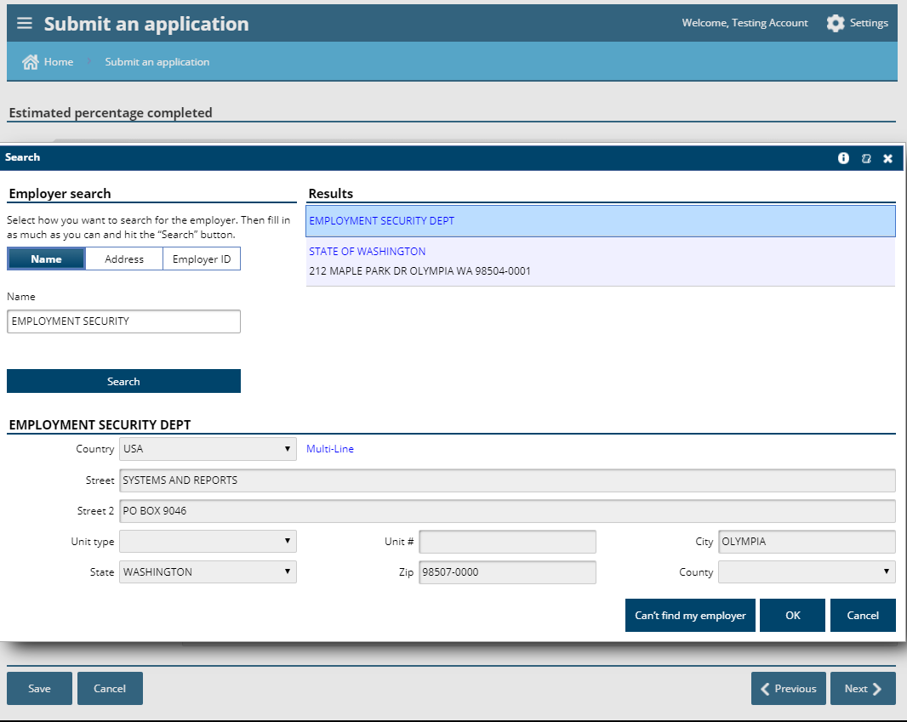

Slide 34
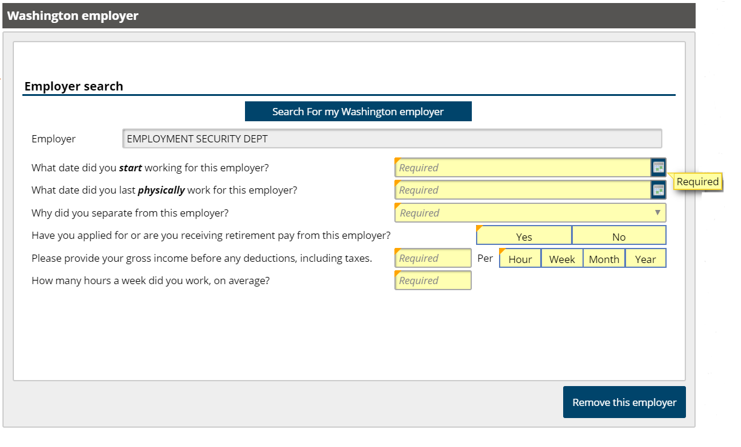

Slide 35
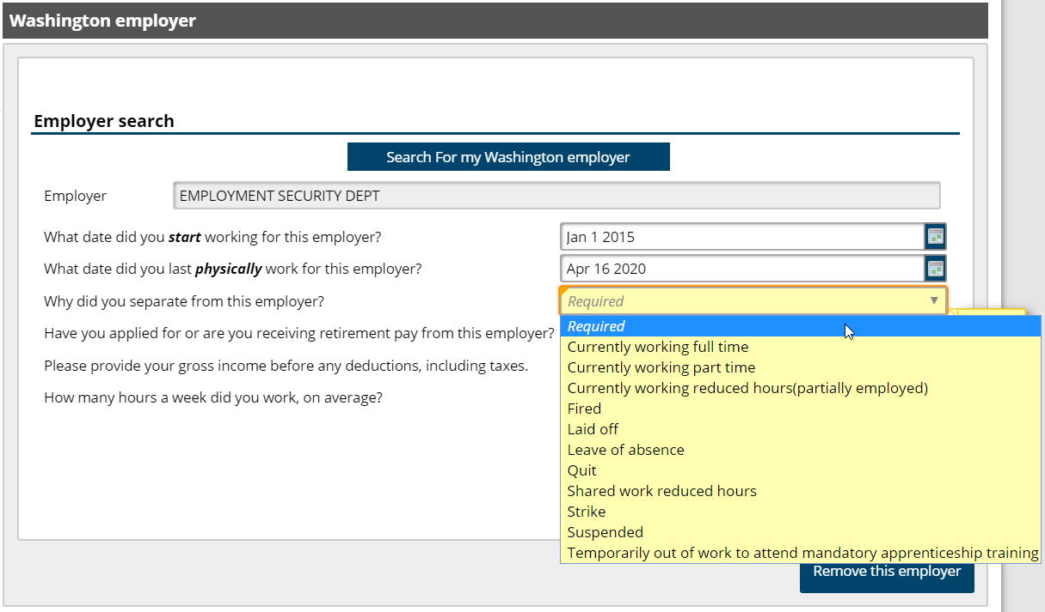
also “lack of work”, “furlough”, or if your employer said you were on “standby”.

Slide 36
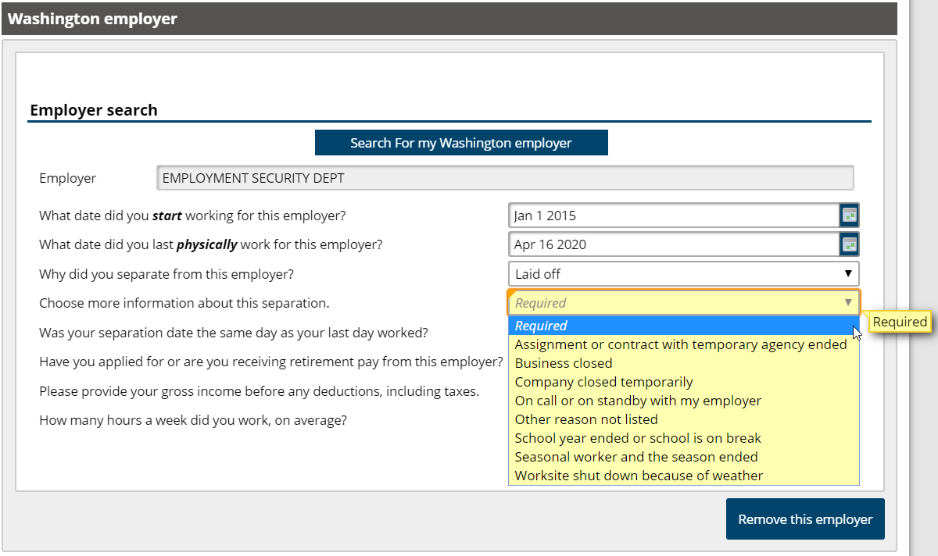

Slide 37
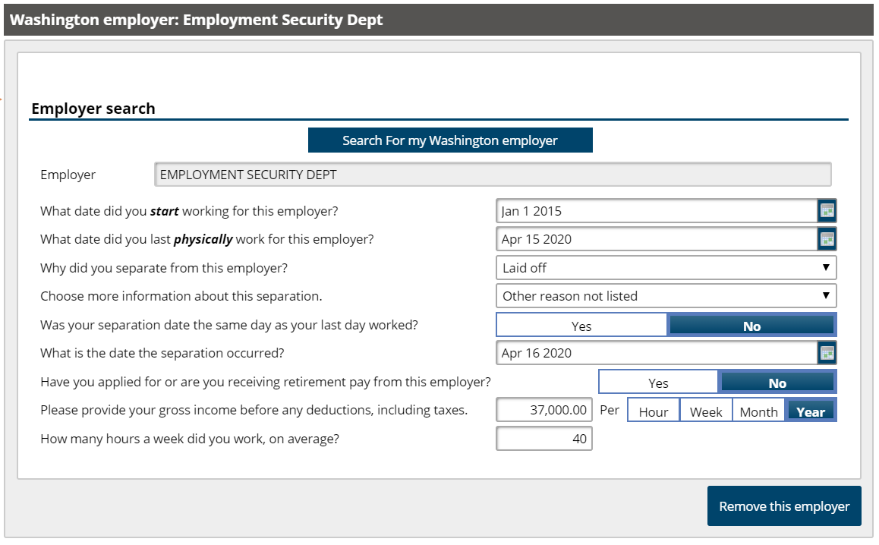
This is $ paid to you because you retired from this specific employer, not if you were contributing to your plan

Slide 38
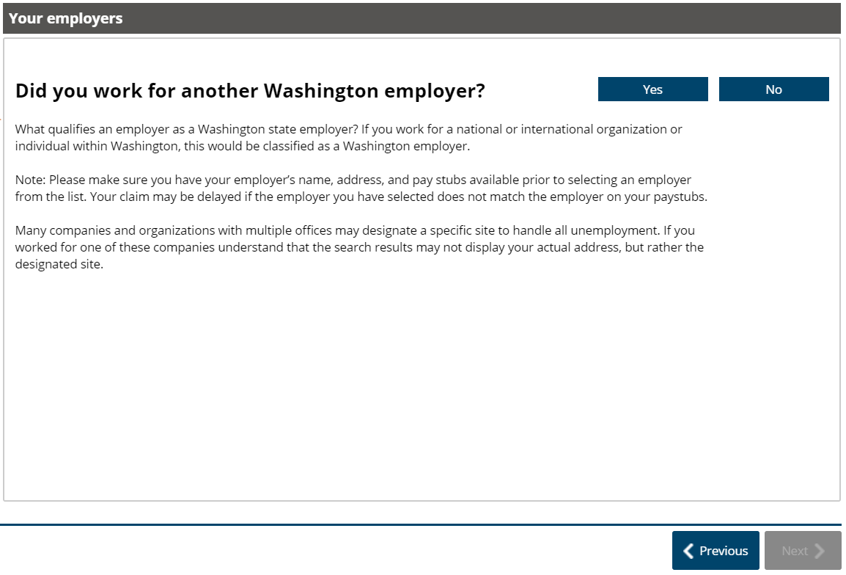

Slide 39
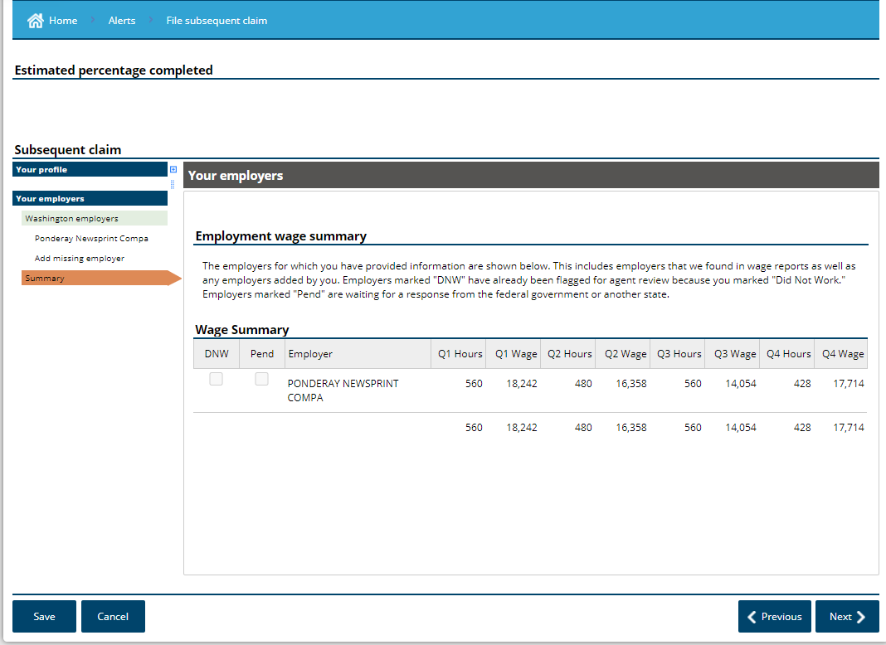
Employment Security Dept
Employment Security Dept

Slide 40
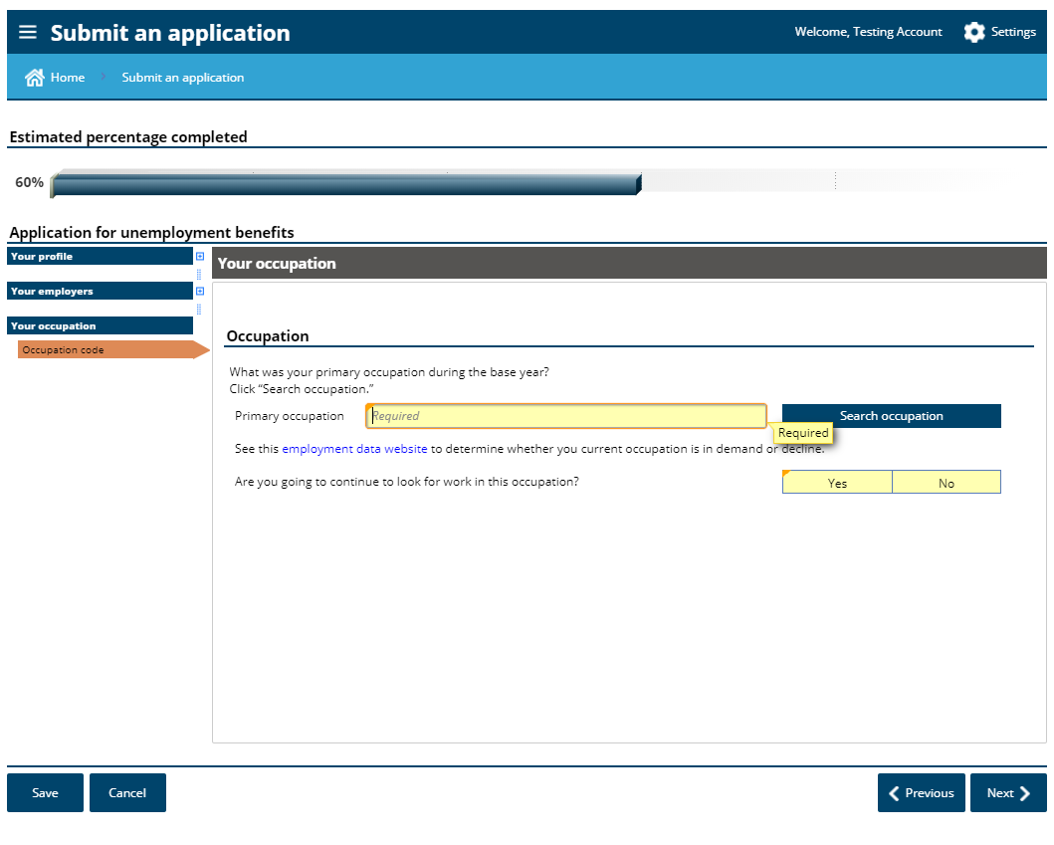

Slide 41
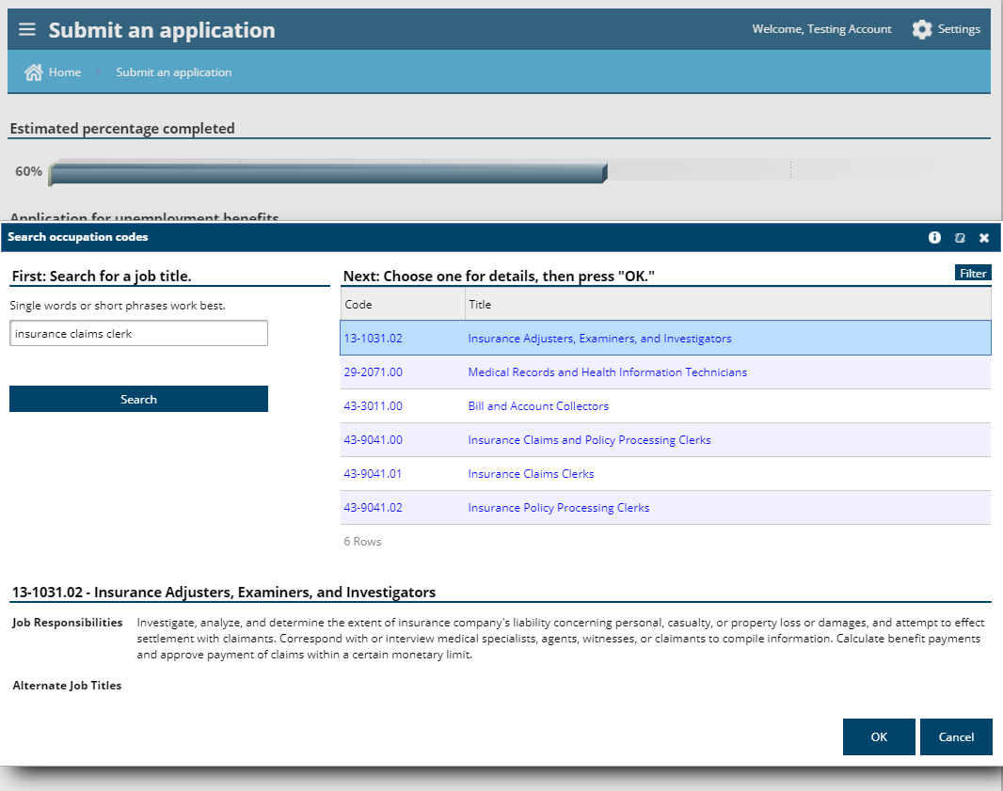

Slide 42
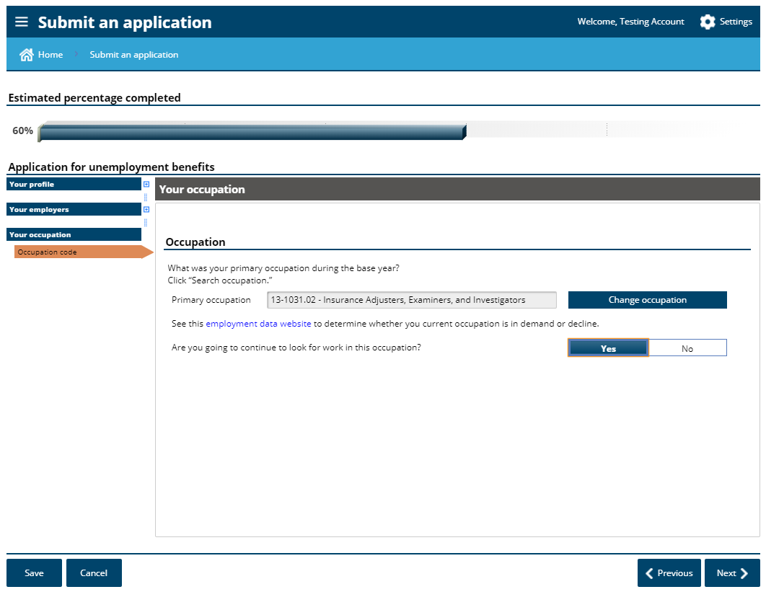

Slide 43
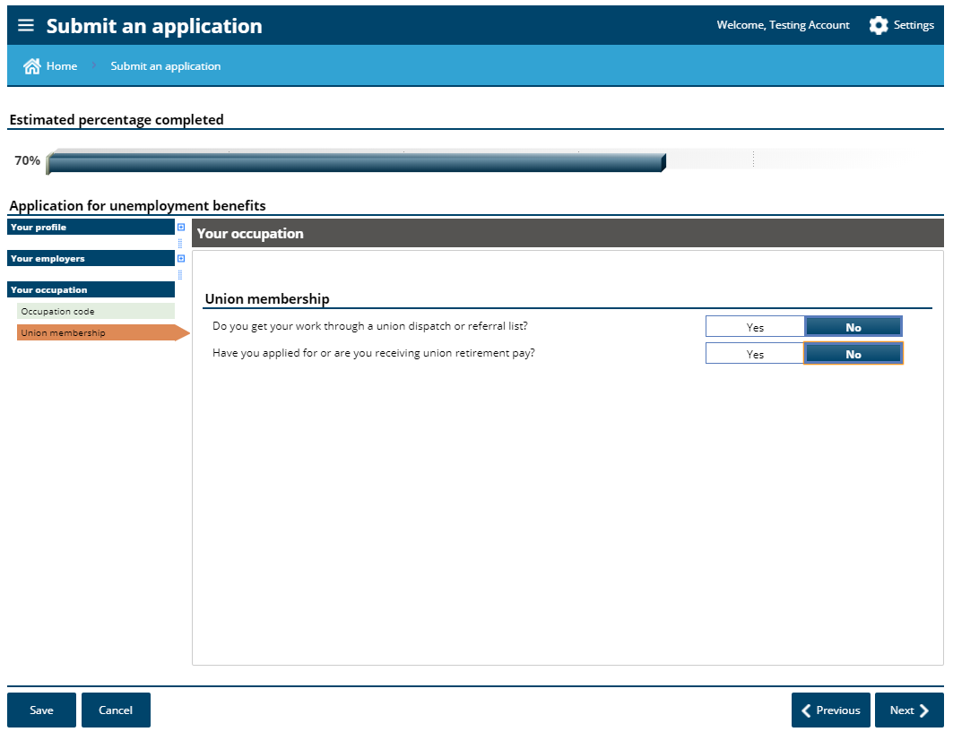

Slide 44
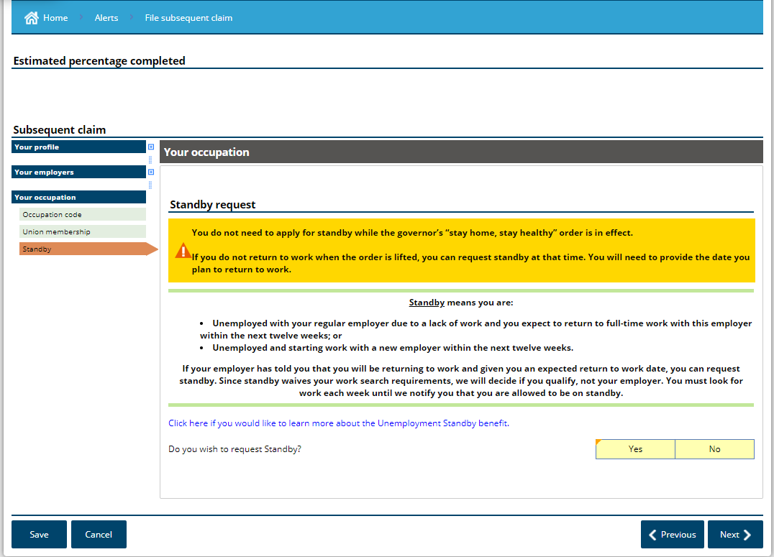
Requesting standby is not necessary while conducting a work search is optional.

Slide 45
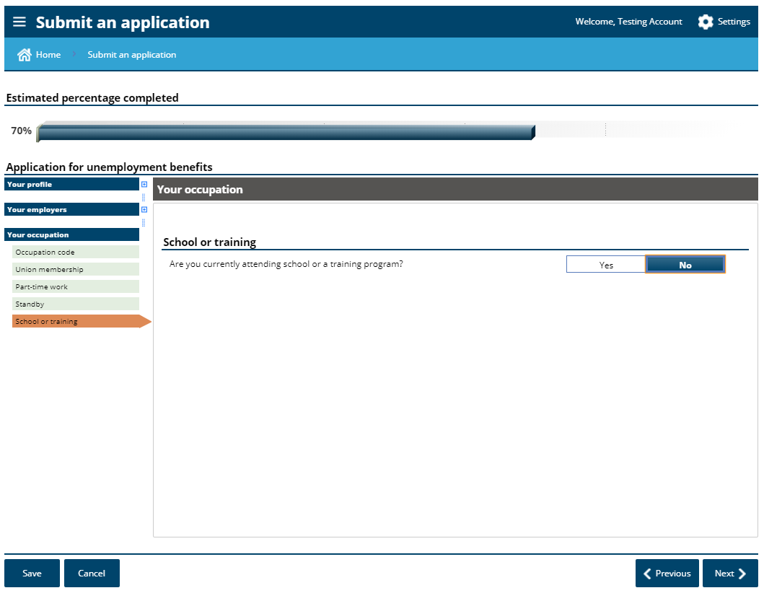

Slide 46
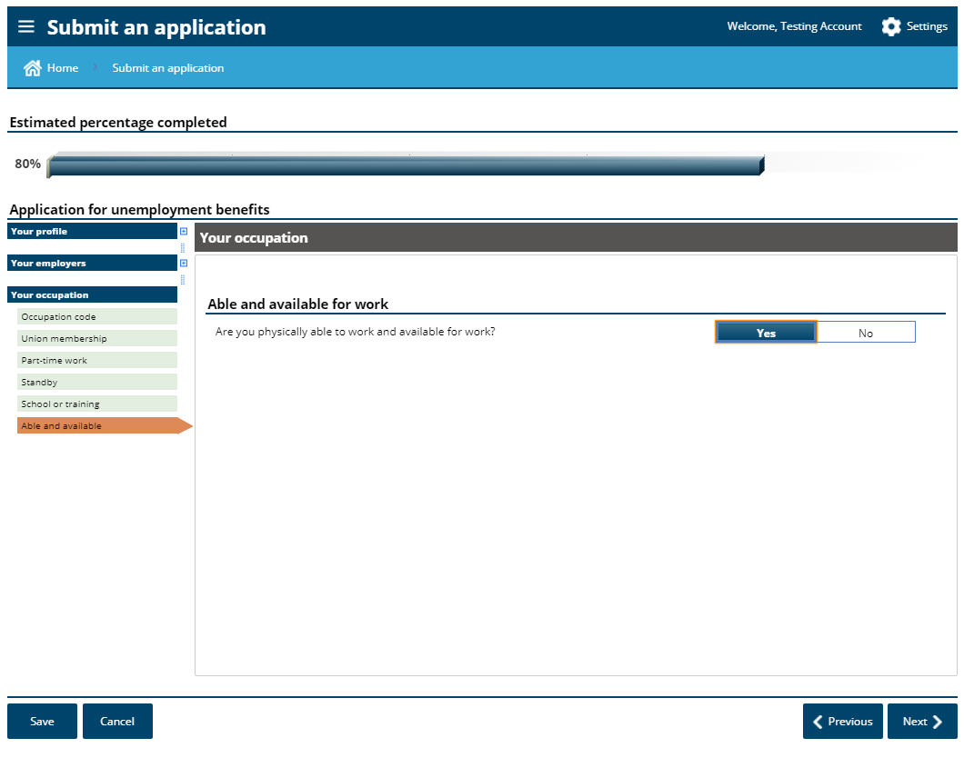
Being able and available means that you can go to work if called, if your employer had employment for you, and that there are no personal barriers to you returning to work.

Slide 47
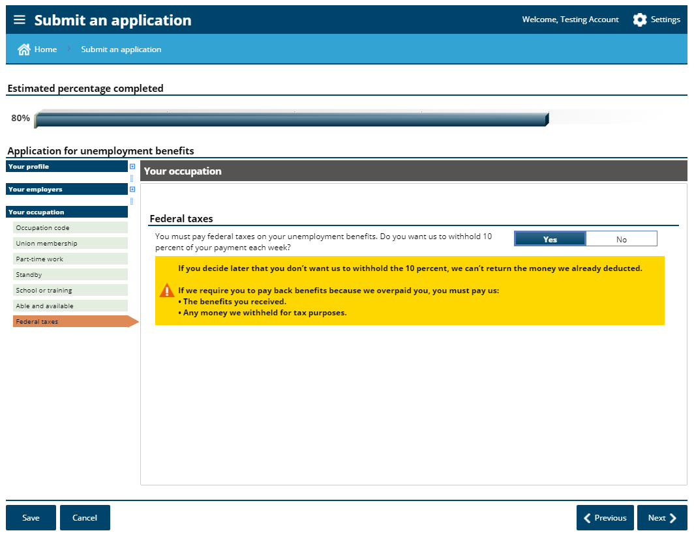

Slide 48
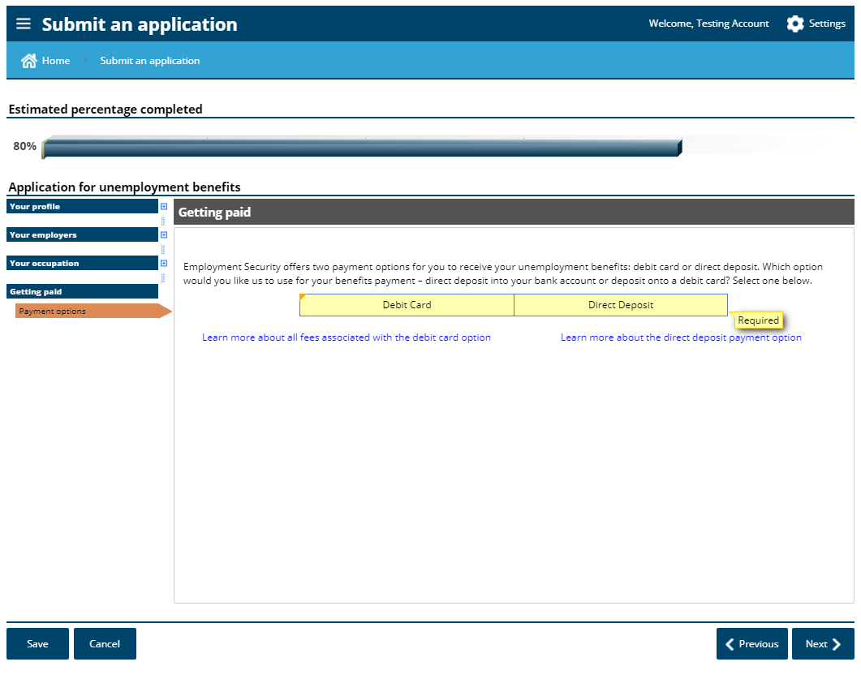

Slide 49
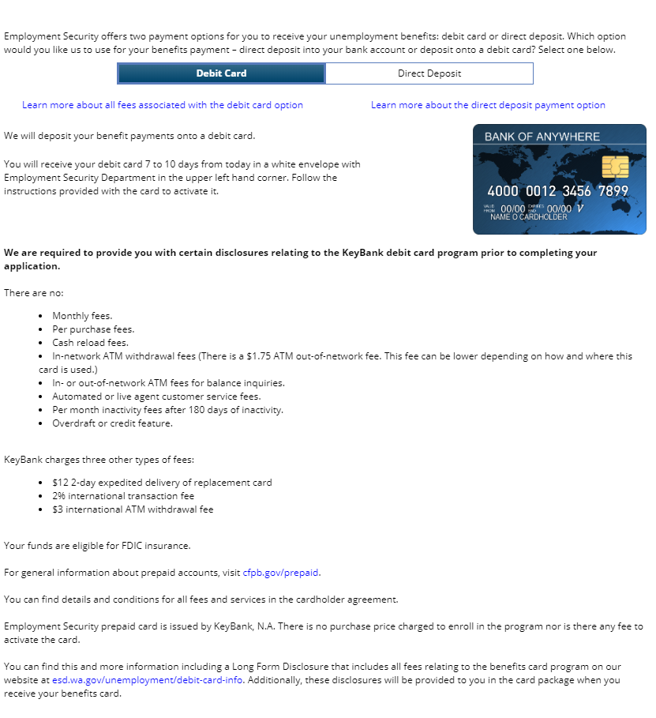

Slide 51
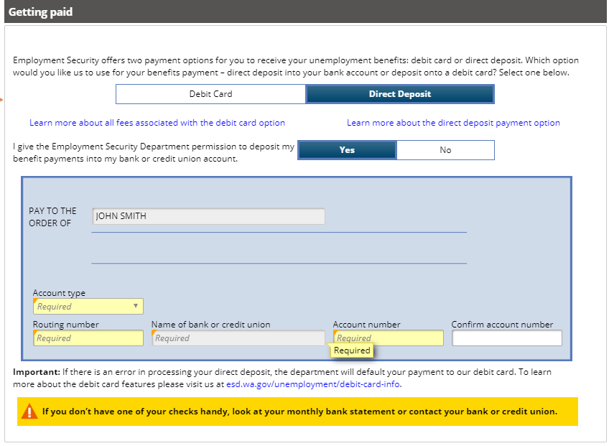

Slide 52
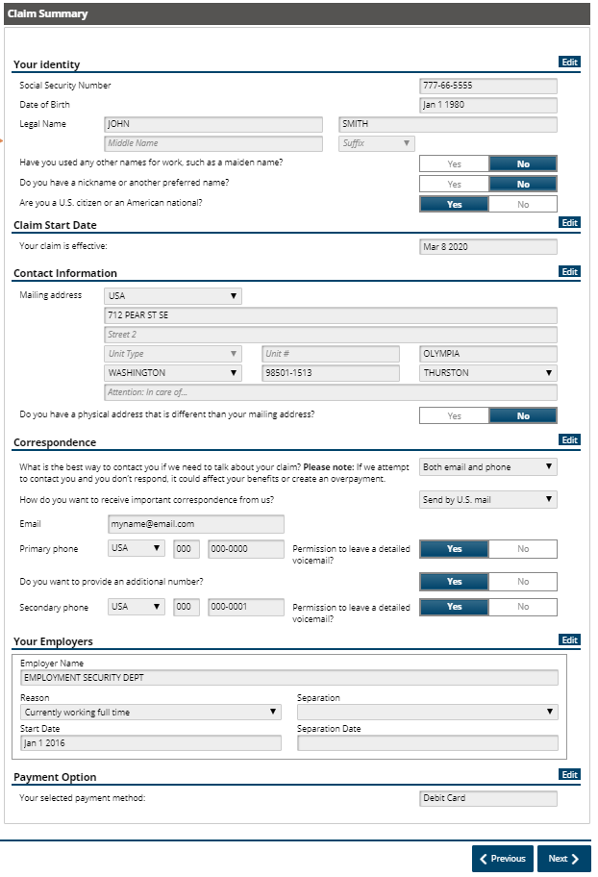
Each section has an “edit” button if you need to correct anything.

Slide 53
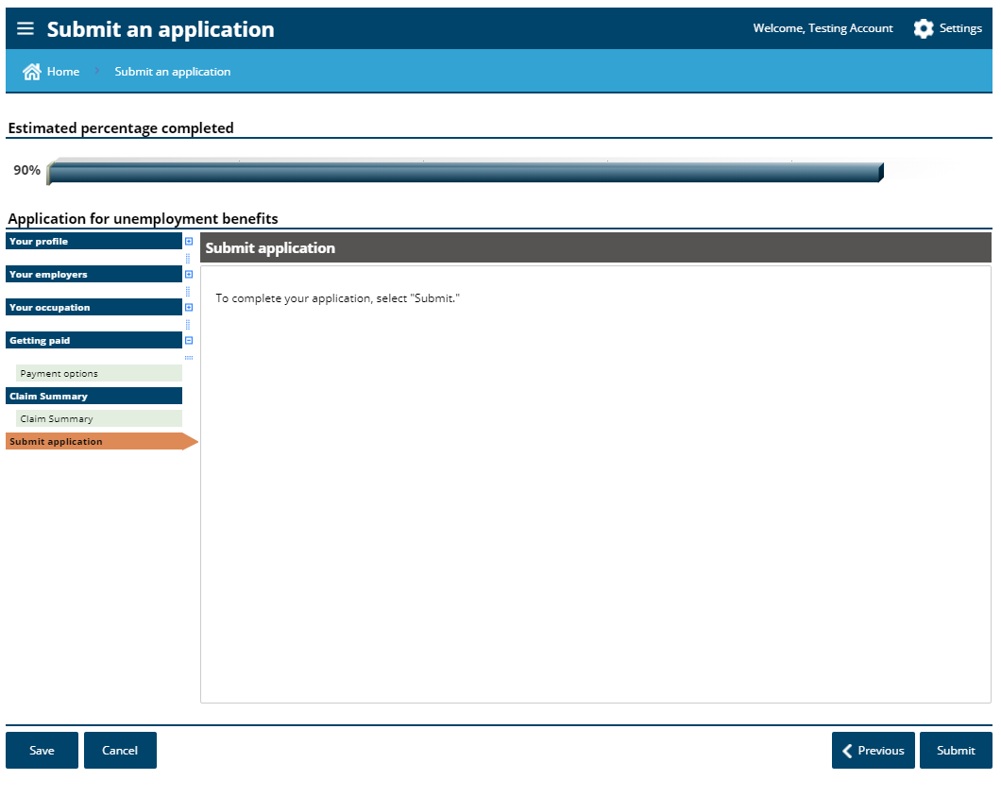

Slide 54
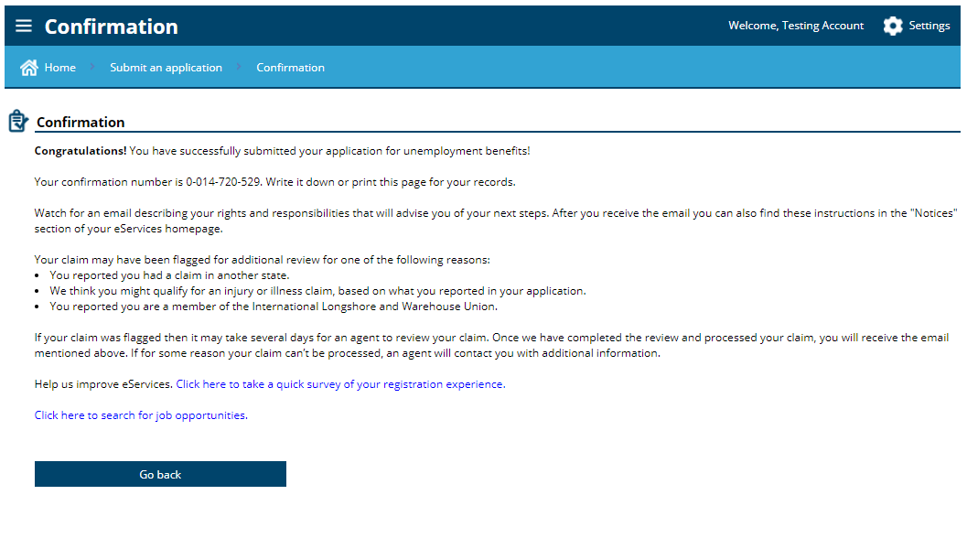

Slide 55
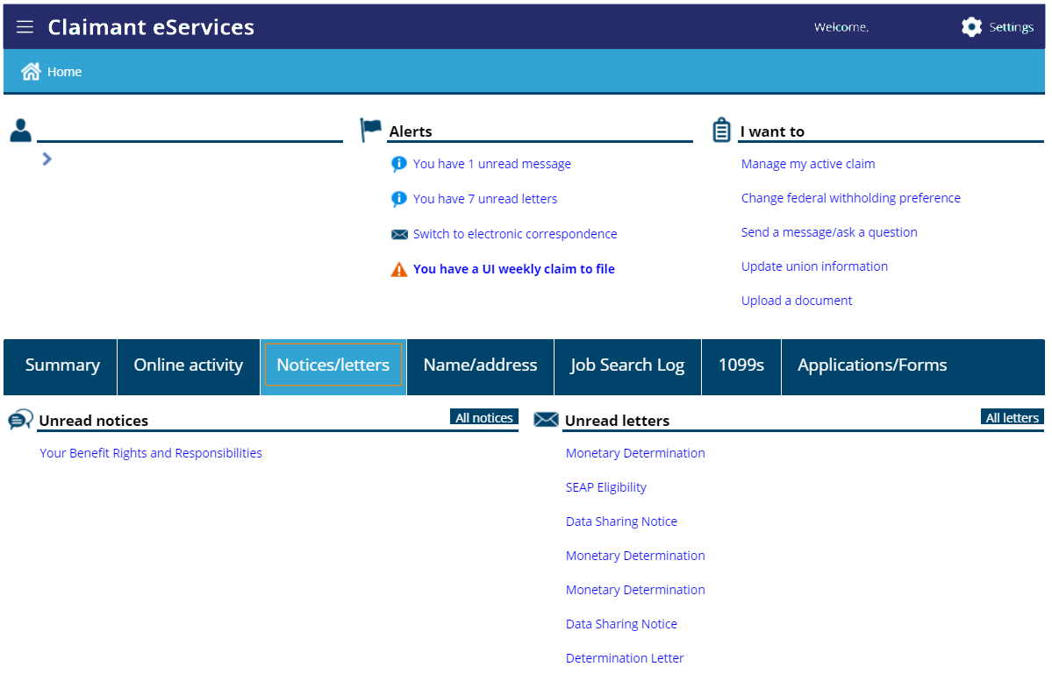

Slide 56
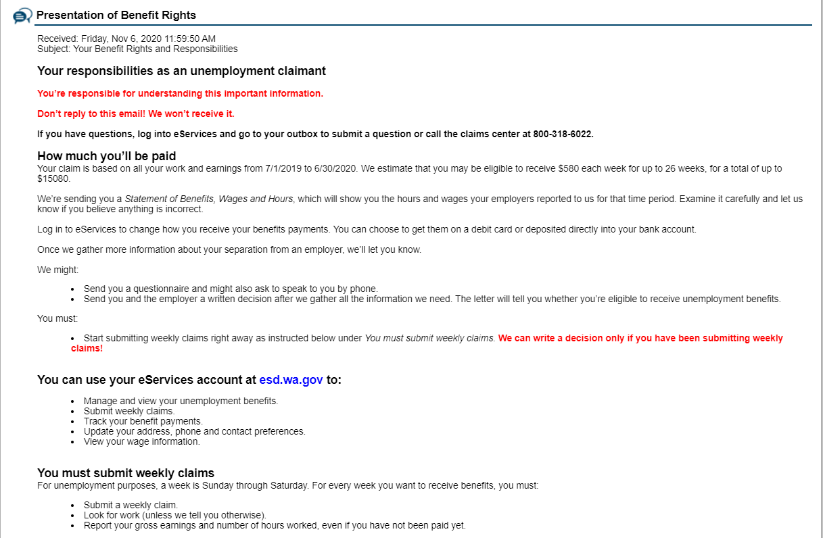

Slide 57
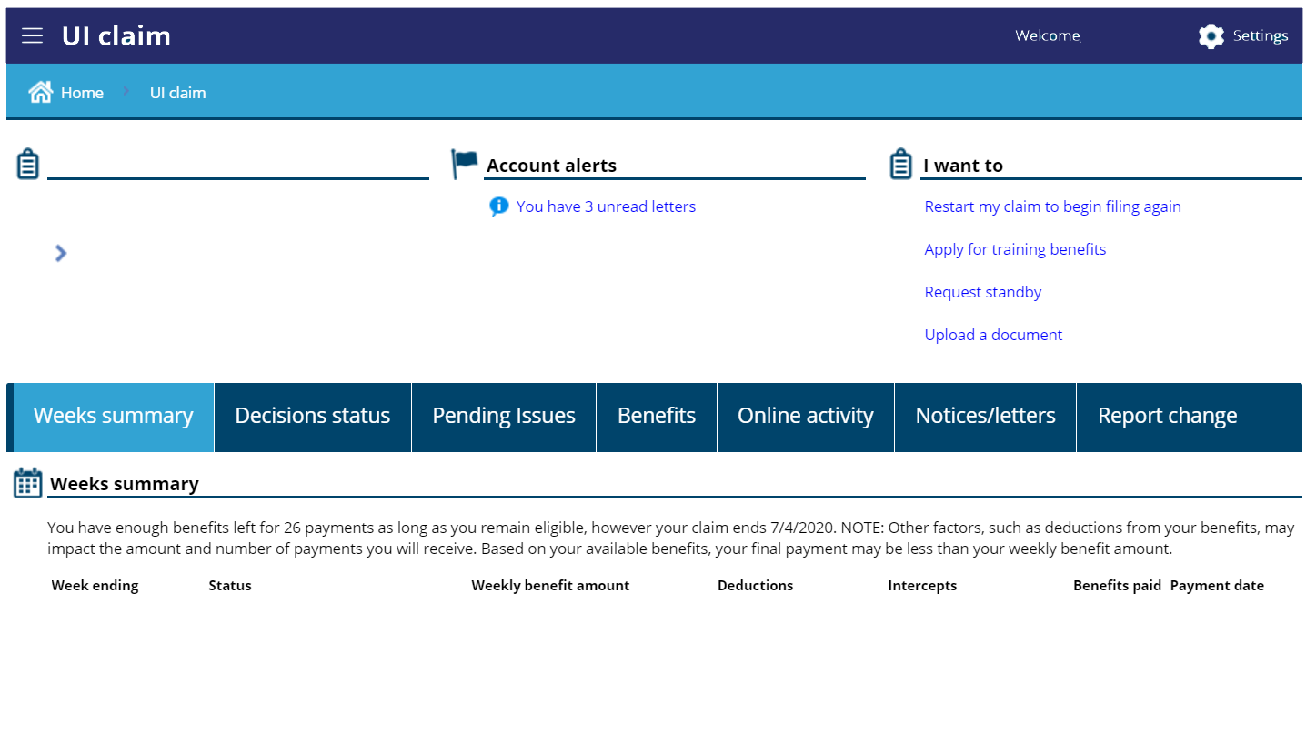
If needed later

Slide 58
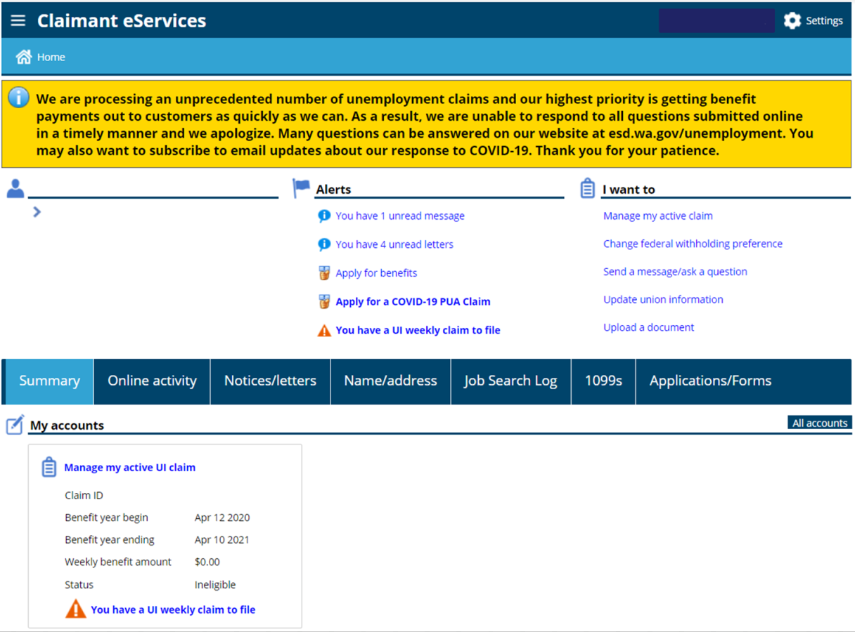
If you no not qualify for regular unemployment, you should use our checklist to determine if you qualify for the Pandemic Unemployment Assistance (PUA) claim

Slide 59
Pandemic Unemployment Assistance (PUA) -
PUA is a separate unemployment benefit program that provides a financial safety net to many people who do not qualify for regular unemployment, including:
Self-employed people
Independent contractors
Part-time workers (with fewer than 680 hours)
If you’ve been denied regular unemployment, some reasons may still allow PUA
This program is now available with start date of Dec 6, 2020 – Mar 13, 2021, phasing out by April 10
If you do not qualify for regular unemployment, review the checklist to determine if you may qualify for PUA.

Slide 60
When do you file your weekly claim -
Preferably every Sunday for each previous week that you want to receive benefits. For example, if your claim start date is 1/17 you will submit your first weekly claim on 1/24 or anytime during that week.
You will then need to submit your weekly claim every week, for the previous week.
You will submit your weekly claim after the week is over.
You can submit your weekly claim using eServices or by calling 800-318-6022.
Start of claim
Submit your weekly claim during this time

Slide 61
Unemployment Information
When you return to full time work, just stop submitting your weekly claims. There is no need to call us or tell us that you have returned to work.
Work search is optional until further notice. Watch esd.wa.gov and look for alerts in your eServices account to find out if this will change.
If you don’t know your exact start dates of employment, just estimate. Your last day of work for your most recent employment needs to be accurate.

Slide 62
Unemployment Information
If you worked for an employer and you also had self employment, you will still need to file a regular unemployment claim.
For regular unemployment, you will give us information related to your work with an employer.
If you don’t qualify there, then you would also apply for the Pandemic Unemployment Assistance program and provide us with your self employment information.
You can still receive unemployment if you work part time or if your employer is paying you sick pay, holiday pay, vacation pay, or personal time off. You just need to report the hours and earnings for each week that you do the work or that the pay is attributable to.

Slide 63
Unemployment Information
If your claim shows “invalid” or “ineligible” it could be because:
Some of your employers are missing. Make sure you inform us of that.
You only had self employment/independent contractor work, or you did not have enough work hours. You should apply for the Pandemic Unemployment Assistance (PUA) program.
If your hours and earnings reported by your employer are not correct, please let us know. We will ask for documentation and then we will get it corrected.

Slide 64
Federal Pandemic Unemployment Compensation
We are now paying the additional $300 per week
No application is necessary
Payable as long as you are eligible for at least $1 in benefits
Payable to those that are receiving regular, Pandemic Emergency Unemployment Compensation, Extended Benefits, and Pandemic Unemployment Assistance.
This $300 is in addition to your regular benefits
Available until March 13, 2021

Slide 65
Scroll down for additional links and information

Slide 66
Resources to Help!
For everything – www.esd.wa.gov
This includes COVID-19, as it relates to programs and services provided by the Employment Security Department
Online webinars – https://esd.wa.gov/uiwebinars
Appropriate phone lines are:
eServices (SAW) Account Support – 855-682-0785
Unemployment Insurance Claims – 800-318-6022
Identity Issues – 800-246-9763
UI Fraud - esd.wa.gov/unemployment/unemployment-benefits-fraud
Reemployment and Retraining Services –
www.WorkSourceWA.com

