Slide 1
Restarting an Unemployment Claim

Slide 2
What you will need
Logged in and on the Internet, www.esd.wa.gov
SSN, address, Date of birth
Employer names, addresses, and dates of employment since you last claimed
For direct deposit – If you would like to receive benefits through direct deposit, you will need your bank routing and account numbers

Slide 3
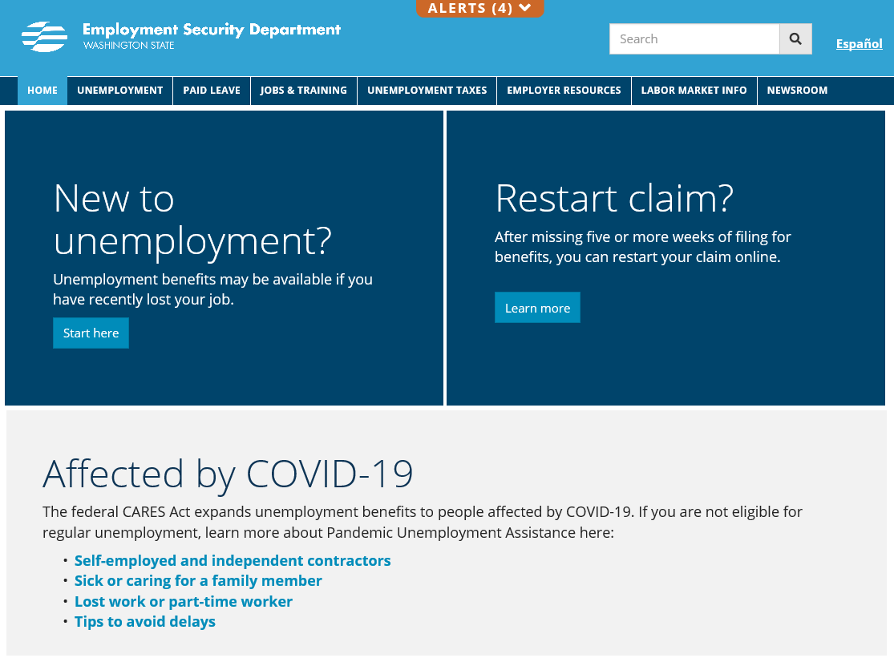
ESD.WA.GOV
Notes:
This process assumes the individual has already set up a SAW account. You should click on the “Learn more” link to begin the process of restarting a claim.

Slide 4
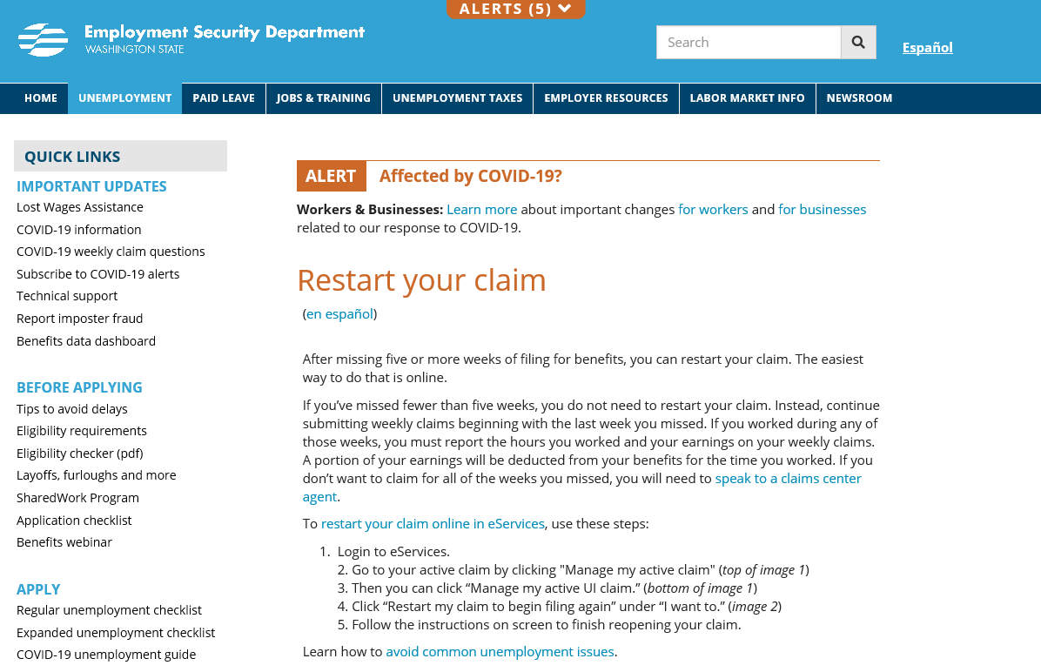

Slide 5
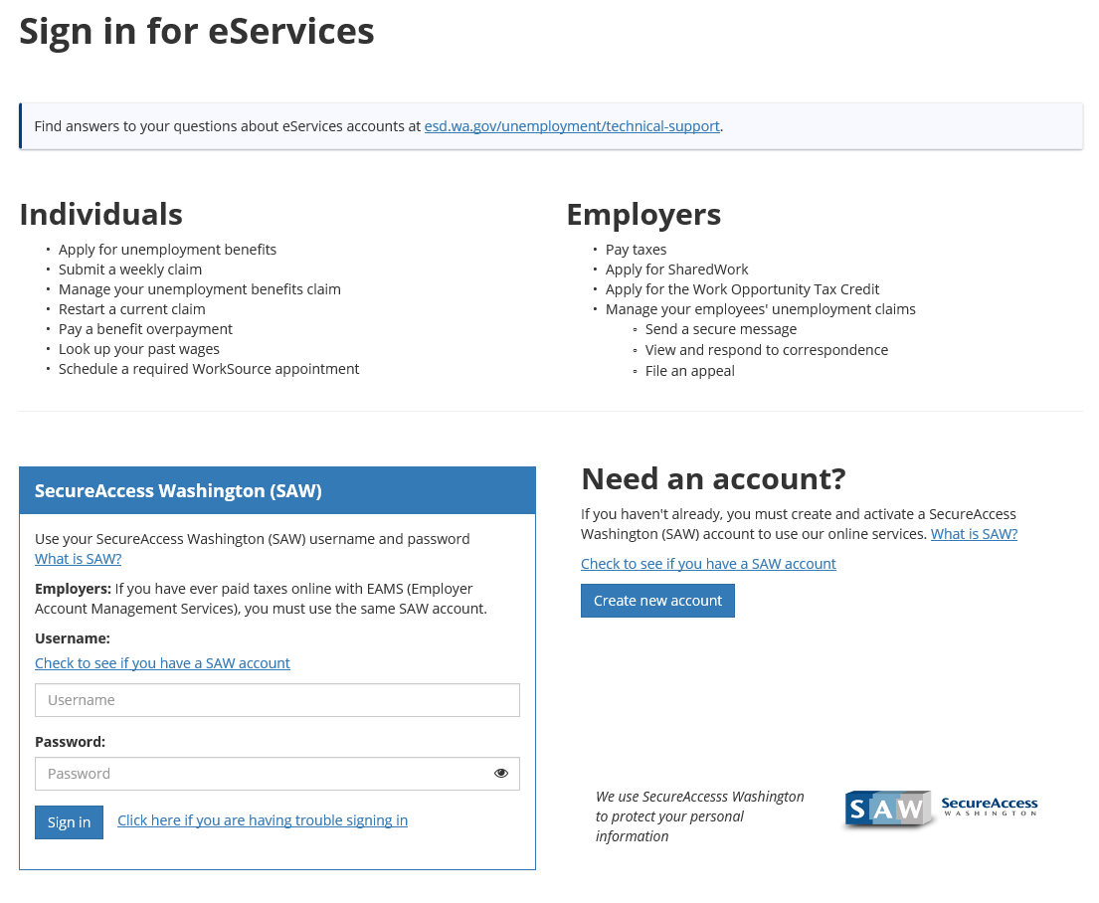
1
2
3
Notes:
1 = If you haven’t created a SAW account, we encourage you to click on this link and get some information on how to create it. This should help prevent any problems.
2 = If you think you had/have one, click this link and you will be able to enter an email address to see if there is a SAW account associated with that email address. If you have more than one email address, you can search using each email address.
3 = If you can’t remember your “username” or “password”, click on this link to walk through the steps of identifying your user name or resetting your password.

Slide 6
Type your Username and Password and click Sign in

Slide 7
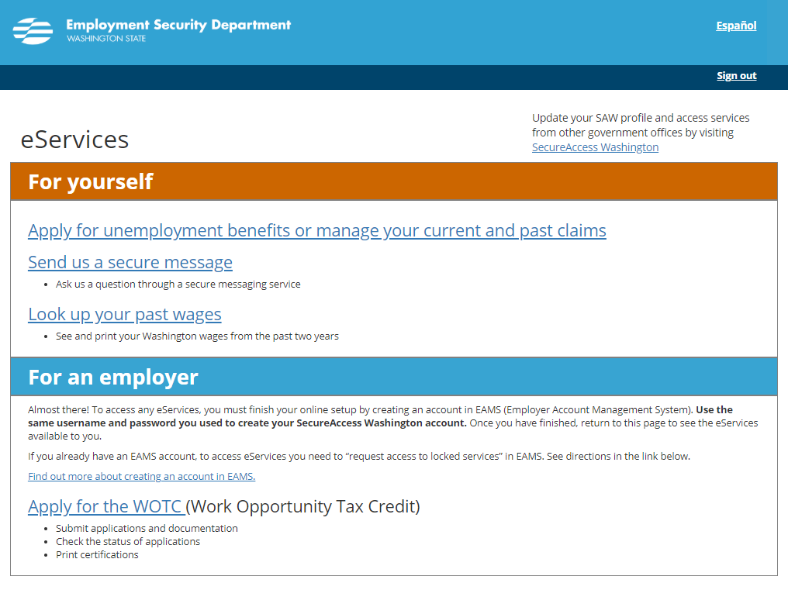

Slide 8
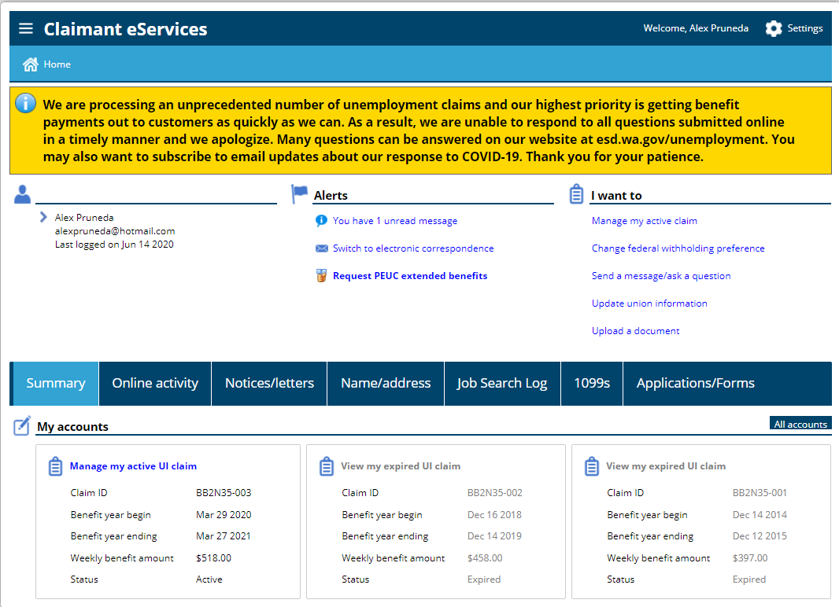
If you have a previous claim, it will look similar to this

Slide 9
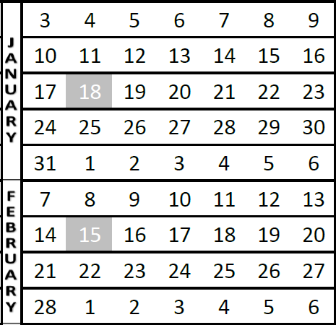
Lets talk about when to restart your claim
Don’t delay. Restart your claim as soon as you are no longer working or when your hours are reduced.
The start date of your claim must always be a Sunday.
Example 1 - If your last day of work is late in the week (January 14-16), you can restart your claim anytime during that following week. The claim start date will be that Sunday, January 17th.
Example 2 – If your last day of work is early in the week (January 24-27), you can restart your claim anytime during that week and your claim start date will be Sunday, January 24th.
If you request to start your claim prior to the week you are in, we will need to decide to allow or deny that request based on your reasons for the delayed start.
Example 1
Example 2

Slide 10
If you have a current claim, let’s restart it

Slide 11
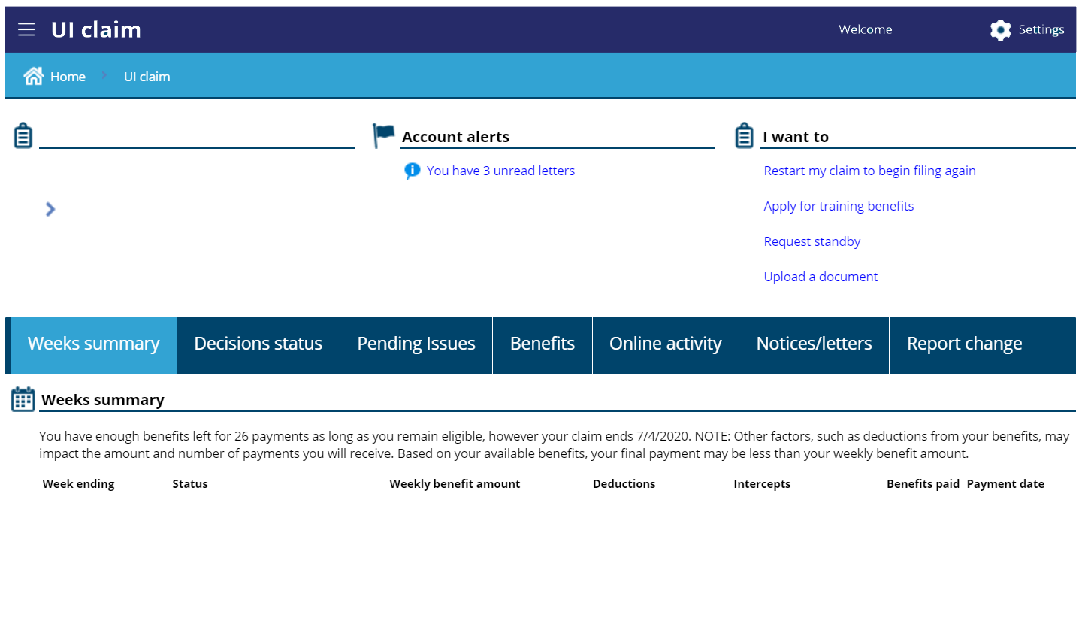
This link will only be there if it has been 5 or more weeks since you’ve claimed unemployment.

Slide 12
When reopening a claim, the questions you get could be different depending on your situation and how you answer the questions. The following screens will give you the most common.

Slide 13
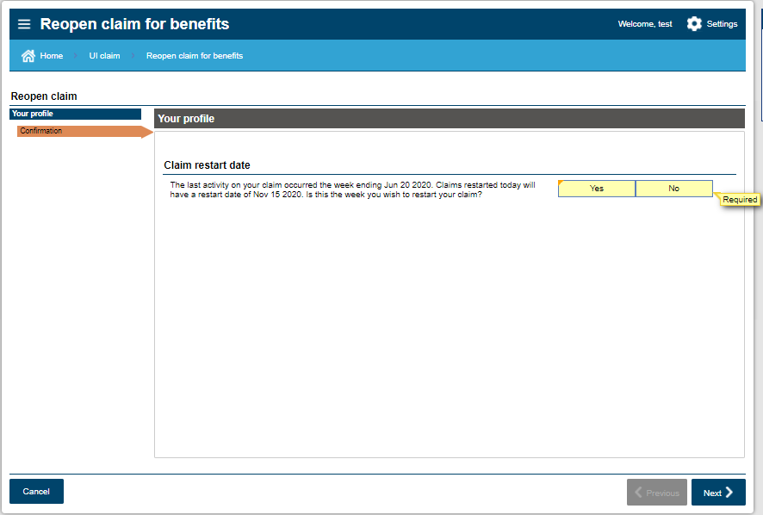
These dates will be different, depending on your circumstances.
Claim restart dates must always be on a Sunday

Slide 14
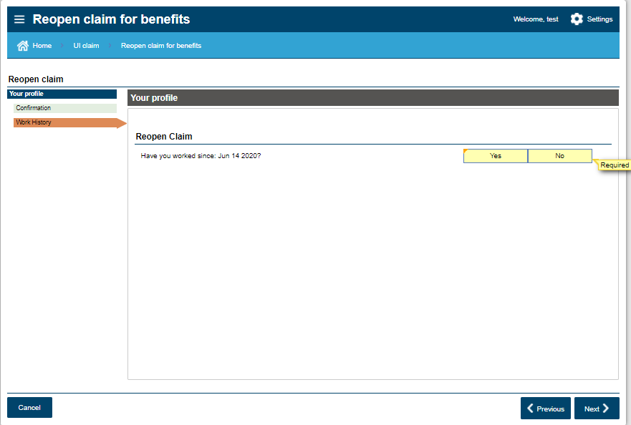
This date will be different, depending on your circumstances.

Slide 15
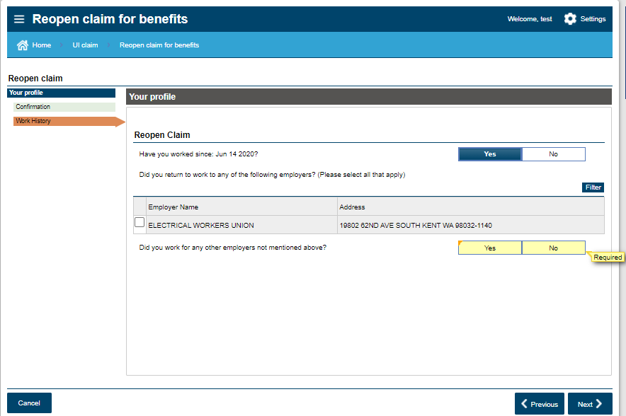
If you have other employers that aren’t listed, you will need to click on “yes” and search/add them.

Slide 16
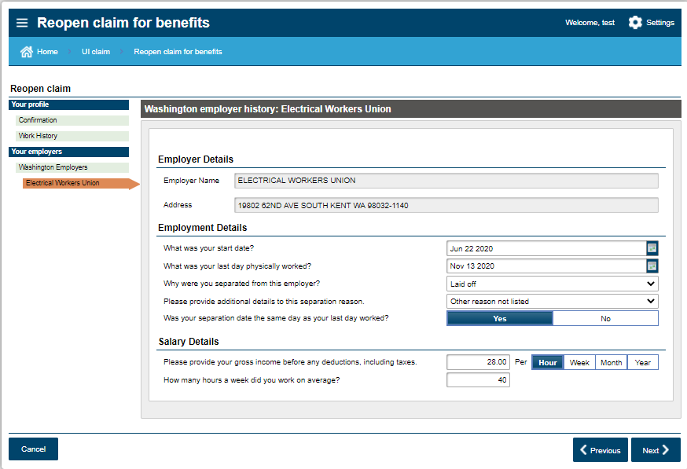

Slide 17
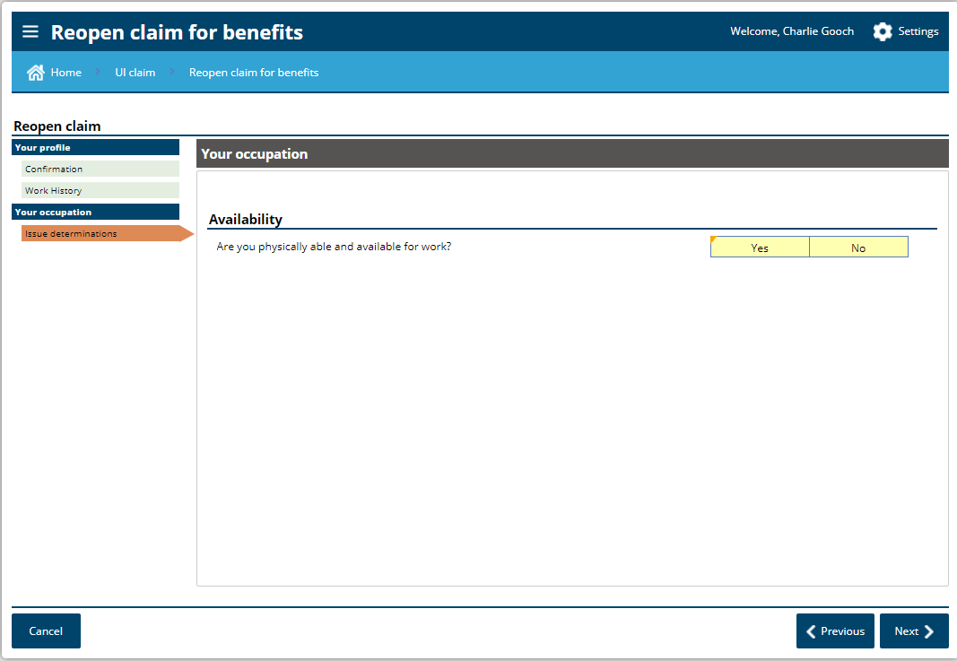
Being able and available means that you can go to work if called, if your employer was able to offer you work, and that there are no personal barriers to you going to work.

Slide 18
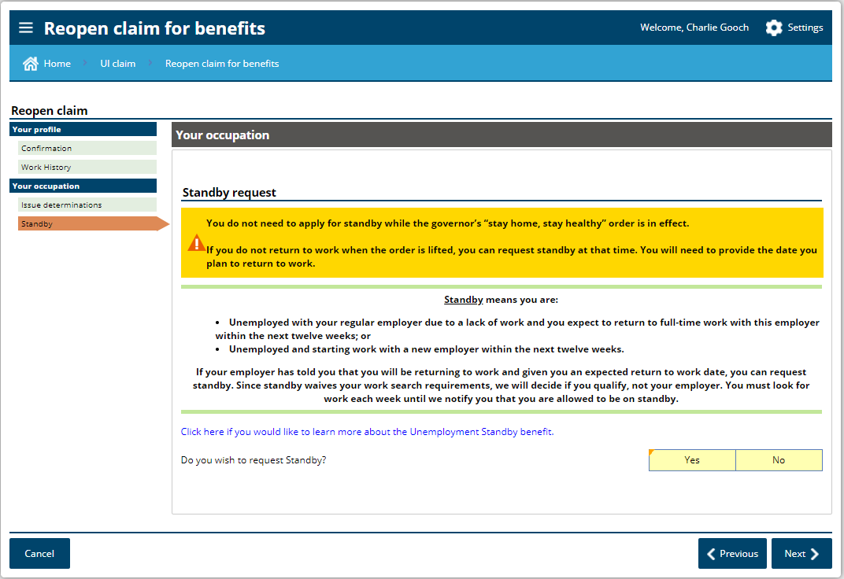
Requesting standby is not necessary while conducting a work search is optional.

Slide 19
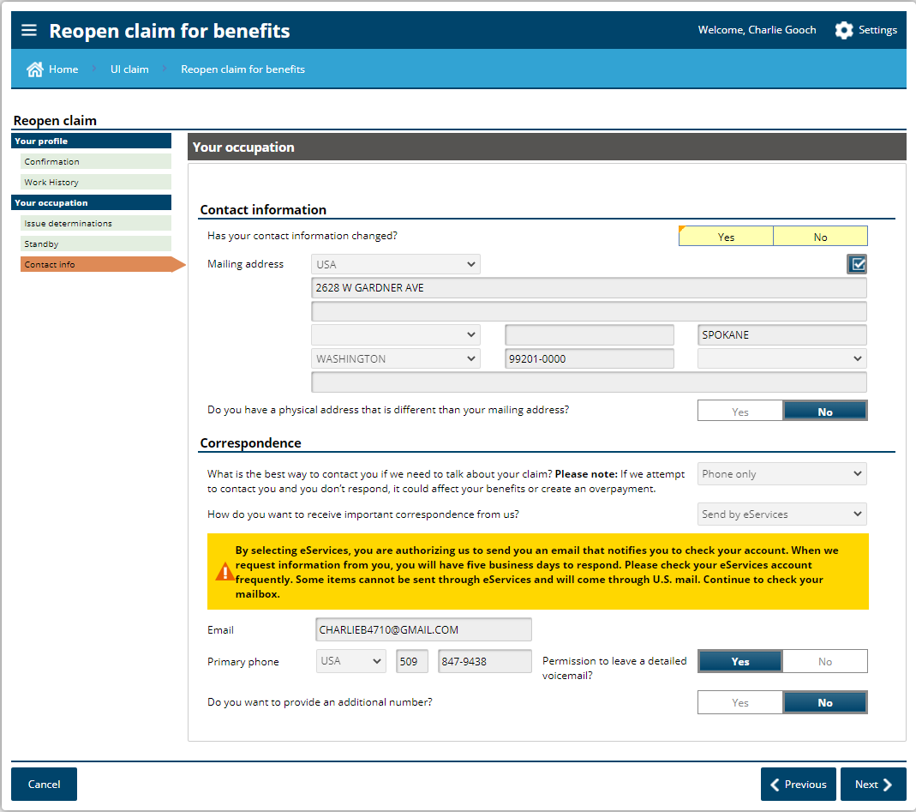

Slide 20
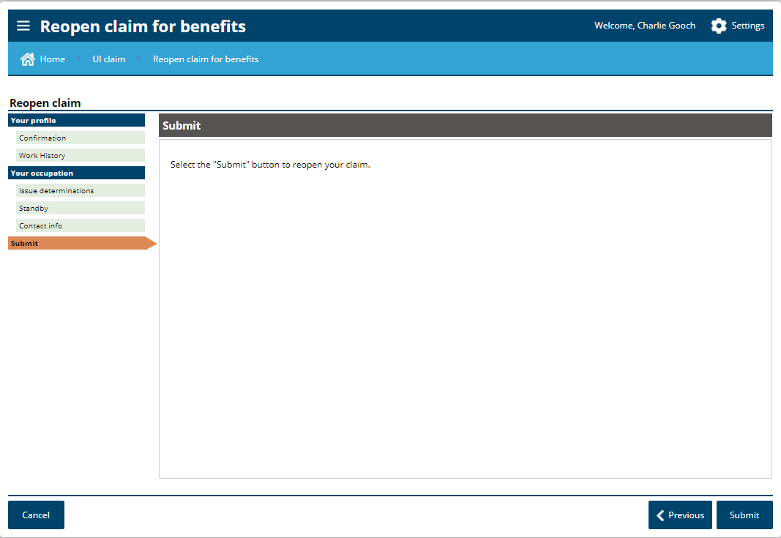

Slide 21
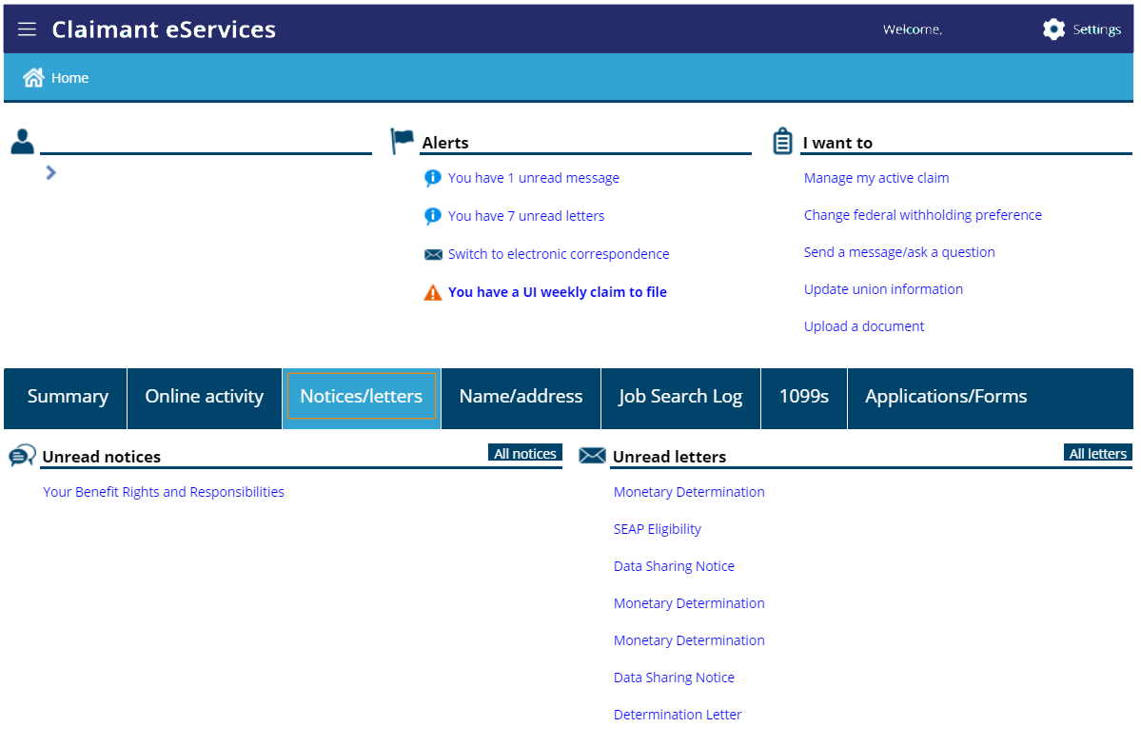

Slide 22
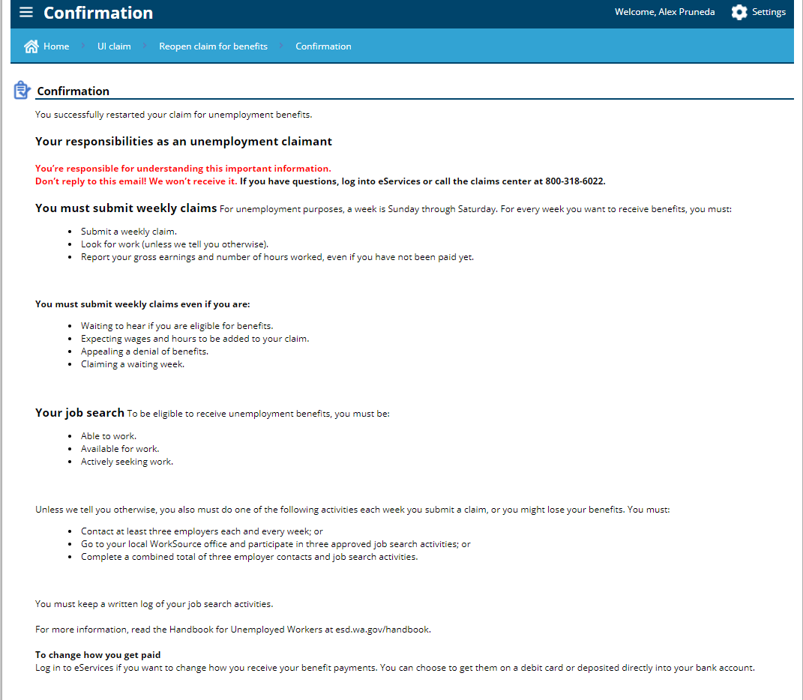

Slide 23
At this point, you have successfully reopened your current claim. Next, we will cover just a couple more slides to keep you on the right path.

Slide 24
If needed later, here are some areas that might be of interest

Slide 25
When do I file my weekly claim?
Preferably every Sunday, for the previous week that you want to receive benefits. For example, if you restart your claim anytime during the week of 1/17, you will submit your weekly claim on 1/24 or anytime during that week. This methodology will continue for future weeks as well.
If you backdated your claim, you will need to submit a weekly claim for each of those weeks.
restart claim
Submit your weekly claim during this time

Slide 26
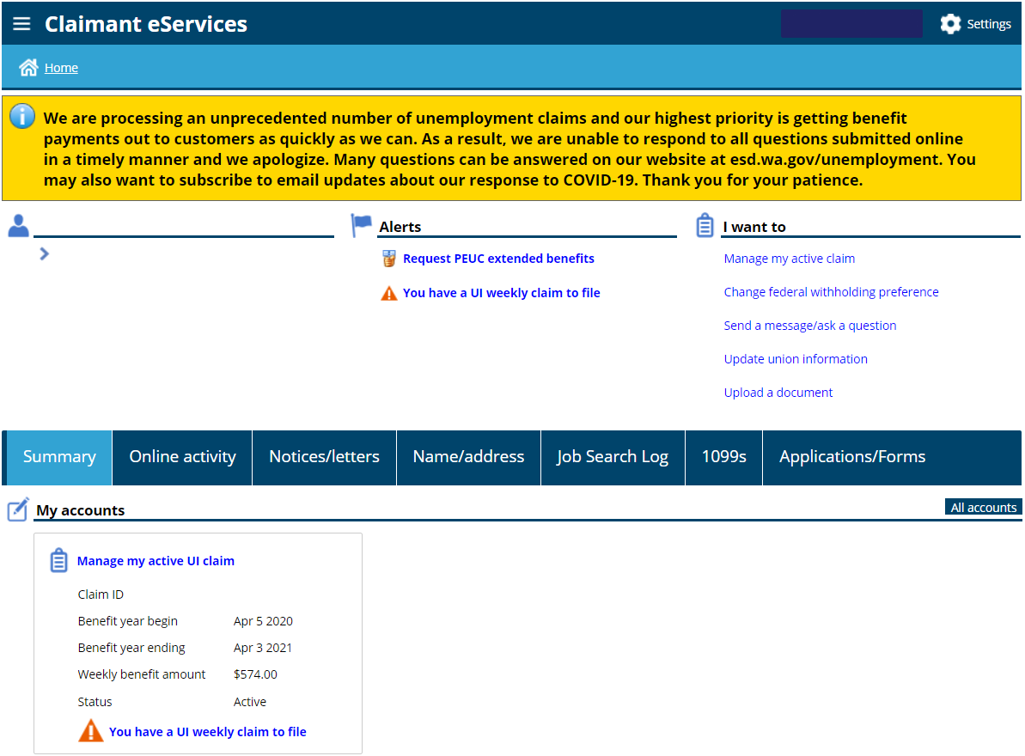
You can use either link to file your weekly claim.
It will appear every Sunday.

Slide 27
Unemployment Information
Work search is optional until further notice. Watch esd.wa.gov and look for alerts in your eServices account to find out if this will change.
When you return to full time work, just stop submitting your weekly claims. There is no need to call us or tell us that you have returned to work.
When restarting a claim, your weekly amount will remain the same as it was previously.

Slide 28
More Unemployment Information
When restarting a claim, and you have new employment since you last claimed, the start and end dates of employment should be the period of time for your most recent work period.
You can still receive unemployment if you work part time or if your employer is paying you sick pay, holiday pay, vacation pay, or personal time off. You just need to report the hours and earnings for each week that you do the work or that the pay is attributable to.

Slide 29
More Unemployment Information
If you are nearing the end of your regular benefits, you should look for a link to apply for Pandemic Emergency Unemployment Compensation (PEUC).
If you are nearing the end of your PEUC benefits, you should look for a link to apply for Extended Benefits.
When restarting your claim, we encourage you to review your eServices account for any updated information. Pay particular attention to the tabs titled “Decision Status”, “Pending Issues”, and “Notices/Letters”.

Slide 30
More Unemployment Information
You should check your eServices account at least once every 5 days. If we send you a questionnaire in your eServices account that needs to be completed and returned, you will only have it available for 5 days.
If you don’t see and respond to a request for information it is likely that you will receive a disqualification notice, and possibly an overpayment notice. You can get more information about the disqualification and overpayment in either the “Decision Status” tab or the “Notices/Letters” tab.

Slide 31
Federal Pandemic Unemployment Compensation
We are now paying the additional $300 per week
No application is necessary
Payable as long as you are eligible for at least $1 in benefits
Payable to those that are receiving regular, Pandemic Emergency Unemployment Compensation, Extended Benefits, and Pandemic Unemployment Assistance.
This $300 is in addition to your regular benefits
Available until March 13, 2021

Slide 32
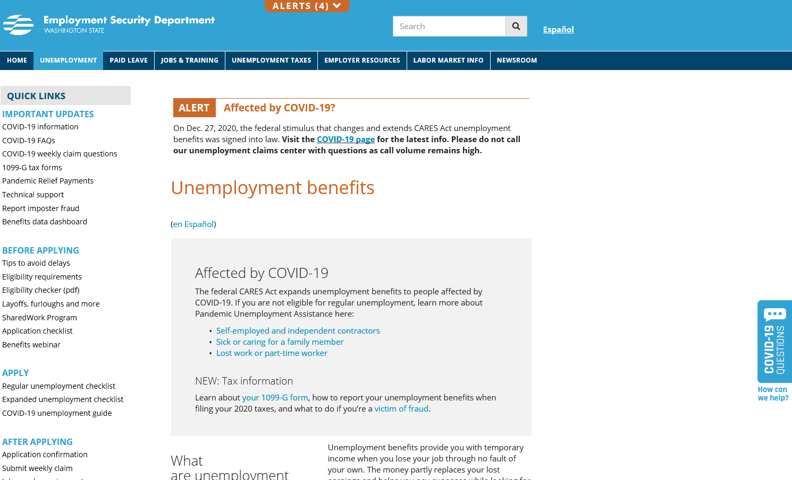
Scroll down for additional links and information

Slide 33
Resources to Help!
For everything – www.esd.wa.gov
This includes COVID-19, as it relates to programs and services provided by the Employment Security Department
Online webinars – https://esd.wa.gov/uiwebinars
eServices Account Support – 855-682-0785
Unemployment Insurance Claims – 800-318-6022
Identity issues – 800-246-9763
Reemployment and Retraining Services –
www.WorkSourceWA.com

