Slide 1
Unemployment Insurance
How to file your weekly unemployment claim

Slide 2
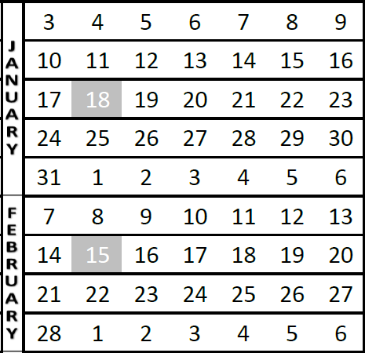
When do you file your weekly claim -
Preferably every Sunday for each previous week that you want to receive benefits. For example, if you want to claim for the week of January 17-23, you will submit your weekly claim on January 24 or anytime during that week.
You will then need to submit your weekly claim every week, for the previous week.
You will submit your weekly claim after the week is over.
You can submit your weekly claim using eServices or by calling 800-318-6022.
Week to claim
Submit your weekly claim during this time

Slide 3
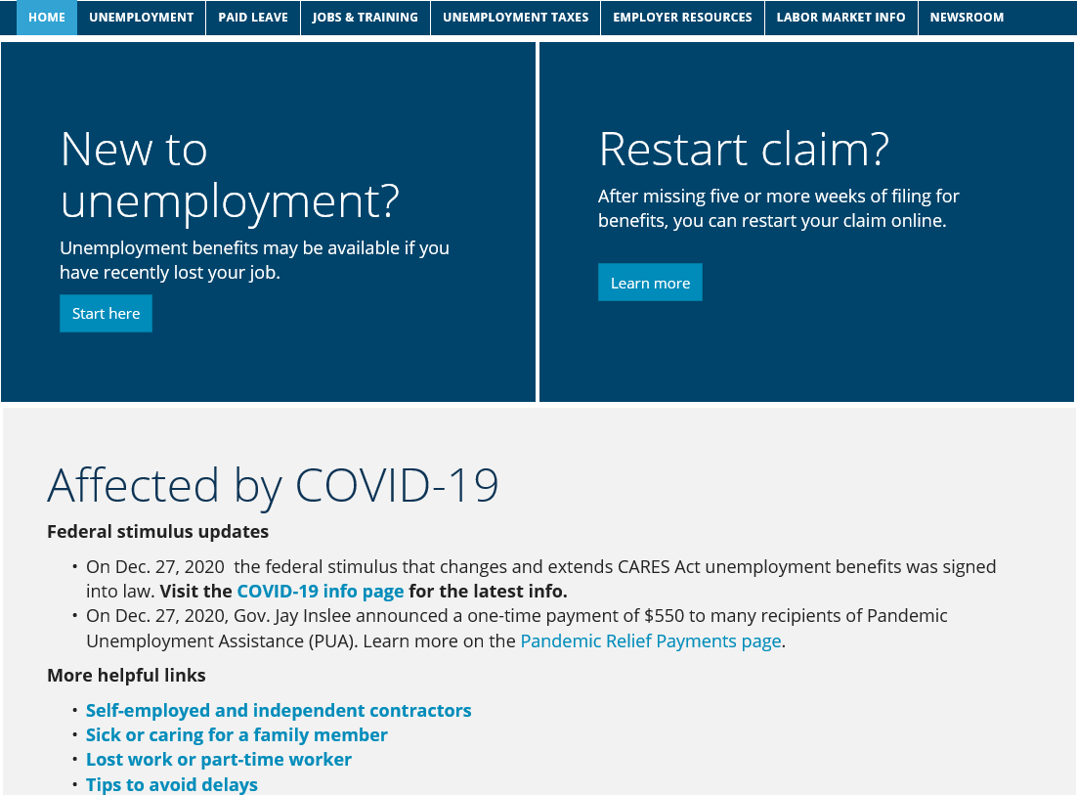
ESD.WA.GOV
Scroll down on this page to log in to eServices.

Slide 4
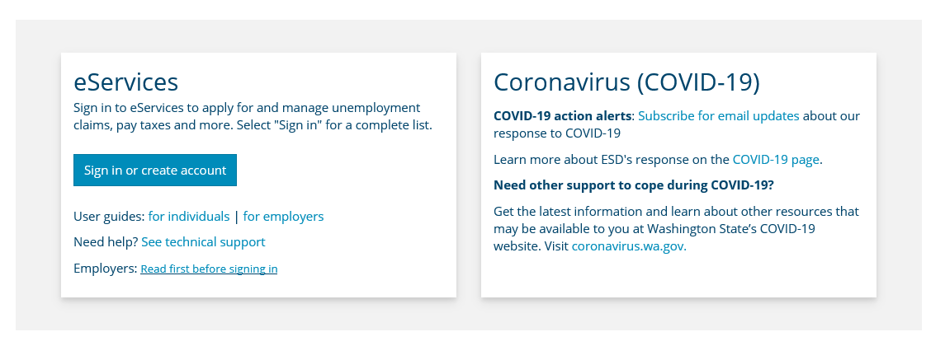

Slide 5
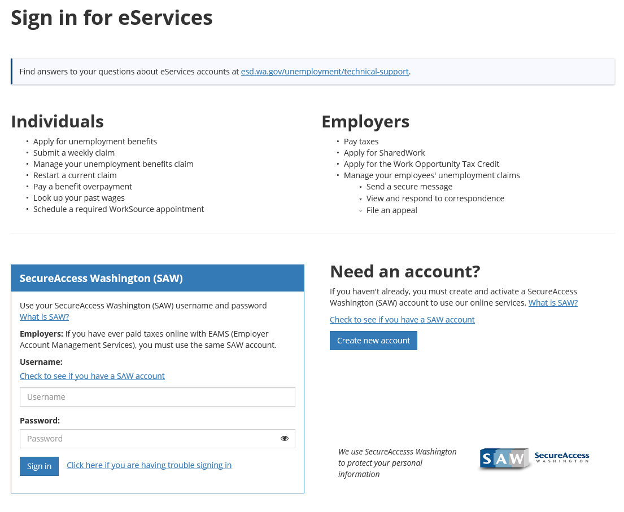
Type your Username and Password and click Sign in

Slide 6
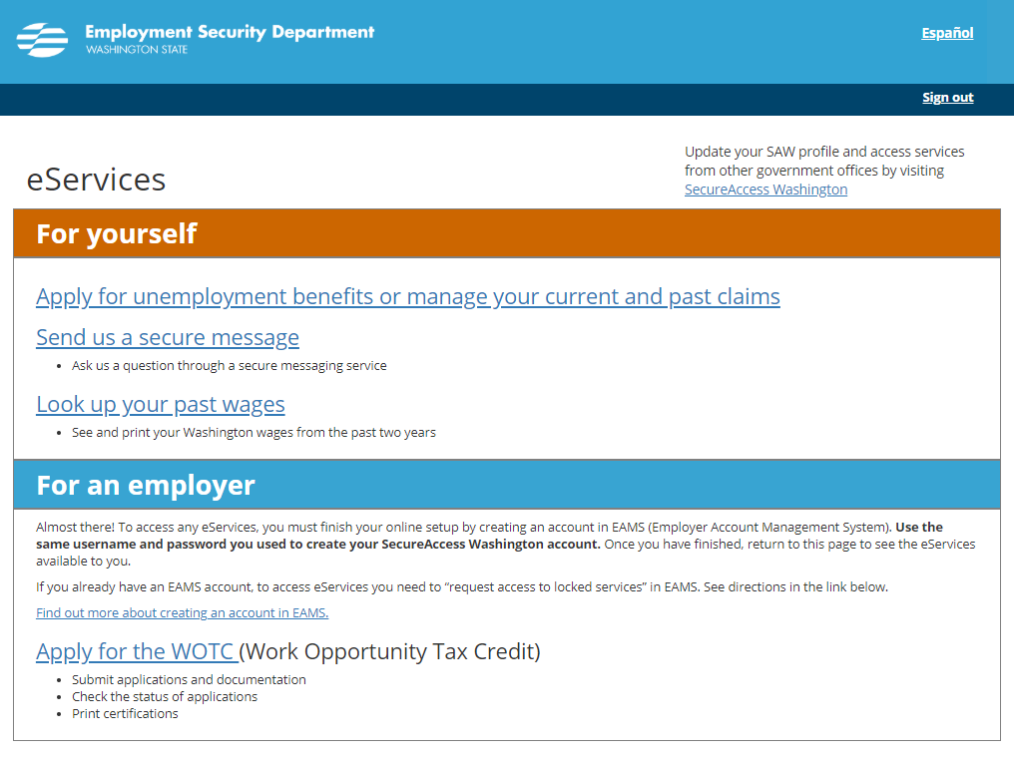

Slide 7
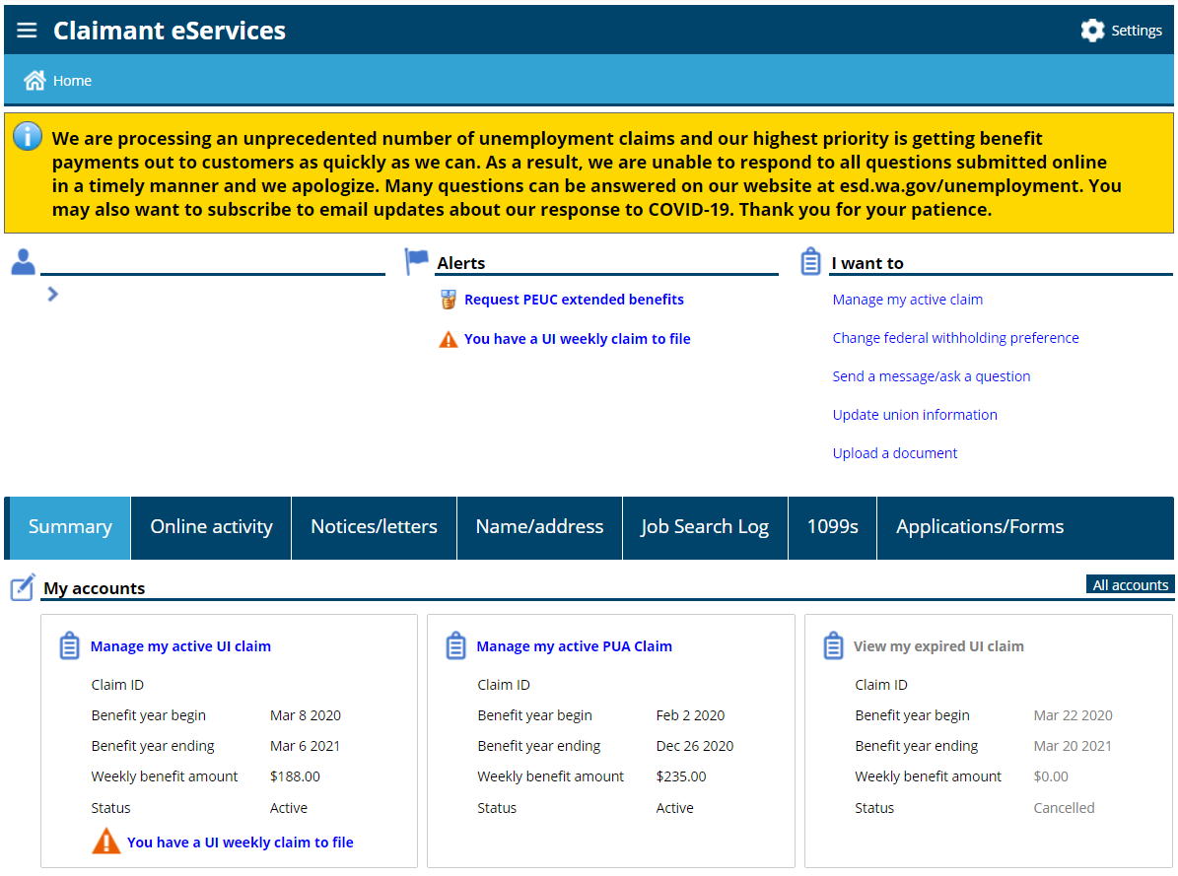

Slide 8
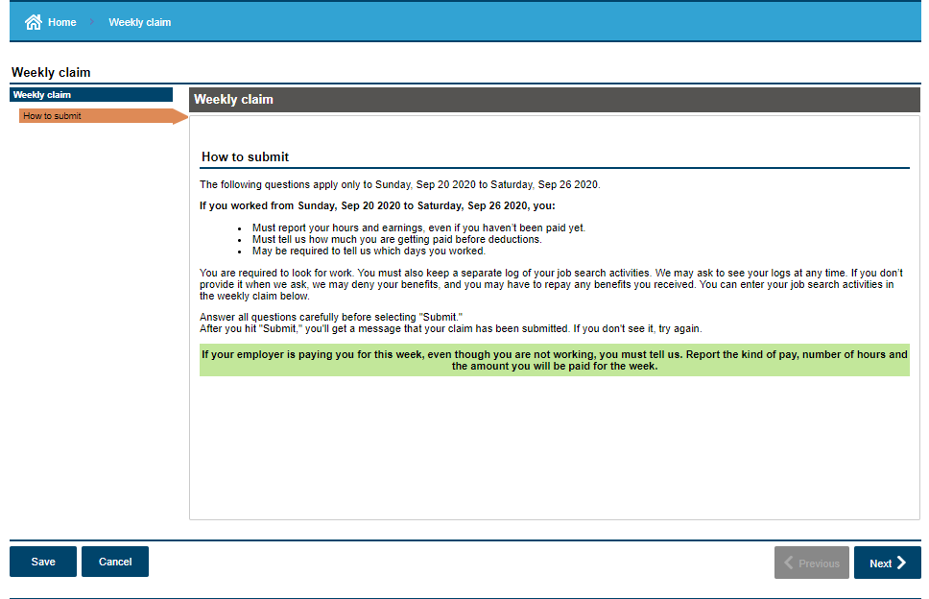

Slide 9
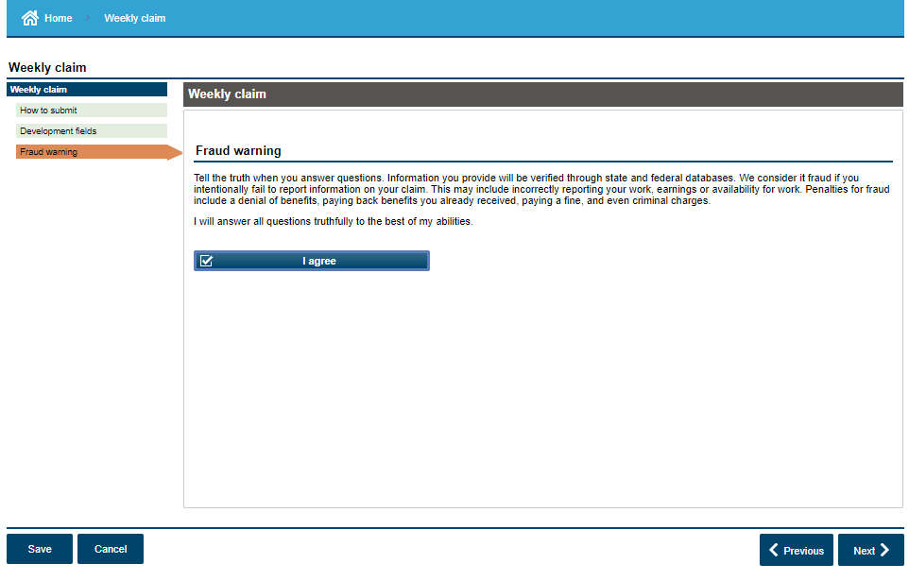

Slide 10
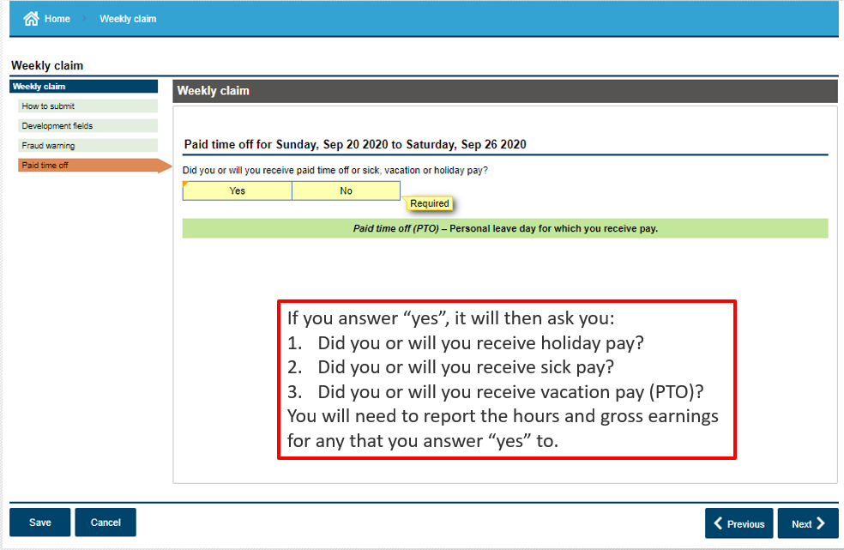

Slide 11
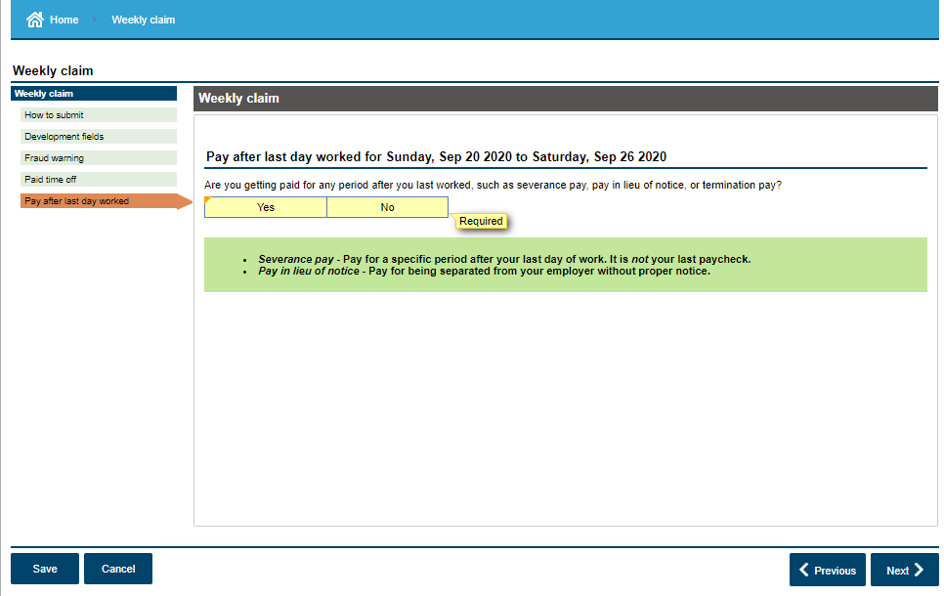
If you answer “yes”, you will be asked:
Is there a contract that requires your employer or union to make these payments?
Is your employer paying you through a notice period?
Has your employer attached any stipulations to the pay, such as having to remain available for work for any period of time after your last day worked?
Would these payments stop if you accepted new employment before the payment period ends?

Slide 12
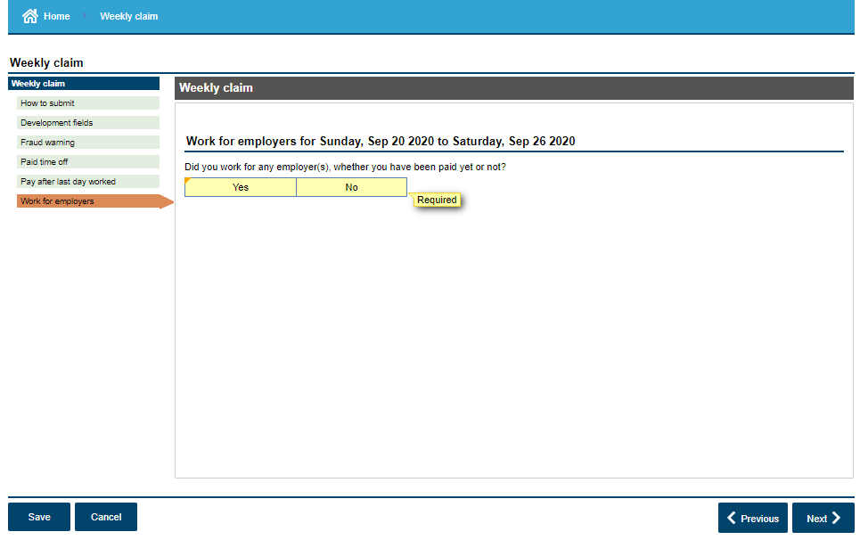
If you answer “yes”, the next three slides will present.

Slide 13
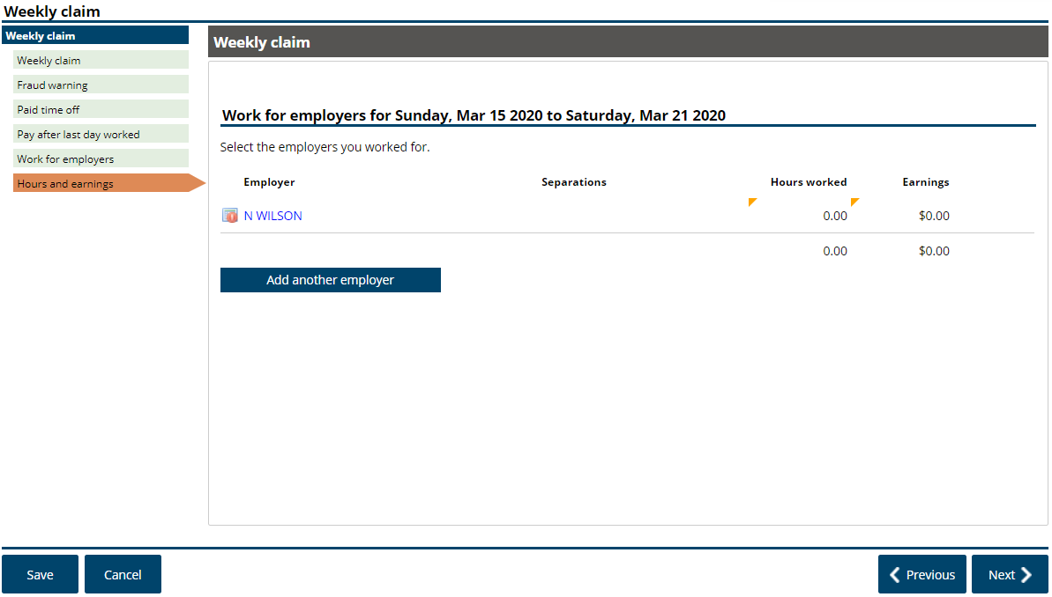

Slide 14
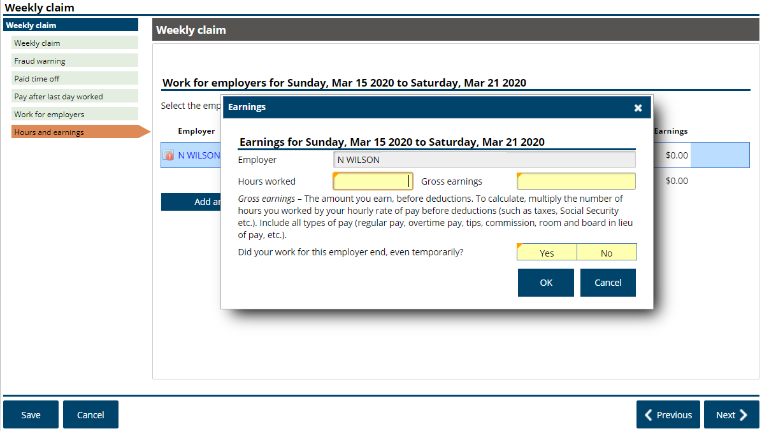
If you answer this “no”, you will be expected to continue to report hours/earnings the next week
Normally you can just multiply your hours with your hourly rate of pay to get your gross earnings.

Slide 15
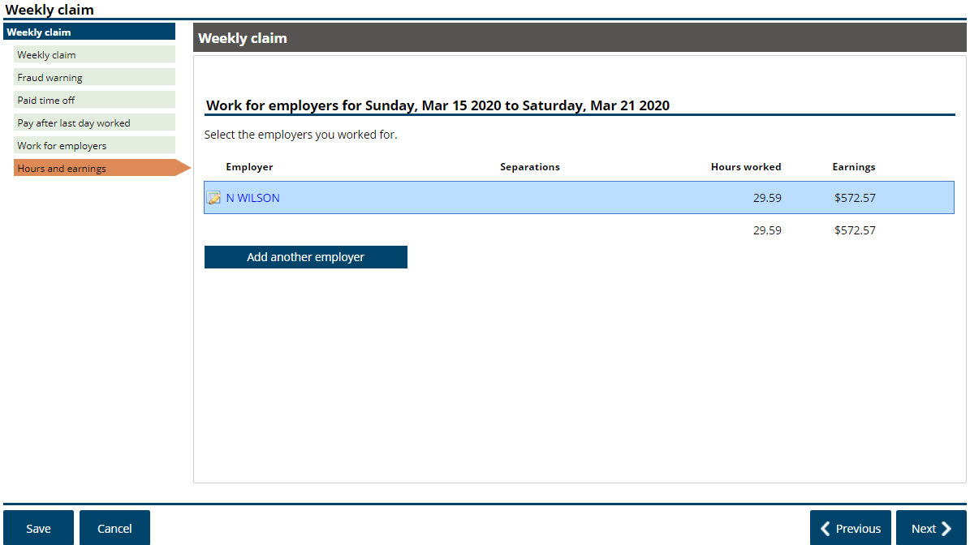

Slide 16
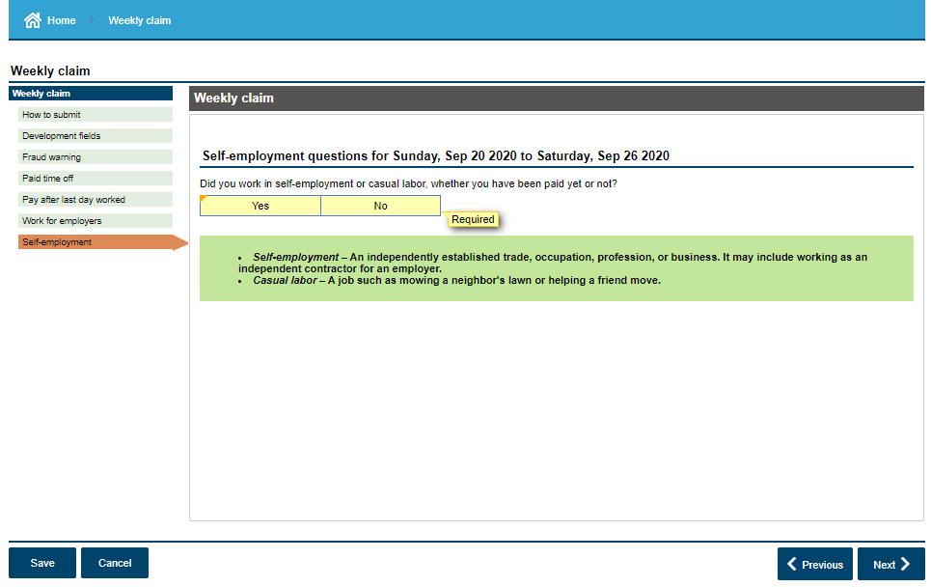
If you answer “yes”, you will be asked:
Was this casual labor, such as mowing a neighbor’s lawn or helping a friend move?
You will need to provide”
Total hours worked
Your net profit (gross income minus reasonable business expenses)

Slide 17
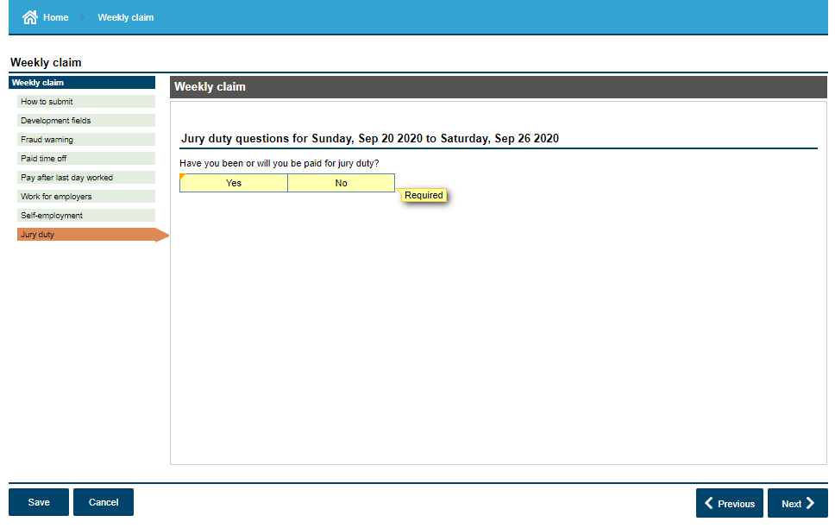
If you answer “yes”, you will be asked to:
Enter the total reimbursement amount, excluding out-of-pocket expenses.

Slide 18
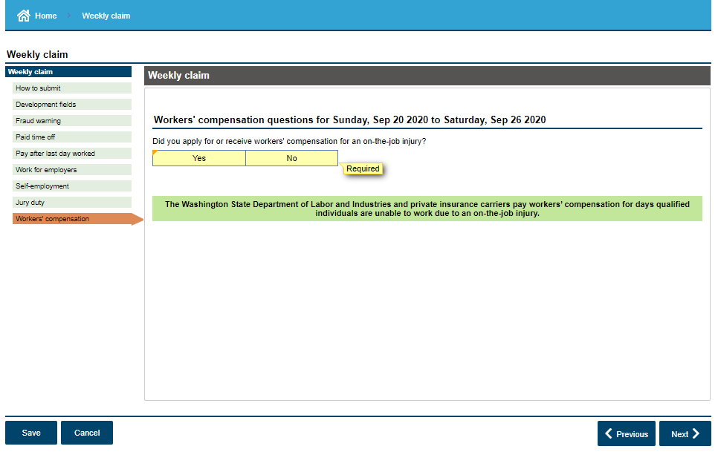
If you answer “yes”, you will receive a fact finding questionnaire or an “alert” after the weekly claim has been submitted. You will need to complete that questionnaire. A decision will be made after the fact finding is conducted to either allow you benefits for the week or you could receive a denial, which may result in an overpayment.

Slide 19
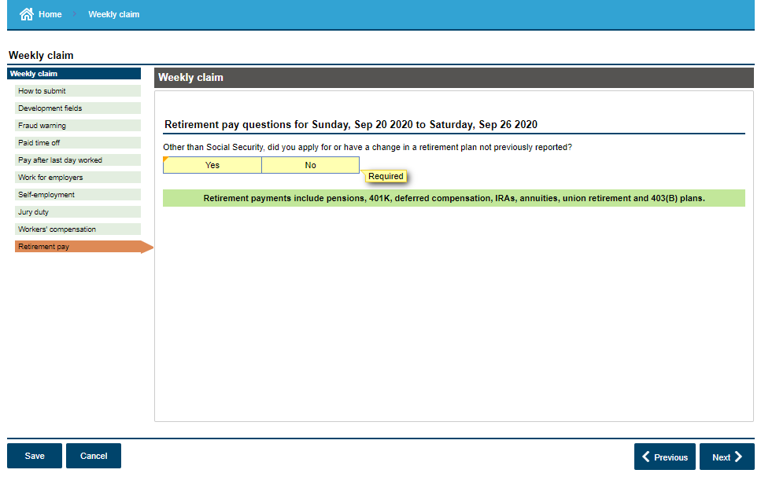
If you answer “yes”, the next two slides will present.

Slide 20
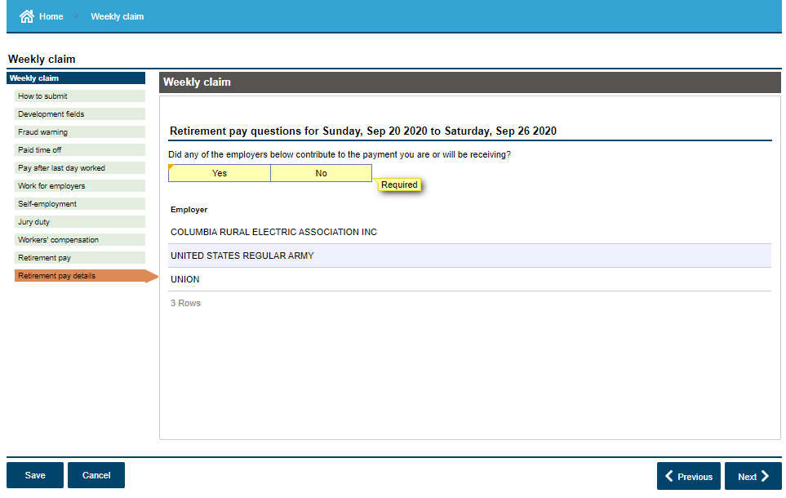

Slide 21
Possible follow up questions regarding retirement pay

Slide 22
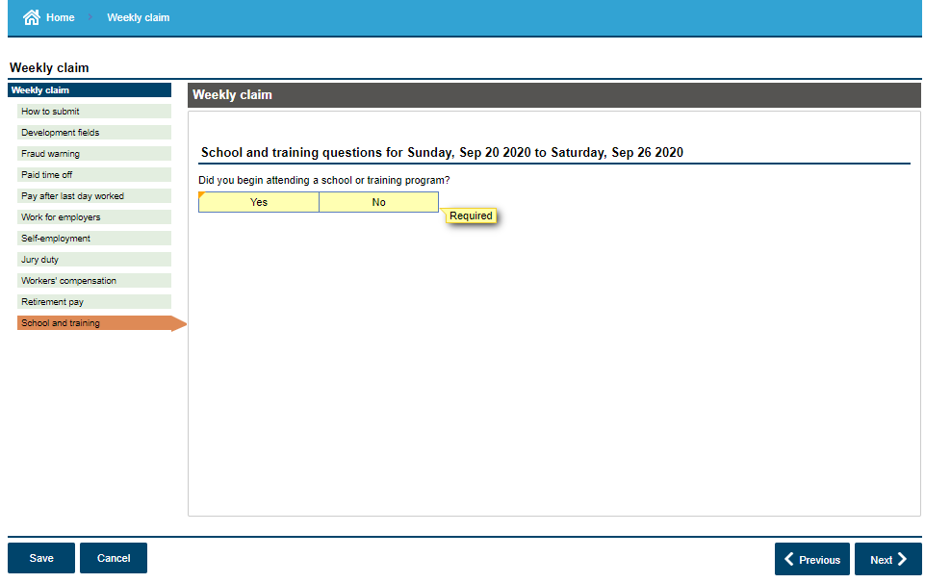
If you answer “yes”, you will receive a fact finding questionnaire or an “alert” after the weekly claim has been submitted. You will need to complete that questionnaire. A decision will be made after the fact finding is conducted to either allow you benefits for the week or you could receive a denial, which may result in an overpayment.

Slide 23
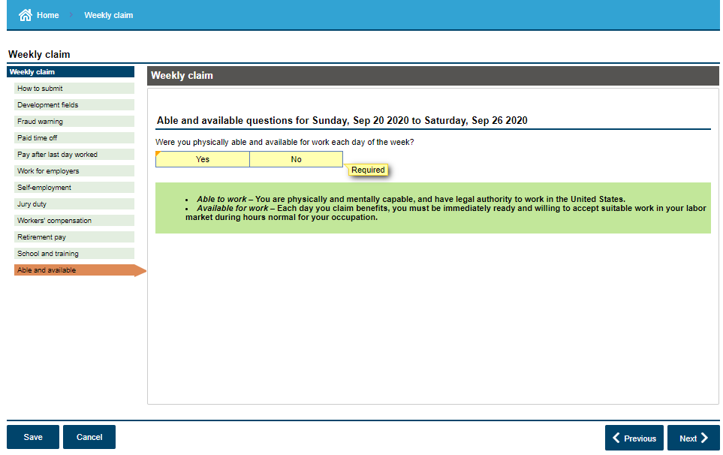
Being able and available means that you can go to work if called, if your employer had employment for you, and that there are no personal barriers to you returning to work.
If you answer “no”, you will receive a fact finding questionnaire or an “alert” after the weekly claim has been submitted. You will need to complete that questionnaire. A decision will be made after the fact finding is conducted to either allow you benefits for the week or you could receive a denial, which may result in an overpayment.

Slide 24
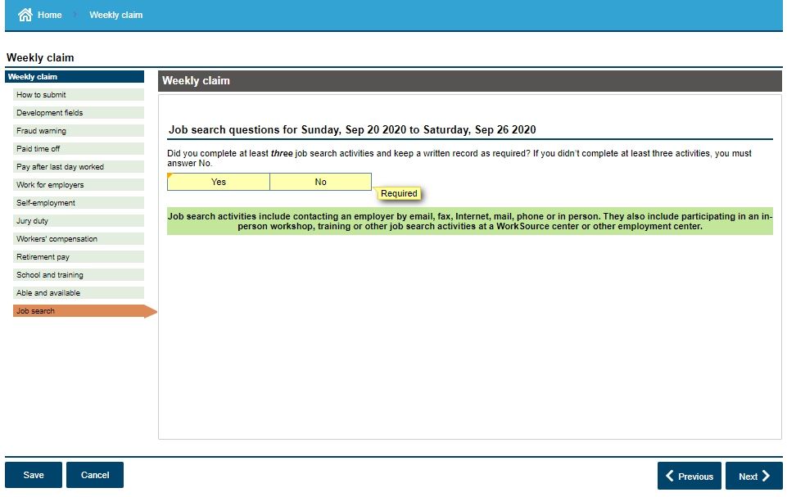
If you answer “yes”, the next three slides will present.
If you answer “no”, that is ok. Currently job searches are optional until after COVID or when legislation is changed.

Slide 25
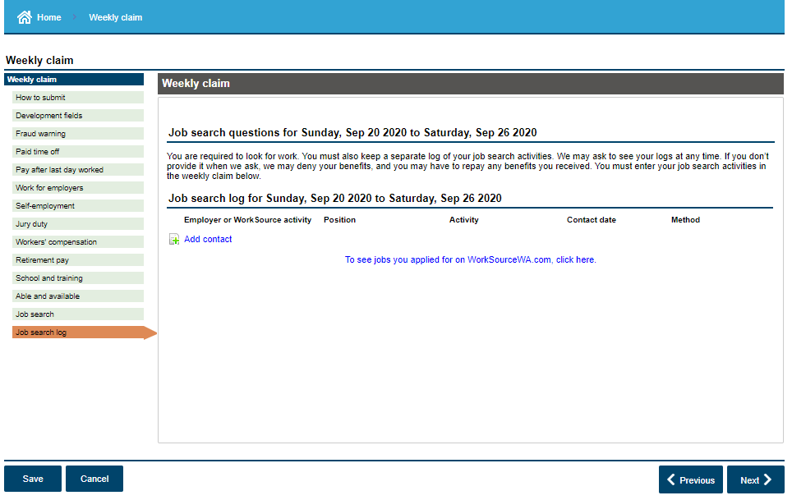

Slide 26
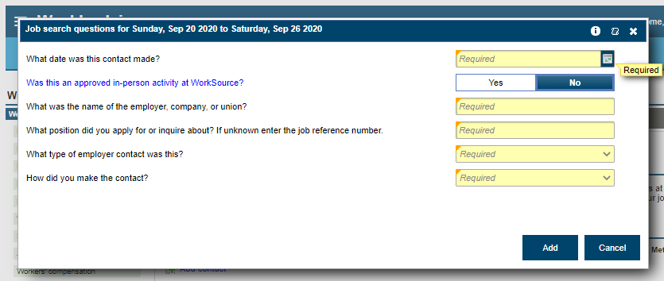

Slide 27
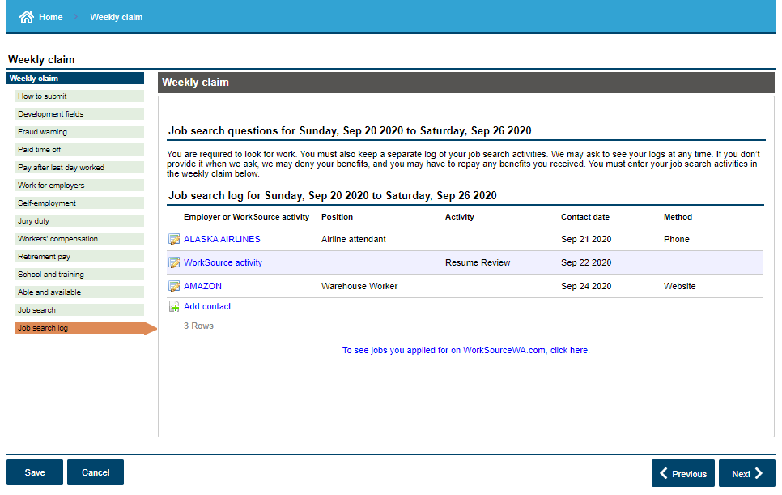

Slide 28
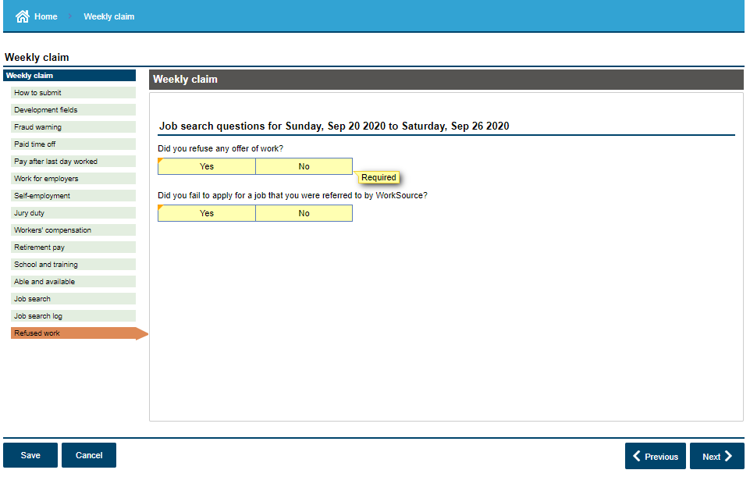
If you answer “yes” to either of these, you will receive a fact finding questionnaire or an “alert” after the weekly claim has been submitted. You will need to complete that questionnaire. A decision will be made after the fact finding is conducted to either allow you benefits for the week or you could receive a denial, which may result in an overpayment.

Slide 29
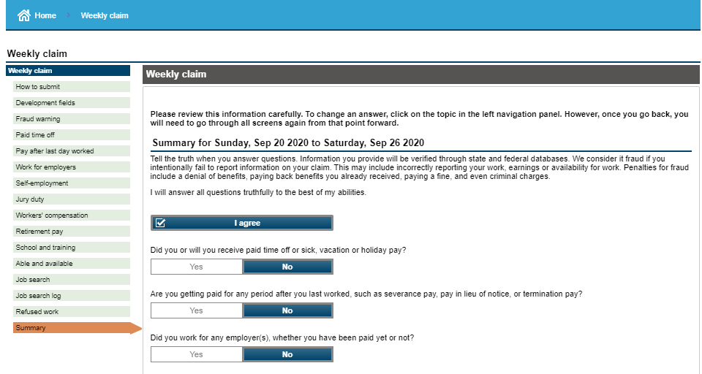
~~~~~~~~~~~~~~~~~~~~~~~~~~~~~~~~~~~~~~~~~~~~~~~~~~~~~~

Slide 30
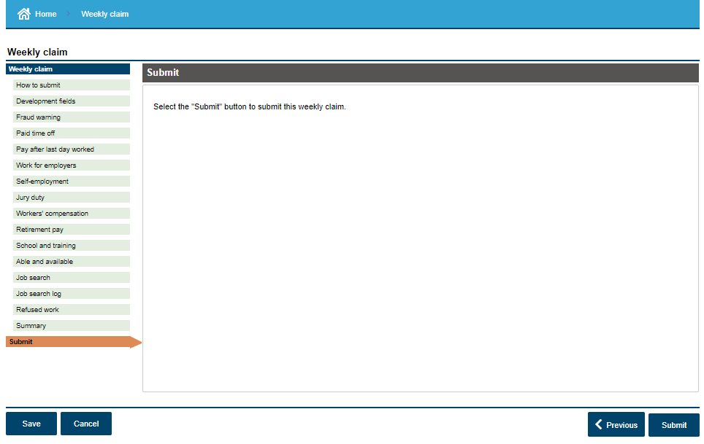

Slide 31
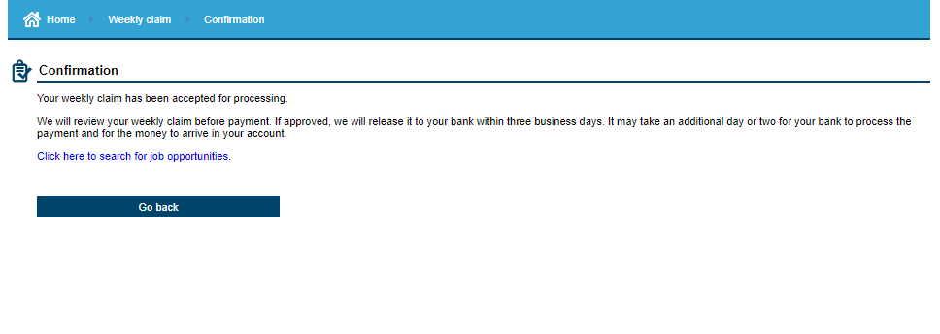

Slide 32
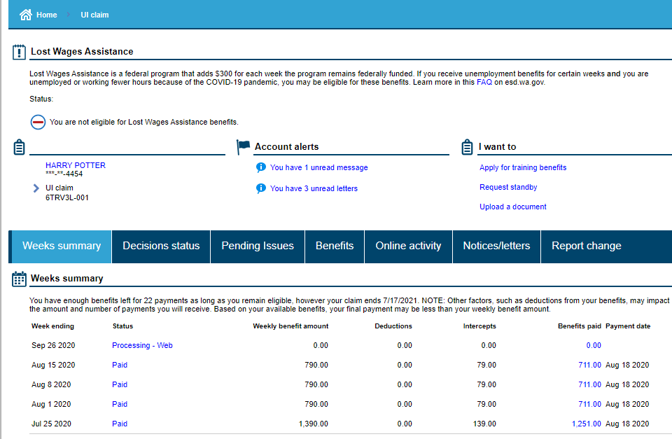

Slide 33
If payment status is “Pending”, your claim is being reviewed for eligibility, check the Pending Issues tab for information.

Slide 34
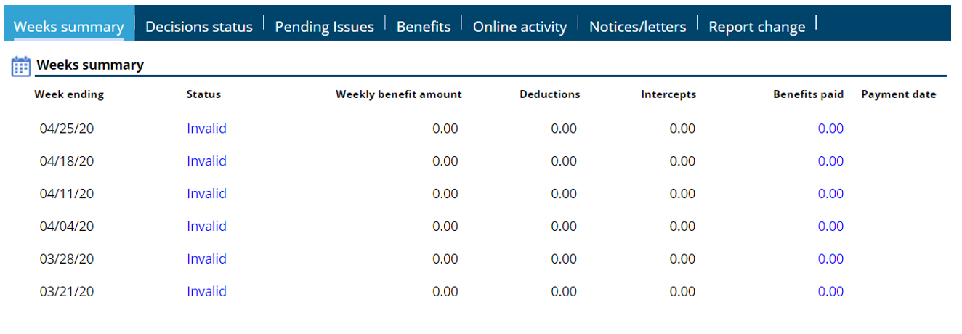
If payment status is “Invalid”, it means you are not monetary eligible. You may want to apply for the Pandemic Unemployment Assistance (PUA) program

Slide 35
If payment status is “Excess Earnings”, this means you have earned to much money to be eligible for unemployment benefits for that week.

Slide 36
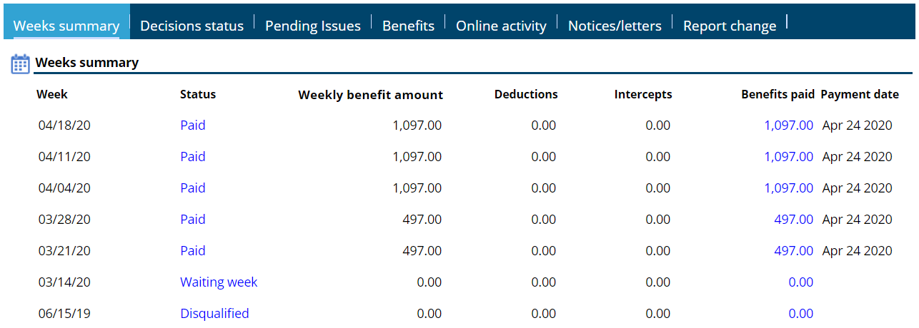
If payment status is “Disqualified”, check Decisions Status tab to find out for what reason.
Click on Benefits paid for addition details

Slide 37
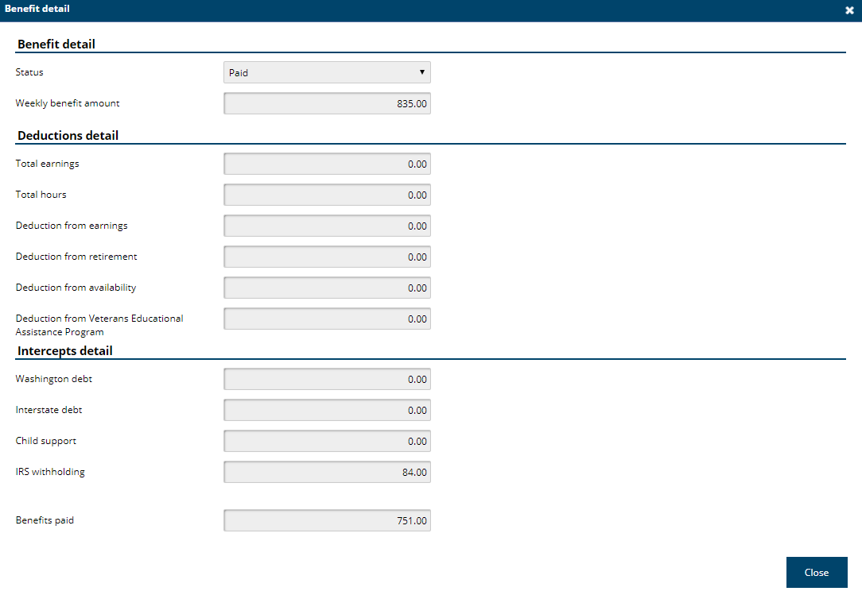
Click on Benefits Paid to view details

Slide 38
Unemployment Information
If you filed a claim with a start date of January 3, 2021 or later, the first eligible week of your claim is considered a waiting week and you will not receive benefits for that week.
A waiting week is kind of like an insurance deductible of time. You don’t loose any money, but you won’t start receiving benefits until the second eligible week.
When you return to full time work, just stop submitting your weekly claims. There is no need to call us or tell us that you have returned to work.

Slide 39
Unemployment Information
Work search is optional until further notice. Watch esd.wa.gov and look for alerts in your eServices account. We will update both when this changes.
You can still receive unemployment if you work part time or if your employer is paying you sick pay, holiday pay, vacation pay, or personal time off. You just need to report the hours and earnings for each week that you do the work or that the pay is attributable to.
The amount of your unemployment claim is based on the “base year” for when you filed your claim.
For claims starting after Jan 3, 2021, it will be Oct 2019 through Sept 2020.

Slide 40
Unemployment Information
If your claim shows “invalid” or “ineligible” it could be because:
Some of your employers are missing. Make sure you inform us of that.
You only had self employment/independent contractor work, or you did not have enough work hours. You should apply for the Pandemic Unemployment Assistance (PUA) program.
If your hours and earnings reported by your employer are not correct, please let us know. We will ask for documentation and then we will get it corrected.

Slide 41
Unemployment Information
You should check your eServices account at least once every 5 days. If we send you a questionnaire in your eServices account that needs to be completed and returned, you will only have it available for 5 days.
If you don’t see and respond to a request for information it is likely that you will receive a disqualification notice, and possibly an overpayment notice. You can get more information about the disqualification and overpayment in either the “Decision Status” tab or the “Notices/Letters” tab.

Slide 42
Federal Pandemic Unemployment Compensation
We are now paying the additional $300 per week
No application is necessary
Payable as long as you are eligible for at least $1 in benefits
Payable to those that are receiving regular, Pandemic Emergency Unemployment Compensation, Extended Benefits, and Pandemic Unemployment Assistance.
This $300 is in addition to your regular benefits
Available until March 13, 2021

Slide 43
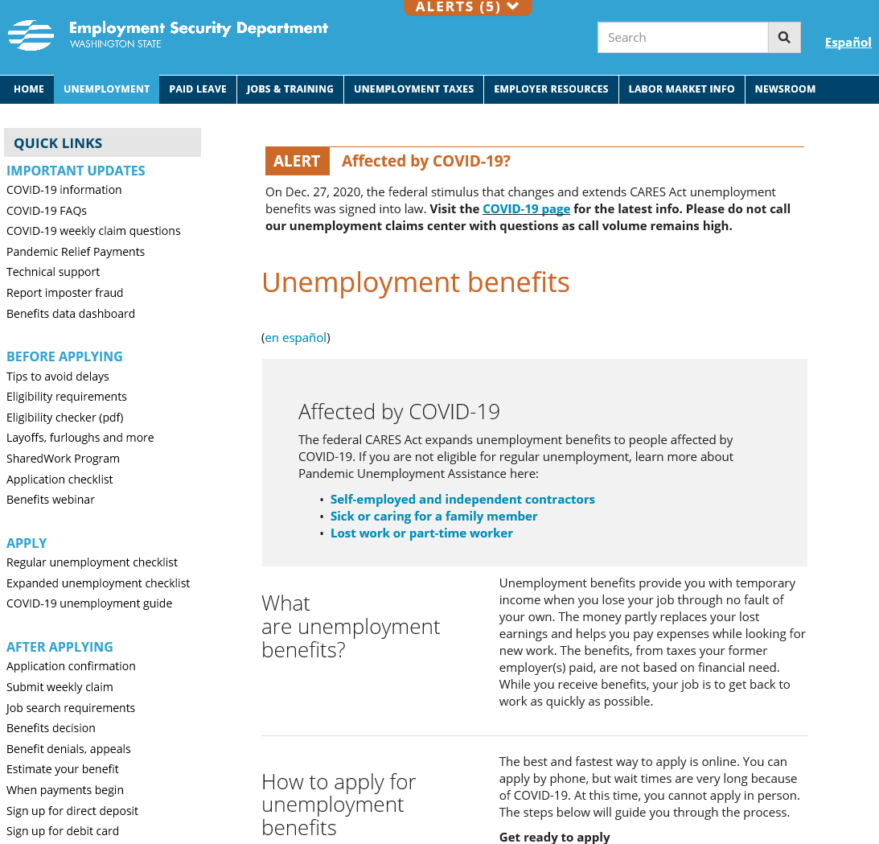
Scroll down for additional links and information

Slide 44
Resources to Help!
For everything – www.esd.wa.gov
This includes COVID-19, as it relates to programs and services provided by the Employment Security Department
Online webinars – https://esd.wa.gov/uiwebinars
Appropriate phone lines are:
eServices (SAW) Account Support – 855-682-0785
Unemployment Insurance Claims – 800-318-6022
Identity issues – 800-246-9763
UI Fraud - esd.wa.gov/unemployment/unemployment-benefits-fraud
Reemployment and Retraining Services –
www.WorkSourceWA.com

