Slide 1
For state employees filing their unemployment claims: To participate in SharedWork

Slide 2
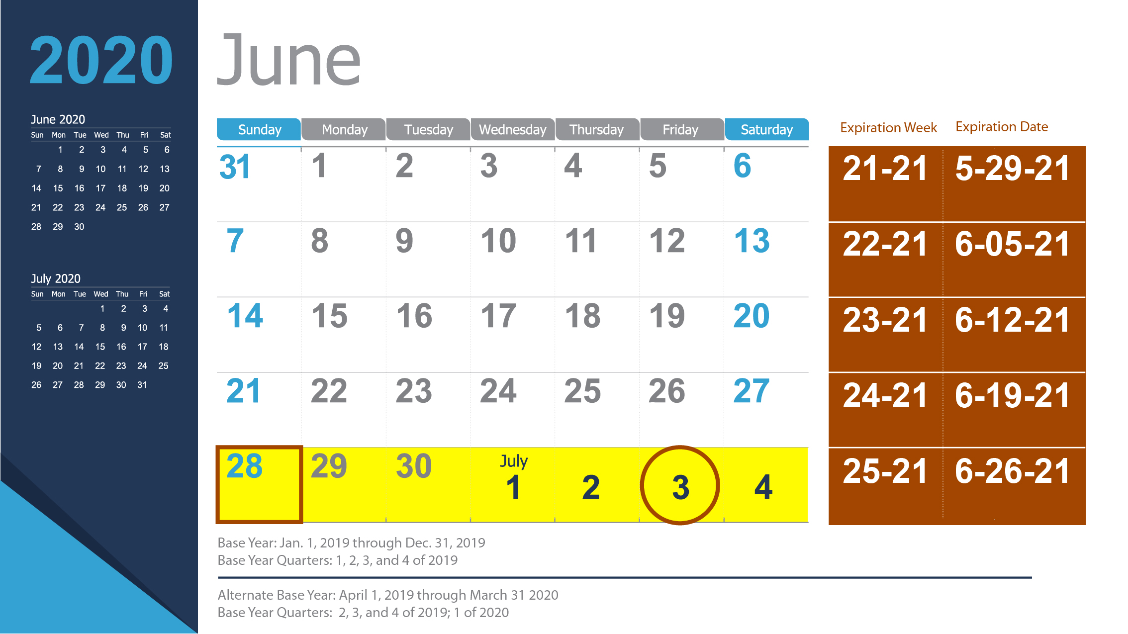
When do I apply for benefits?
If your first furlough day is during the week beginning June 28, you can apply for benefits as early as Sunday, June 28. You will NOT have a waiting week as long as you file before midnight, July 4.

Slide 3
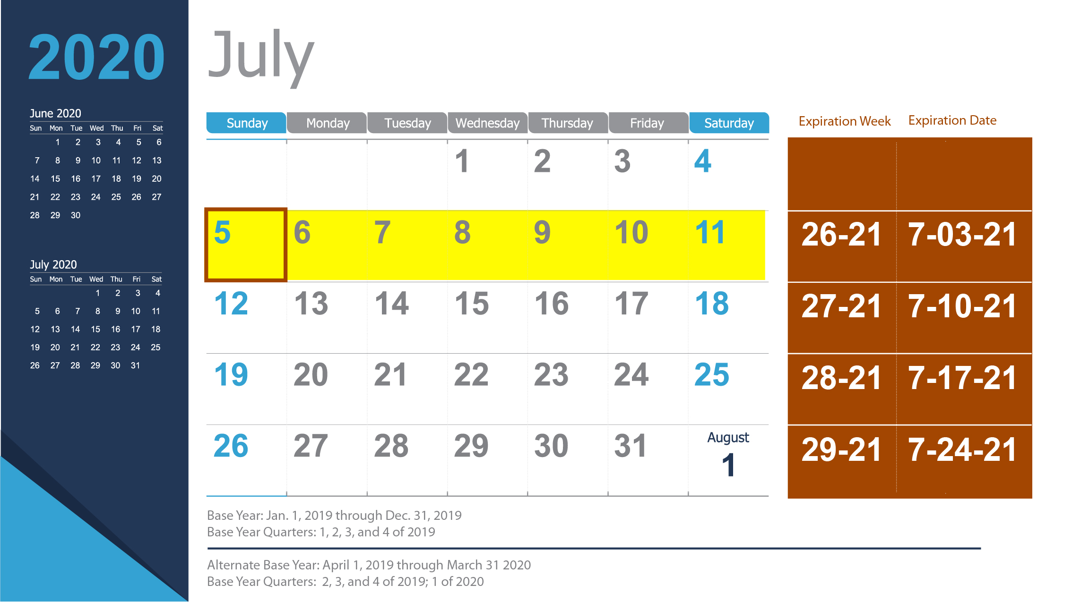
When do I submit my first weekly claim?
You can submit your first weekly claim as early as Sunday, July 5, or anytime that week through midnight Saturday, July 11.

