Slide 1
CONNECTING THE DOTS: Metrics that Matter
Suzi LeVine
Commissioner, Washington State Employment Security Department
@ESDCommish
Notes:
Good morning fellow fans of numbers and spreadsheets!
I so appreciate your being here today to discuss how we connect the dots across our state and unpack the metrics that matter.

Slide 2
THANK YOU!
ESD Partners
Notes:
Before we dive in, though, I want to take a moment to thank the key folks who have made today happen.
First, our core partners for the event
- Washington Workforce Association
- Workforce Training and Education Coordinating Board
- Washington's Forecast Council

Slide 3
THANK YOU!
Sponsors
Notes:
In addition to our partners, I would like to thank and recognize our Sponsors
- CATCH Intelligence
- Geographic Solutions
- Monster
Washington College Savings Plans (WA 529)
Office Depot/Office Max
I also would like to thank Dave McFadden for the Port of Seattle’s tremendous support for this event. We’re thrilled and grateful to spend today in the Port’s beautiful conference center.
And finally… today really wouldn’t be possible without the staff who dedicated so much of their creativity and time to bringing it to fruition.
- Steven Ross
- Robert Haglund
- Carmen Serrano
-Anneliese Vance-Sherman
-Doug Tweedy
-Bretta Beveridge
And our regional economists – who I’d like to ask to please stand.

Slide 4
State & Regional Economists
Notes:
During the breaks, please visit the exhibit tables to meet all these folks

Slide 5
Notes:
I’m now in my 9th month on the job and during that time, I traveled all over Washington state to see our jobs and career infrastructure and to listen to those who make it happen.
I saw up close and personal how diverse our economy and our state is. We have industries thriving here, doing everything from cloud services to hops production, from ship-building to milk-frothing, and from selling real estate to producing carbon fiber – with many industries in between.
We have very wet areas of our state and we have very dry areas. And we have regions that are sprawling and some that are getting more and more compressed.

Slide 6
Notes:
But even in our diversity, key factors connect us.
Each of those industries, especially right now, is trying to fill its talent pipeline.
Each of those regions is looking for ways to embrace innovation and the wave of oncoming automation and artificial intelligence.
And each region is wrestling with societal issues, including the rise in mental and behavioral health challenges, opioid addiction, homelessness, housing affordability, and intergenerational poverty.
When we come together as a state, that’s when we can tackle these issues more effectively and efficiently.

Slide 7
“You can’t manage what you don’t measure”
- Peter Drucker
Notes:
Now – we’re at an Economic Symposium. So some of you may be wondering “Where are the Numbers!?”
Here’s where the numbers and spreadsheets come in. If we –
and when I use the term “we” I am referring to us as a collective partnership and not just ESD, because WE have a shared interest, and that is why WE are in this room today and have the ability to accomplish so much more in partnership than as individual entities
If we want to show how we’re progressing, how we’re tackling problems, how we’re knocking it out of the park, or where we’re failing and need to apply resources – we must use metrics.
As Peter Drucker famously said, “You can’t manage what you don’t measure.”
That’s what today’s conversation is really about. We’re asking the questions: What are we measuring today? Do our measurements undergird the outcomes we want to drive? Do we want the same outcomes for everyone in these diverse regions? Can we find common metrics? How do we account for variability?
How — as a state — do we know we’re succeeding? And how do we forecast and prepare for the future? For example, many people today look at the unemployment rate as a gauge of our state’s economic well-being. And every month, my awesome team publishes the updated unemployment figures for Washington state.

Slide 8
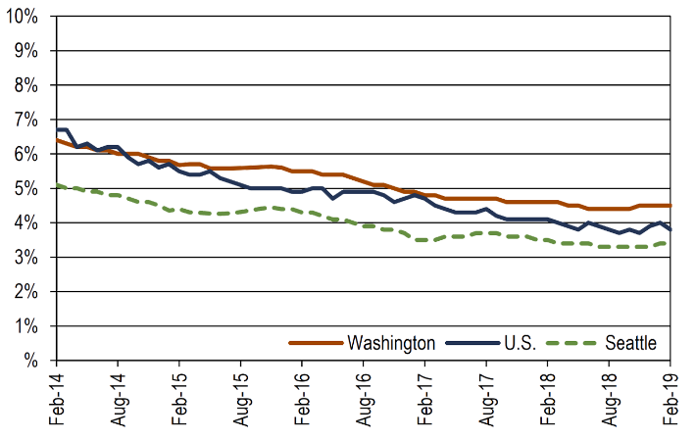
Unemployment rate
4.5%!
Notes:
The past year has seen perhaps the lowest unemployment rate in Washington’s history at a whopping 4.5%! But does it tell the right or the whole story?
Now – I love numbers spreadsheets – give me a pivot table and I’m happy for hours. AND, I also love books – and stories
SO join me for a moment while I invoke a couple of great storytellers to help us challenge the merits of relying on that figure.

Slide 9
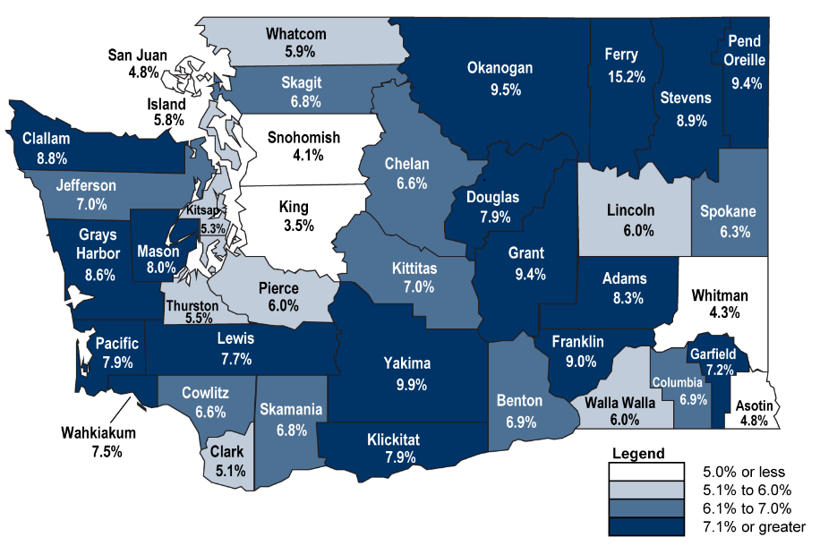
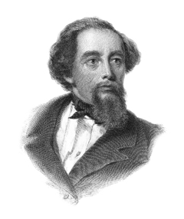
County unemployment rates
(not seasonally adjusted - February 2019)
“It was the best of times, it was the worst of times.”
Notes:
First – I’m going to call on Charles Dickens.
When you look more closely at the county-by-county unemployment figures, you feel like you’ve been dropped into the middle of A Tale of Two Cities. It was the best of times, it was the worst of times.

Slide 10
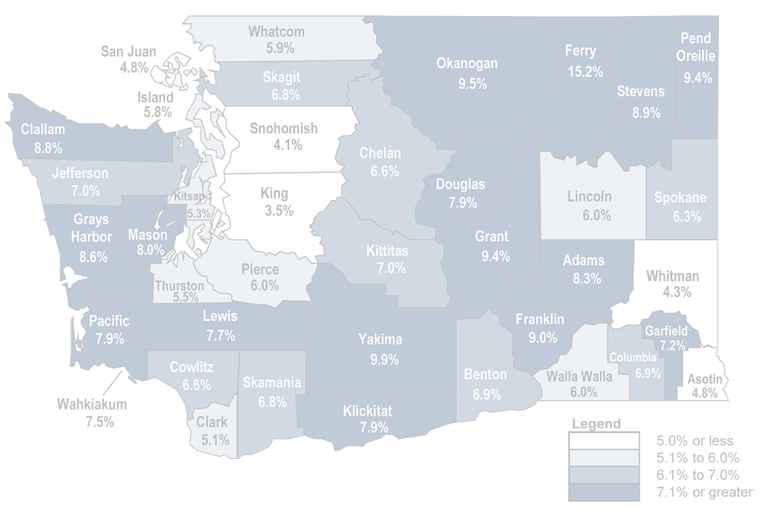
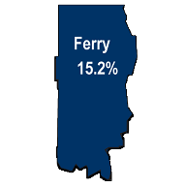
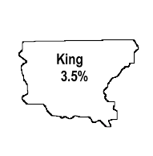
County unemployment rates
(not seasonally adjusted - February 2019)
“It was the best of times, it was the worst of times.”
Notes:
King County at 3.5% but Ferry County at 15.2%

Slide 11
Notes:
OR - look at the fact that revenue collections for the Washington state Near General Fund are projected to increase 10% - or almost $5B from the last biennium from $46.5B in 2017-19 to $51B for the 2019-2021 biennium.
On top of that, Washingtonians’ per capita personal income grew by more than 5% last year!
Awesome, right?

Slide 12
Results WA Economic Security review
26% of
Washingtonians
are underwater*
* This measures the % of Washingtonians who live below 200% of the Federal Poverty Level and are eligible to receive SNAP benefits
Notes:
But then you look at what was recently shared at the Results WA Economic Security review: while the state, on the whole, is doing well, 26% of Washingtonians are under water. They are eligible to receive SNAP benefits and are at 0% of the federal poverty line

Slide 13
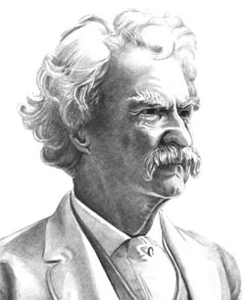
“Take a man and put one of his feet in a bucket of ice and the other foot in a bucket of boiling water; and, on average, he’s comfortable”
Notes:
Now – I invite Mark Twain to join us.
“Take a man and put one of his feet in a bucket of ice and the other foot in a bucket of boiling water; and, on average, he’s comfortable.”
We can’t be lulled into satisfaction by averages.
The unemployment rate is an important indicator, but it doesn’t take equity into account nor does it measure underemployment. Most people who live in poverty in our state have a job – so they are invisible when we use employment as the arbiter of success.
So how do we make sure we are not so satisfied by King County’s 3.5% unemployment rate that we forget about the 26% who are at just 200% of the federal poverty level across the state? OR – how do we also look at that 3.5% figure and recognize that it also means that certainly areas have a dearth of labor? These are the right and important questions we hope to spur today.

Slide 14
VISION:
The nation’s best and most future ready workforce with opportunities for all
Notes:
At ESD, our vision and what will exist when we succeed is:
The nation’s best and most future ready workforce with opportunities for all.

Slide 15
VISION:
The nation’s best and most future ready workforce with opportunities for all
The nation’s best and most future ready workforce with opportunities
for all
Notes:
For ALL, and not just for SOME.
That’s why we have an outstanding team of labor market economists here to collaborate with you, to ask questions with you, to workshop ideas with you, and to measure with you.
We want to make sure everyone has opportunities to succeed; to determine what works and what doesn’t; and to bring our vision to life. In fact, our labor market team is hard at work thinking about how we reconcile unemployment with equity, trying to identify new measures that will more accurately reflect our state’s true economic health!
At the event today, we have people here from all across Washington state who bring very different perspectives and backgrounds to the conversation about the metrics that matter and how we connect the dots across our state.
Today, we want to provoke many questions from you. And when you walk out of here, we want you to know the people and tools available to help you formulate or track the answers.

Slide 16
Today’s agenda
Notes:
Over the course of the day, you’ll be invited to alternately take a wide angle look at Washington, then zoom in for regional perspectives.

Slide 17
Bret Bertolin
Senior Economist
Washington State Economic and Revenue Forecast Council
Notes:
The morning speeches and breakout sessions will give that statewide view, starting off with Bret Bertolin (BURR-tuh-lin) of the state Economic and Revenue Forecast Council ….

Slide 18
Inger Brinck
Executive Director
Results Washington
Notes:
…and Inger Brinck of Results Washington.

Slide 19
Steven Ross
Director, Labor Market Information
Washington State Employment Security Department
Notes:
After lunch, Steven Ross will kick off an afternoon that hones in on Washington’s regional economies, but with particular emphasis on commonalities that connect those local dots.
He will tell you about what other talents we have at our disposal that may redefine how we measure success

Slide 20
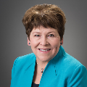
Key Economic Factors Across Geographies and Sectors: How They Affect Us and How We Address Them
Moderator Emory Thomas
Lisa Brown
Vice President, Local Markets American City Business Journal
Director, Washington State Department of Commerce
Cory Hopkins
Jordan Matson
Kim Sullivan
Sr. Managing Editor Zillow Research, Zillow
General Manager Matson Fruit
Vice President of Human Resource Kaiser Permanente Washington
Notes:
Directly following Steven’s presentation, the panel discussion moderated by Emory Thomas of American City Business Journals will take a deep dive into some of those commonalities. Giving their perspectives on agriculture, healthcare and real estate, we’ll hear from some folks on the front lines: Lisa Brown of the state Department of Commerce and Kim Sullivan of Kaiser Permanente Washington. Jordan Matson of Matson Fruit Company in Selah will share his company’s struggles as a family farm. And Cory Hopkins of Zillow will explore the causes and effects of fluctuations in Washington’s housing market.

Slide 21
Dan White
Director, Government Consulting and Public Finance Research
Moody’s Analytics
Notes:
Finally, our camera zooms way out again for the closing keynote about predicting and preparing for economic cycles. I had the pleasure of hearing Dan White from Moody’s Analytics …

Slide 22
Lindsi Leahy
Unemployment Insurance Deputy Division Director for Benefits
Oregon Employment Department
Notes:
…and Lindsi Leahy from the State of Oregon speak recently at the National Governor’s Association Workforce Liaisons Conference, and I know you’ll enjoy their timely and compelling discussion about strategies we can use to be ready for whatever may come and whenever it may come.

Slide 23
Thank you
Notes:
This is just the start of a conversation with us, your virtual team – now let’s get going!
First up in our journey for today, I’m so pleased and honored to introduce Bret Bertolin.
Bringing his expertise as senior economist of the Washington State Economic and Revenue Forecast Council, Bret is going to unearth for us those mysterious seeds that produce our national and state economic forecasts.
Welcome, Bret. We’re so happy to have you here.

