Slide 1
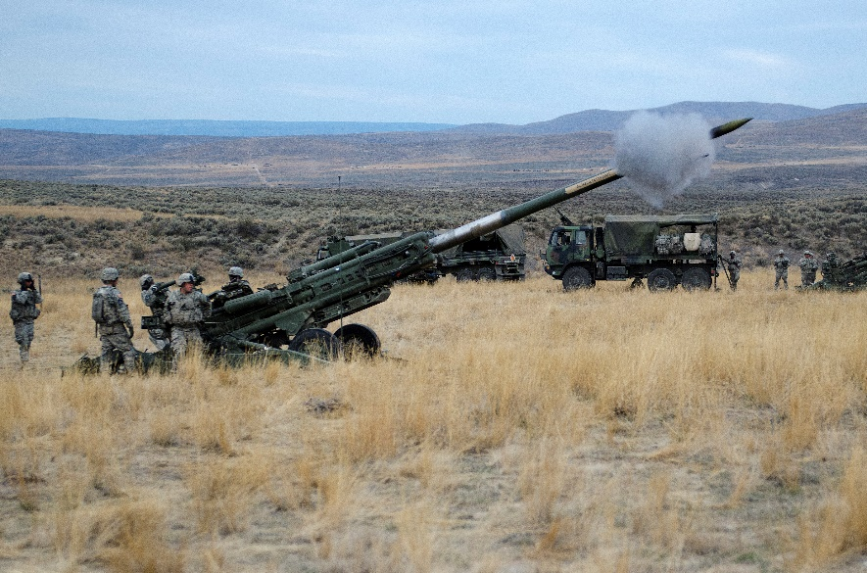
Yakima Training Center Economic Impact Analysis
2018 Yakima and Central Washington Economic Symposium
Dr. Charles S. Wassell, Jr.
Department of Economics, CWU
wassellc@cwu.edu

Slide 2
Yakima Training Center (YTC)
Key Facts:
1. The U.S. Army originally leased 160,000 acres from 1942 to 1946. The YTC currently covers 327,000 acres — about 10% of Yakima County.
2. The YTC is assigned to Joint Base Lewis-McChord
3. The YTC is the 9th largest employer in Yakima County, with approximately 850 employees and an annual payroll of ~ $26 million.

Slide 3
Yakima Training Center (YTC)
Key Facts:
Average annual construction expenditures of $17.8 million.
Other expenditures:
Food and Lodging: $966,000
Fire-fighting support: $1.27 million
Fuel (JP8, Diesel, Unleaded): ~ $3.2 million
Service Contracts: $2.97 million
Other: $634,000

Slide 4
Economic Impact Methodology
An increase or decrease in production and employment within a local area has a “multiplier” effect as other sectors of the local economy are impacted by the changes in local spending.
The estimation of the multiplier effect for each sector is the objective of input-output analysis.

Slide 5
Three Types of Impacts
Impacts from a particular event fall into three categories: direct, indirect, and induced.
Direct Impact
Indirect Impact
Induced Impact
Induced Impact
Total = Direct + Indirect + Induced

Slide 6
Multiplier Example
Multiplier = Total Impact ÷ Direct Impact
e.g. (100 + 25 + 30 ) / 100 = 1.55
For every construction worker hired, employment increases an additional 0.55 workers.

Slide 7
Yakima County Impacts
Construction: YTC five-year average annual construction is $17.8 million. For this expenditure, employment, output, and income impacts on Yakima County are:
 | Direct | Indirect | Induced | Total | Multiplier
Employment | 98.5 | 29.3 | 26.7 | 154.6 | 1.57
Output | $18,400,000 | $4,196,507 | $3,560,433 | $26,156,941 | 1.42
Labor Income | $6,635,119 | $1,309,952 | $1,125,516 | $9,070,587 | 1.37

Slide 8
Yakima County Impacts
Non-construction Impacts: employment, output, and income impacts on Yakima County are:
 | Direct | Indirect | Induced | Total | Multiplier
Employment | 294.6 | 7.4 | 48 | 349.9 | 1.19
Output | $30,473,211 | $947,718 | $6,393,891 | $37,814,820 | 1.24
Labor Income | $14,331,688 | $284,592 | $2,021,102 | $16,637,382 | 1.16

Slide 9
Kittitas County Impacts
Kittitas County: expenditure, employment, output, and income impacts on Kittitas County are:
 | Direct | Indirect | Induced | Total | Multiplier
Employment | 9 | 0 | 1.3 | 10.4 | 1.16
Output | $900,000 | $5,079 | $173,844 | $1,078,922 | 1.20
Labor Income | $431,948 | $1,692 | $44,137 | $477,777 | 1.01

Slide 10
Washington State Impacts
Washington State: expenditure, employment, output, and income impacts on Washington State are:
 | Direct | Indirect | Induced | Total | Multiplier
Employment | 324.9 | 53 | 151.6 | 529.4 | 1.63
Output | $53,192,702 | $10,057,409 | $24,201,254 | $87,451,365 | 1.64
Labor Income | $26,688,498 | $3,191,783 | $7,833,378 | $37,713,658 | 1.41

Slide 11
State and Local Taxes
Create up to $3 million in state and local taxes:
up to $850,000 is comprised of property taxes
up to $1.73 million in sales taxes.
Ambiguity because federal expenditures are not subject to state and local taxes; however, indirect and induced expenditures, at a minimum, do contribute to taxes.

Slide 12
Non-pecuniary Benefits
Supports readiness by U.S. military forces, as well as allied forces and law enforcement.
As the only place in Washington where shrub-steppe occurs on a landscape scale, the YTC also provides valuable habitat for some species, e.g. the Greater Sage Grouse.

