Slide 1
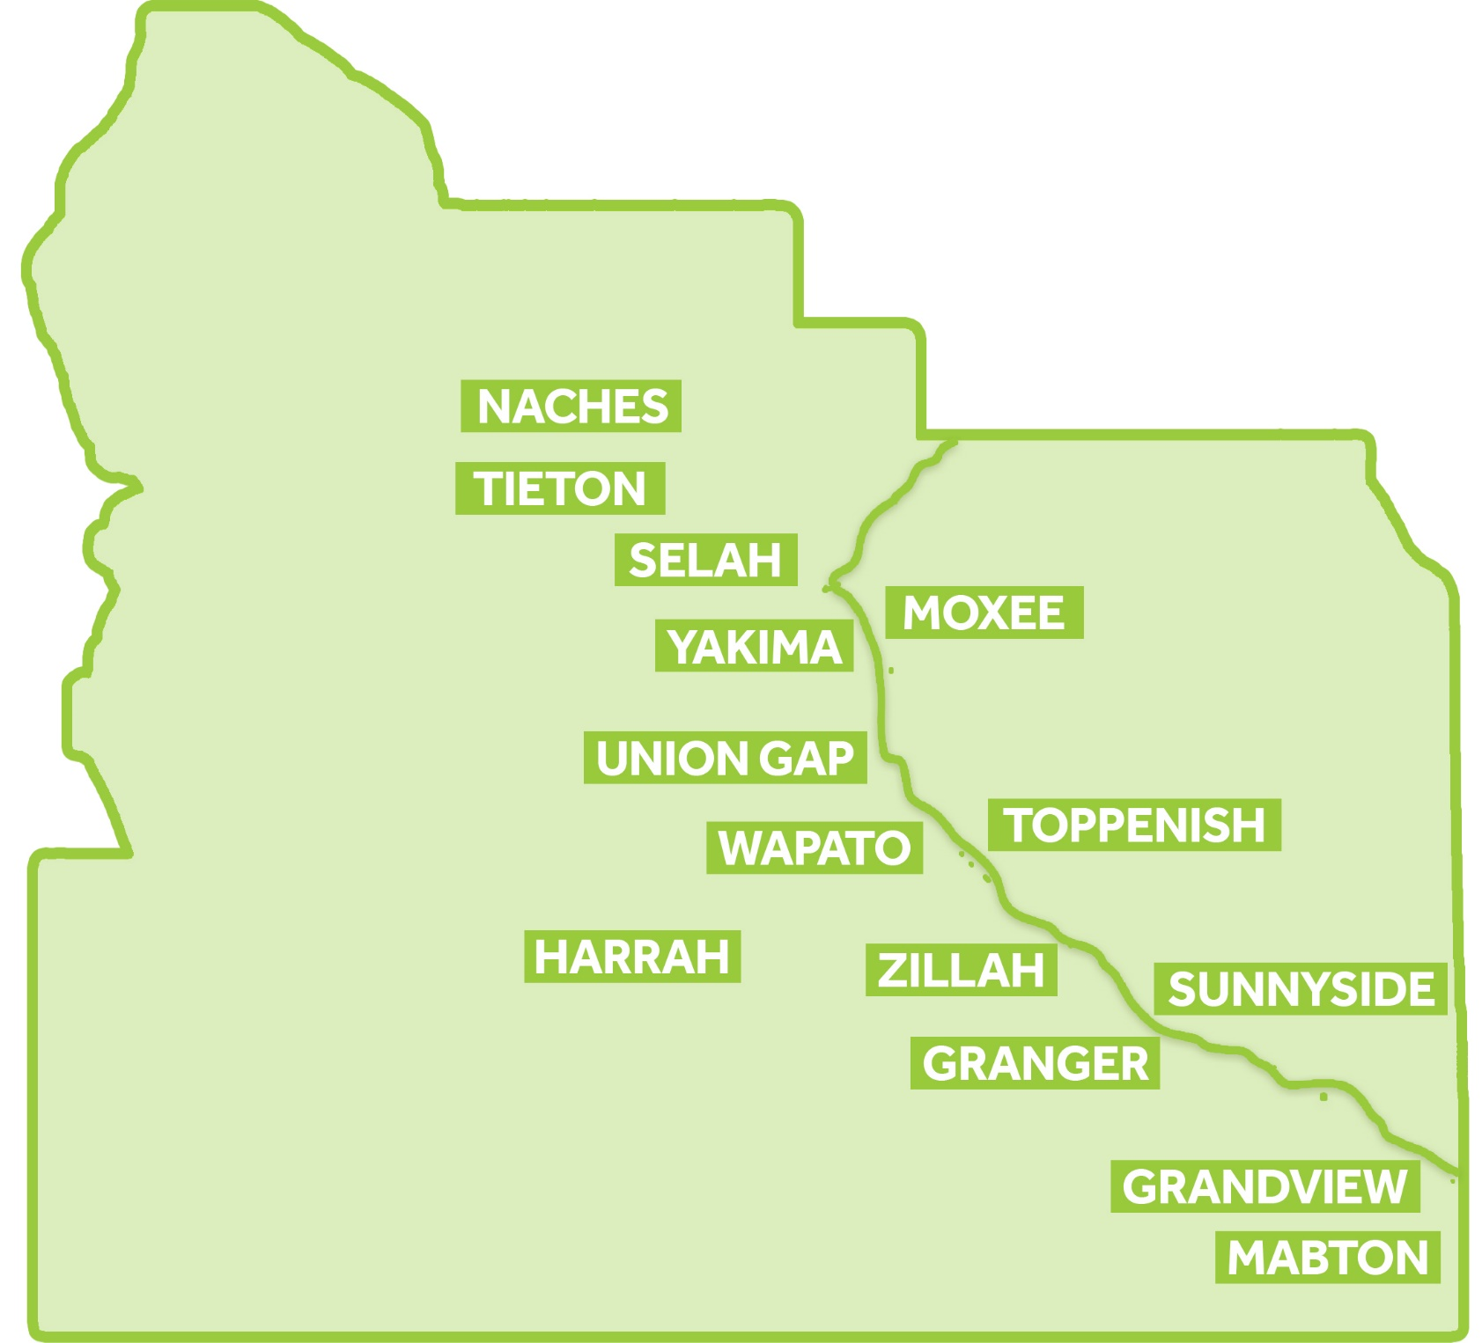

Slide 2
Supporting Investments in Economic Development
$45 Million
121 Projects

Slide 3
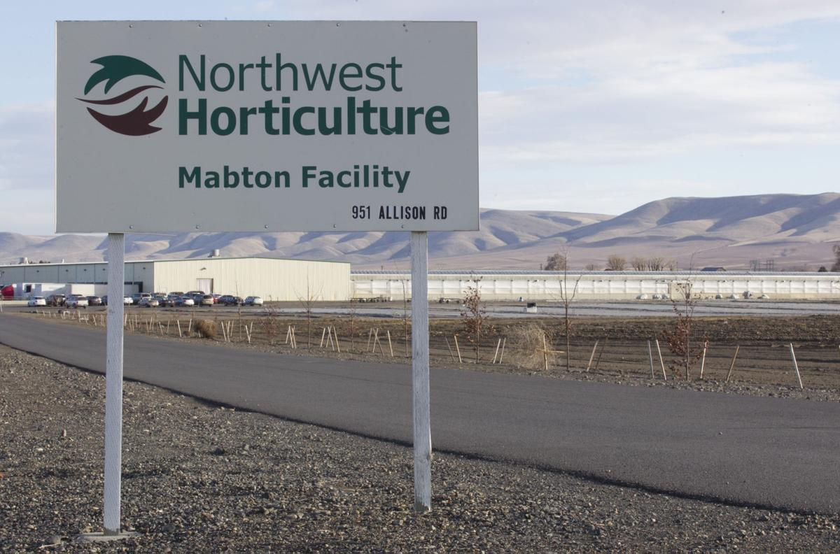
Mabton

Slide 4
Grandview

Slide 5
Grandview
Wal-Mart Distribution Center – 600+ employees
Grandview Lumber
Fruit Smart
Pallet Place

Slide 6
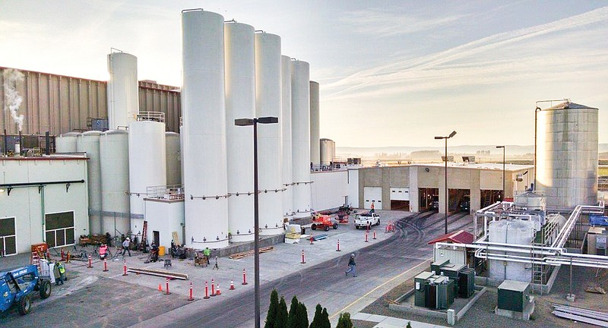
Sunnyside

Slide 7
Sunnyside
CanAm Steel
Crop Production Services
Co Dinn Cellars
Yakima Chief Hopunion
Valley Processing
Johnson Foods

Slide 8
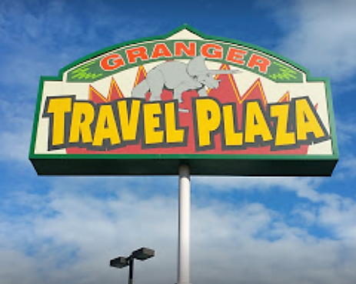
Granger

Slide 9
Zillah

Slide 10
Toppenish

Slide 11
Wapato

Slide 12
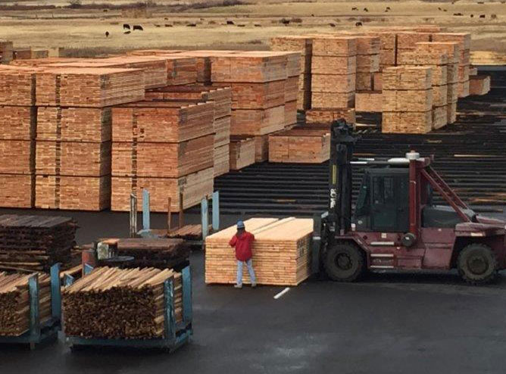
Harrah & White Swan

Slide 13
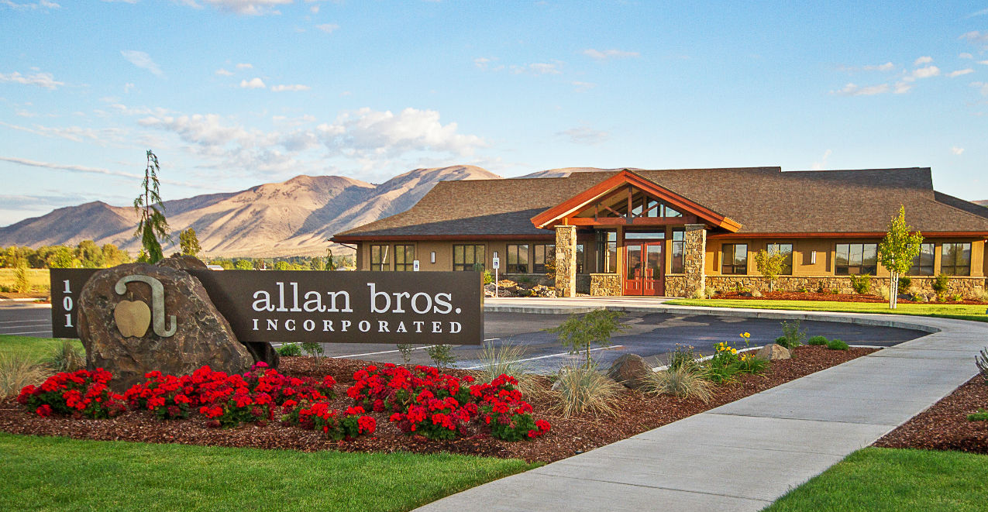
Naches

Slide 14
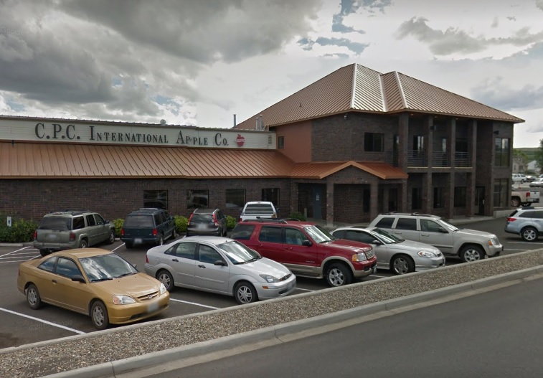
Tieton

Slide 15
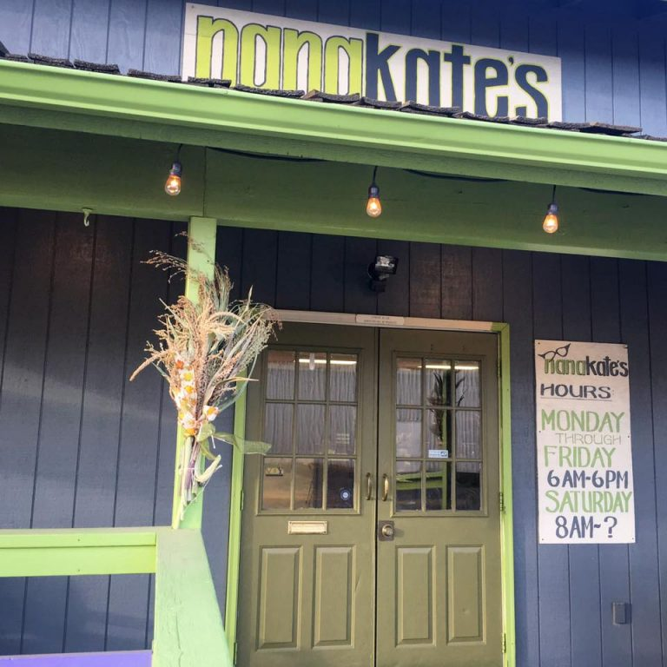
Selah

Slide 16
Selah
Graham Packaging
Matson Fruit
North Park Drive Commercial Development
South Park Drive Commercial Development

Slide 17
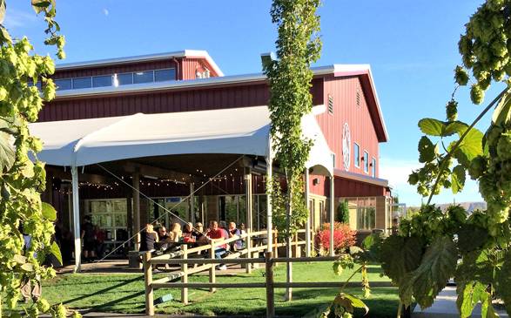
Moxee

Slide 18
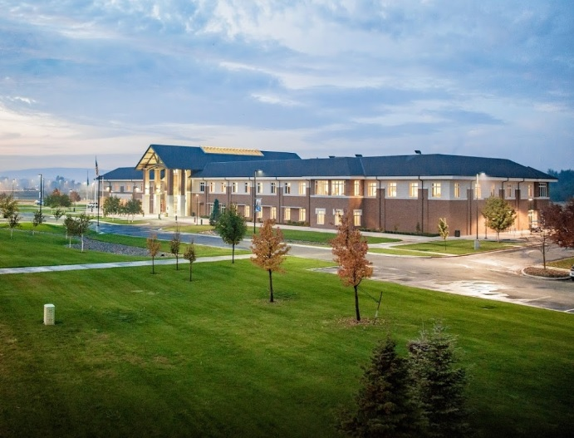
Yakima County

Slide 19
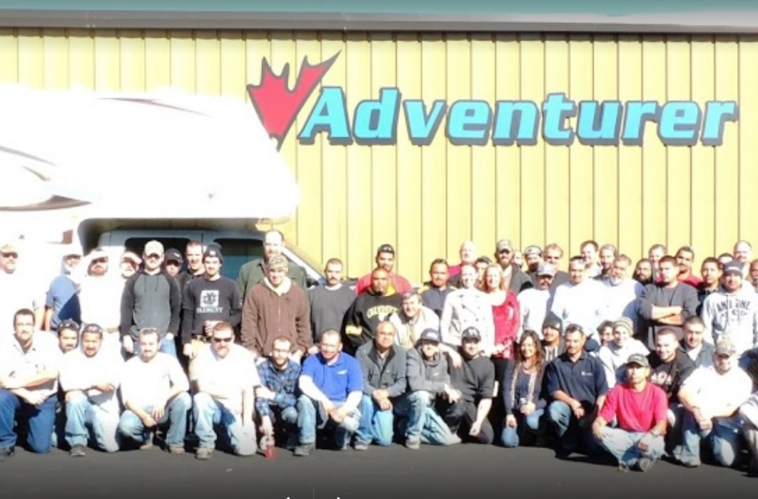
Yakima

Slide 20
Yakima
SOZO Sports
Costco Call Center
Cubcrafters
JR Helicopters
Washington Vision Therapy

Slide 21
Union Gap
Borton Fruit
Paragon Films
Liberty Bottleworks
Macro Plastics
Thermoforming Systems
Fed Ex

Slide 22
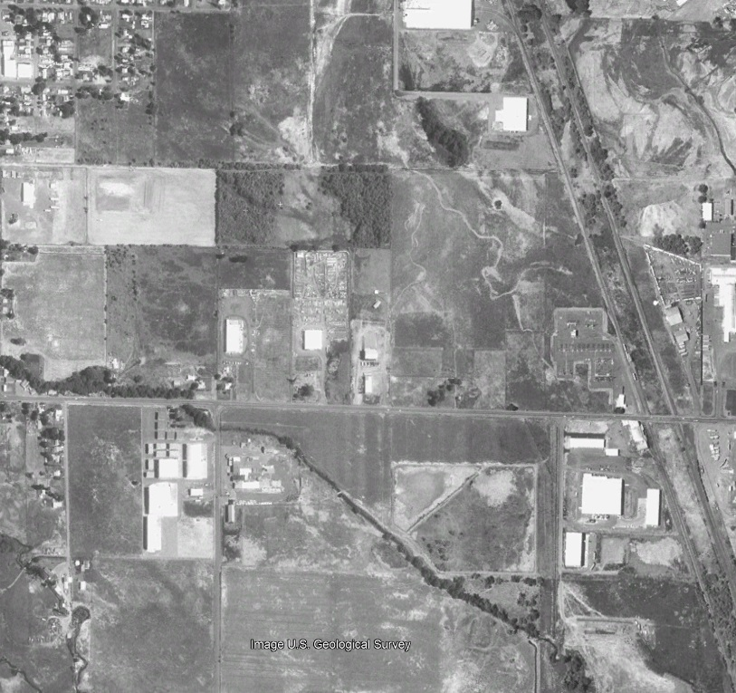
Union Gap

Slide 23
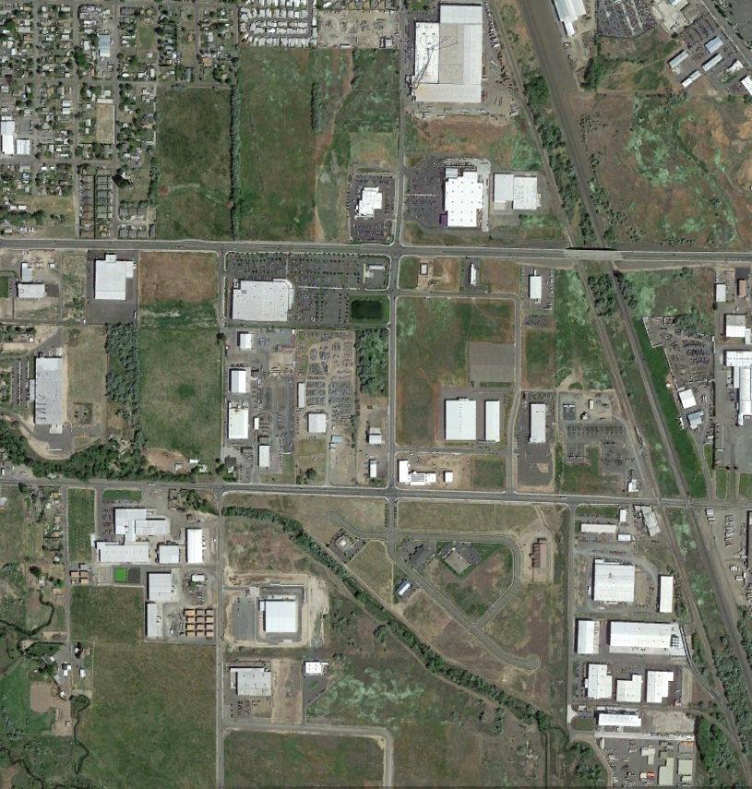
Union Gap

Slide 24
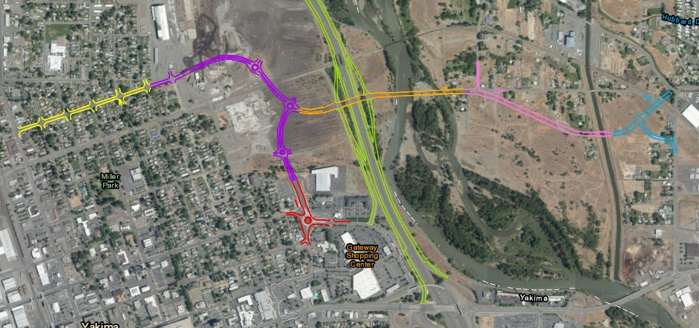
Cascade Mill Site
225 acres
City of Yakima & Yakima County
East West Corridor
Over $100 million in funding including $7+ million in SIED support

Slide 25
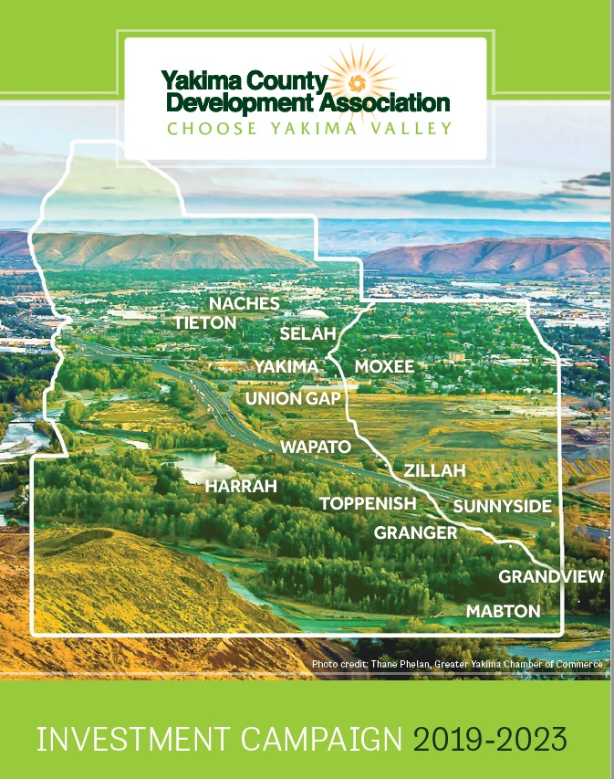
Choose Yakima Valley Campaign
2019-2023

