Slide 1
Yakima County Economic Update
For: 2018 Yakima and Central Washington Economic Symposium
By: Donald W. Meseck, Regional Labor Economist, Washington State Employment Security Department
Date: July 20, 2018
Notes:
My name is Don Meseck, Regional Labor Economist, assigned to the Workforce Information and Technology Services (WITS) Division of the Washington State Employment Security Department.
I provide economic analysis services and Labor Market Information (LMI) for a seven-county area in Washington State. Some of our major clients are: WorkSource offices, the North and South Central Washington Workforce Development Councils, economic development councils, chambers of commerce, ports, public and private sector schools, elected officials, the media, Rotary and Kiwanis clubs, banks, realtors, other businesses, etc. primarily in Adams, Chelan, Douglas, Grant, Kittitas, Okanogan, and Yakima counties.

Slide 2
Today’s presentation
Quarterly Census of Employment and Wage (QCEW) summaries for Yakima County in 2017
Slides 3-9
Civilian Labor Force (CLF) and unemployment rate trends in Yakima County: long-term and short-term
Slides 10-13
Nonfarm employment trends in Yakima County, long-term and short-term
Slides 14-19
Summary and questions
Slides 20-21
Notes:
In Slides 3-9, will discuss employment and wage trends, as of 2017, for Yakima County’s 22 industries/sectors. Out of these 22 industries, five provided the most jobs and largest payrolls in Yakima County in 2016 - the most recent year for which we have detailed annual average employment and wage data. Please note that preliminary annual average total covered employment and wage data for 2017 only became available as of May 2018, and revised data should become available as of August 2018.
In Slides 10-13, I will summarize average annual unemployment and labor force trends from 2005-2017 in Yakima County plus year-over-year changes in monthly data up through and including May 2018. Civilian Labor Force (CLF) data from the BLS’ Labor Area and Unemployment (LAUS) program were used to provide much of this analysis.
In Slides 14-19, will provide an overview of 2007-2017 nonfarm employment trends in Yakima County, highlighting trends between 2016 and 2017 for several major industries/sectors. Will also briefly discuss year-over-year changes in monthly data up through and including May 2018. Estimates for Yakima County and Washington State were obtained from the Bureau of Labor Statistics (BLS) Current Employment Statistics (CES) program.
The presentation summary and Point of Contact (POC) information are shown in Slides 20 and 21.

Slide 3
Analyzed county-level QCEW data for 22 industries/sectors
19 private-industry sectors |  | Three government sectors
NAICS 11 (Agriculture, forestry and fishing) |  | Federal government
NAICS 21 (Mining) |  | State government
NAICS 22 (Utilities) |  | Local government
NAICS 23 (Construction)
NAICS 31-33 (Manufacturing) |  | * North American Industry Classification System (NAICS)
NAICS 42 (Wholesale trade)
NAICS 44-45 (Retail trade)
NAICS 48-49 (Transportation and warehousing)
NAICS 51 (Information)
NAICS 52 (Finance and insurance)
NAICS 53 (Real estate and rentals)
NAICS 54 (Professional and business services)
NAICS 55 (Management of companies)
NAICS 56 (Administrative and waste services)
NAICS 61 (Private education services)
NAICS 62 (Health services)
NAICS 71 (Arts, entertainment and recreation)
NAICS 72 (Accommodation and food services) |  | QCEW is the Quarterly Census of Employment and Wages, a
NAICS 81 (Other services) |  | U.S. Bureau of Labor Statistics data set.
Notes:
The North American Industry Classification System (NAICS) is an industry classification system that groups businesses/organizations into categories or sectors based on the activities in which they are primarily engaged.
For this briefing, the most recent average annual covered employment and wage figures (for 2017) were analyzed using Washington State Employment Security Department’s Quarterly Census of Employment and Wage (QCEW) data for Yakima County, primarily at the 2-digit NAICS code level.

Slide 4
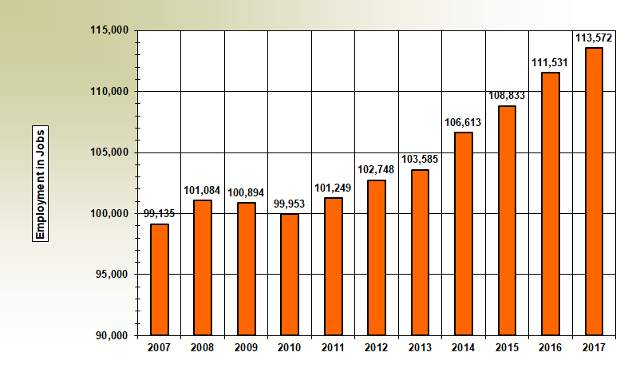
Yakima County: Total covered employment from 2007-2017
Source: QCEW Data
Notes:
The National Bureau of Economic Research (NBER) announced that the national recession occurred from December 2007-June 2009. But, the effects of this recession hit Yakima County’s labor market primarily in 2009 and 2010. You can see that the “valley” of our local recession here in Yakima County occurred in 2010. Please keep in mind that these total covered employment and wage data, include nonagricultural and agricultural employers.
Total covered employment rose from 111,531 jobs in 2016 to 113,572 in 2017, as shown in this graph. This was a 2,041-job and a 1.8-percent upturn during 2017.

Slide 5
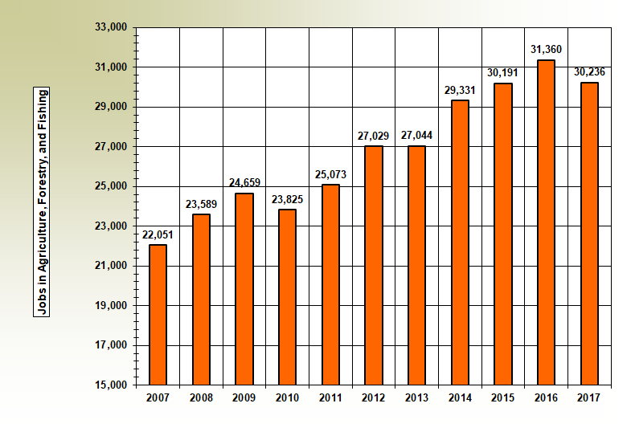
Yakima County: Agricultural employment declined by 3.6 percent from 2016-2017
Source: QCEW Data
Notes:
Between 2016 and 2017 agricultural employers shed 1,124 jobs (i.e., in NAICS 11) down 3.6 percent.
Hence, following six consecutive years of agricultural employment expansions (from 2011-2016, inclusive – we saw a contraction last year). The question is: “Is this just a seasonal downturn or a structural change in the local agricultural market?” I tend to think it is the latter – primarily due to automation
.

Slide 6
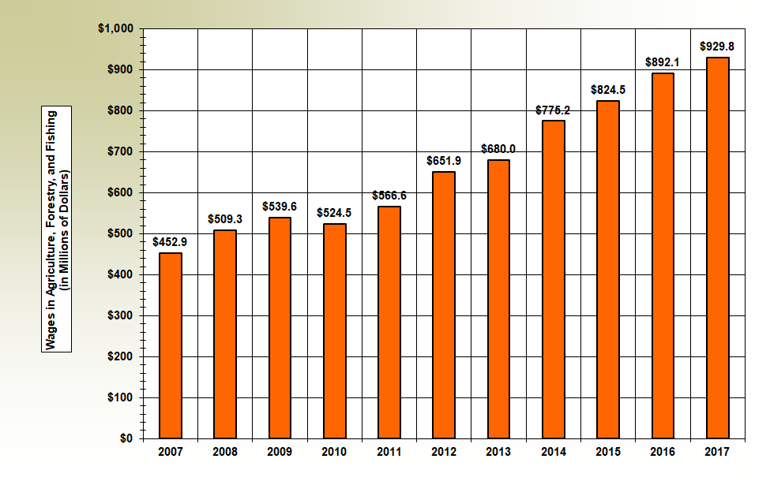
Yakima County: Agricultural payroll increased by 4.2 percent from 2016-2017
Source: QCEW Data
Notes:
While the number of agricultural jobs fell countywide last year, the total agricultural payroll rose 4.2 percent - as shown in this slide. Please note that these data were not adjusted for inflation.
There are probably many reasons for this. But, my observations are that there are at least three reasons:
Automation is making many agricultural jobs more “technical,” and hence increasing wages.
More sharing of labor amongst employers.
Gradual move from seasonal to year-round employment in this industry.

Slide 7
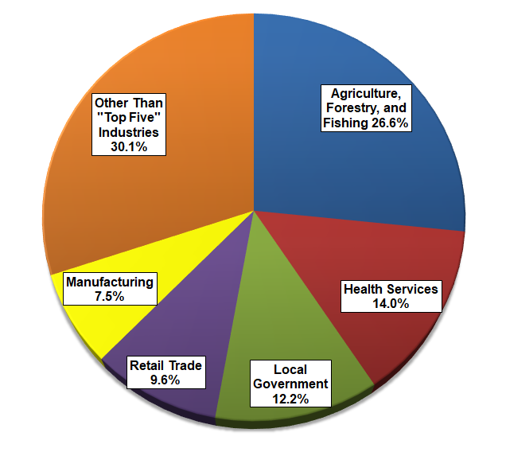
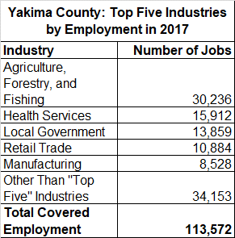
Yakima County: Top 5 industries by employment in 2017
Source: QCEW Data
Notes:
This slide and the next slide (“Top 5 Industries by Percent of Total Wages”) rank Yakima County’s top industries in terms of jobs and wages provided in the 22 major industries/sectors, mentioned earlier.
In 2017, QCEW data showed that Yakima County’s labor market provided 113,572 jobs. Approximately 70 percent of all local jobs were in five (i.e., agriculture, health services, local government, retail trade, and manufacturing) two-digit NAICS industries or sectors. Hence, for a Metropolitan Statistical Area (MSA), Yakima County is not a very diverse economy. In fact, this situation holds true for many counties here in Central Washington.

Slide 8
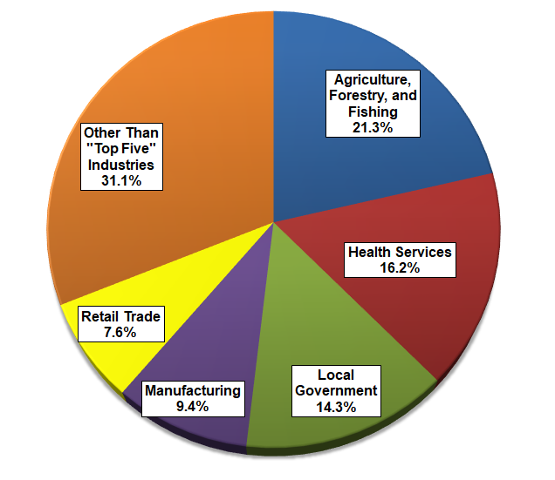
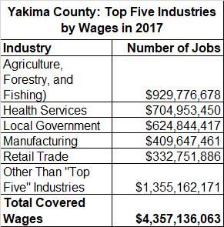
Yakima County: Top 5 industries by wages in 2017
Source: QCEW Data
Notes:
In 2017, QCEW data showed that Yakima County’s labor market provided nearly $4.36 billion in wages.
Over two-thirds of all wage income countywide was earned in just five industries: agriculture, health services, local government, manufacturing, and retail trade.

Slide 9
Yakima County in 2017: Summary of “Top 5” industries (ranked by % of jobs)
Total covered wages = $4.36 billion
Average annual employment = 113,572
Average annual wage = $38,365 (61.8 percent of Washington State’s average annual wage of $62,077)
Industry | Percent of jobs (in Yakima County) | Percent of wages (in Yakima County)
Agriculture | 26.6 | 21.3
Health services | 14.0 | 16.3
Local government | 12.2 | 14.2
Retail trade | 9.6 | 7.6
Manufacturing | 7.5 | 9.4
Notes:
This slide summarizes the differences between the industries that provided the most jobs in the Yakima County economy in 2017, and the industries that pumped the most money (via wages/payrolls) into that economy. Specifically:
Agriculture provided 26.1 percent of all jobs countywide, but supplied only 21.3 percent of total wage income. Why? Many jobs in agriculture are seasonal.
Conversely, private health services tallied 14.0 percent of total covered employment , but accounted for 16.3 percent of total wage income – indicating it is a relatively “good paying” industry.
The local retail trade sector accounted for nearly one in ten jobs countywide, but provided only 7.6 percent of total wage income.
Conversely, manufacturing supplied only 7.5 percent of all jobs in Yakima County but 9.4 percent of total wages/payroll. Almost one in every ten dollars of wage income countywide is earned at a local manufacturing firm. (Note: the manufacturing sector includes the “food processing” subsector.)

Slide 10
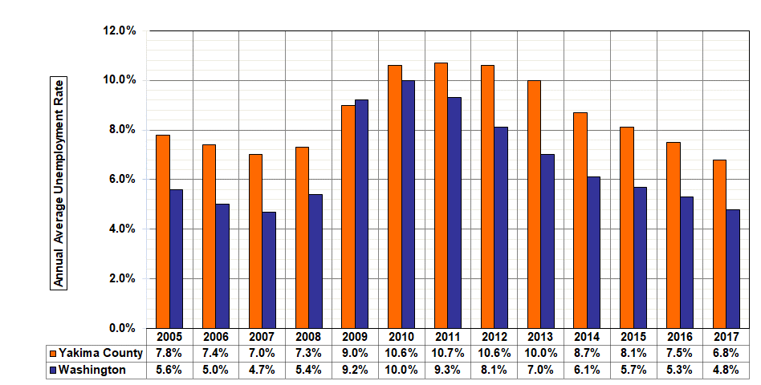
Annual Average Unemployment Rates in Yakima County and in Washington from 2005-2017
Notes:
Note the difference in the magnitude of the rates, in both areas, from 2005-2008, from 2009-2015, and from 2016-2017.
In Yakima County for example, unemployment rates were in 7-percent range from 2005-2008. For the past eight years however (from 2009-2016) not seasonally adjusted rates have lingered in the 8-10 percent range.
LAUS estimates indicate that the unemployment rate fell seven-tenths of a point in 2017. Why? The number of residents in the Civilian Labor Force (CLF) grew 0.8 percent between 2016 and 2017 (good news) while the number of unemployed residents fell at a 8.6-percent clip in 2017 (more good news). The local unemployment rate has been moving in the right direction (i.e., downward) for six consecutive years (2012-2017, inclusive). The 6.8-percent reading for Yakima County in 2017 was the lowest rate in recent recorded history (i.e., since our agency began compiling data electronically in 1990.)
Annual average unemployment rates for Washington have steadily decreased in each of the past seven years (i.e., from 2011-2017, inclusive) and by 2015 and 2016 were back to the pre-recession levels of 4-5 percent (experienced from 2005-2008). The 2017 rate of 4.8 percent for Washington State was the lowest rate in ten years (i.e., since the 4.7 percent average annual rate in 2007.)

Slide 11
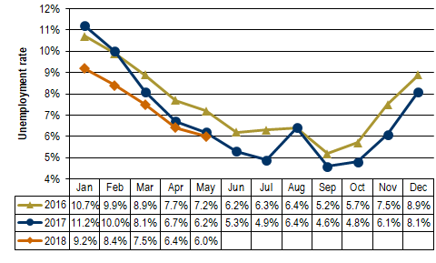
Unemployment Rates in Yakima County: From January 2016-May 2018
Notes:
In Yakima County, the not seasonally adjusted average annual unemployment rate edged downwards only seven-tenths of a percentage point between 2016 and 2017, from 7.5 to 6.8 percent.
The unemployment rate fell from 6.2 percent in May 2017 to 6.0 percent in May 2018, a two-tenths points drop as the number of residents entering the labor force increased while the number of unemployed decreased. The rate has either stabilized or posted year over year declines for the past 15 months (March 2017 through May 2018). This May’s rate (6.0 percent) is the lowest reading for the month of May for Yakima County since electronic records were implemented in 1990 – 28 years ago.

Slide 12
Yakima County’s Civilian Labor Force: From May 2017-May 2018
Notes:
In May 2018, the number of local residents who were unemployed was 7,669 countywide, a 1.5 percent decline from the 7,782 residents out of work in May 2017. Simultaneously the number of residents in the CLF grew by 2.2 percent. The result: Yakima County’s unemployment rate dropped from 6.2 percent in May 2017 to 6.0 percent in May 2018.
The rate has either stabilized or posted year over year declines for the past 15 months (March 2017 through May 2018). This May’s rate (6.0 percent) is the lowest reading for the month of May for Yakima County since electronic records were implemented in 1990 – 28 years ago.

Slide 13
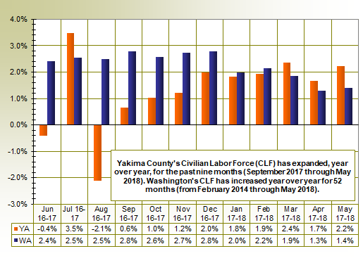
Labor Force Changes in Yakima County and Washington in the last twelve months
Notes:
On an average annual basis, Yakima County’s CLF increased a modest 0.8 percent between 2016 (125,834 residents) and 2017 (126,814 residents). But, the County's labor force has been expanding for the past nine months (from September 2017 through May 2018).
Washington's Civilian Labor Force (CLF) expanded by 89,522 residents (a 2.5 percent upturn) from 2016 to 2017. The state’s labor force has grown, year over year, for the past 52 months (February 2014 through May 2018). In May 2018, Washington’s CLF tallied 3,753,803 residents versus 3,702,170 in May 2017 equating to 51,633 more Washingtonians in the labor force (up 1.4 percent).

Slide 14
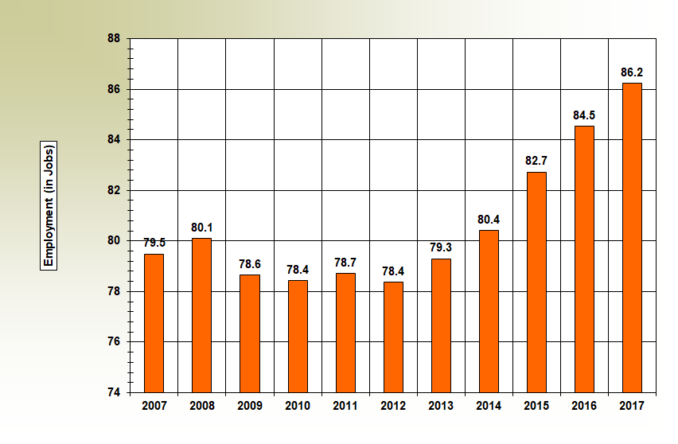
Yakima County: Total nonfarm employment from 2007-2017
Source: CES Data, LMPA, ESD
Notes:
The National Bureau of Economic Research (NBER) announced that the national recession occurred from December 2007 through June 2009. But, the effects of the recession hit Yakima County’s nonfarm labor market heavily in 2009, 2010, and again in 2012. Please note: nonfarm employment data do not count agricultural jobs. Nonfarm figures are derived from Current Employment Statistics (CES) data/estimates (i.e., from CES quarterly benchmarked data, not seasonally adjusted) at the county, state, and national levels.
The “pre-recession” peak for nonfarm employment was in 2008 when the local economy provided 80,100 jobs. Then the recession hit and it took six years, until 2014, for the Yakima County economy to regain (and slightly exceed) this level of employment. The “valleys” of our local recession here in Yakima County occurred in 2010 and 2012, when nonfarm employment averaged just 78,400.
In 2017 nonfarm employment averaged 86,200.
An important takeaway: the recent recession hit the local nonfarm market harder than the total covered employment job market. It took six years (from 2008-2014) for Yakima County’s nonfarm economy to regain the number of jobs lost; but it took only three years (from 2009-2011, inclusive) for total covered employment (which includes agricultural jobs) to bounce back to the 2018, pre-recession peak.

Slide 15
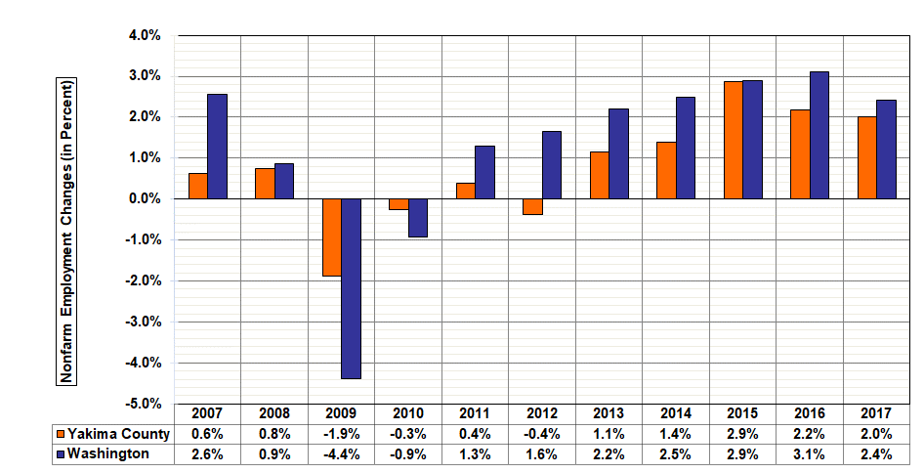
Yakima County and Washington: Nonfarm employment changes during the last 10 years (2007-2017)
Notes:
This slide (plotting average annual nonfarm changes for the past 10 year-period in Yakima County and Washington) helps to substantiate the generalization about the Yakima County economy that: “In good economic years, we lag the state; but in bad years, we lead the State.”
The blue bars depict over-the-year employment changes in Washington State, while the orange bars depict over-the-year employment changes in Yakima County. Note that:
Washington’s nonfarm economy lost jobs more rapidly than Yakima during the recession in 2009 and 2010. Why? Agriculture, and agriculturally-dependent industries (i.e., food manufacturing, fresh fruit packinghouses, trucking, etc.) has a “stabilizing effect” on the local labor market.
In each of the past eleven years (inclusive) shown in this slide, local nonfarm job growth has lagged the growth pace statewide; with the exception of calendar year 2015 when Yakima County added nonfarm jobs at the same pace (2.9 percent) as the State.

Slide 16
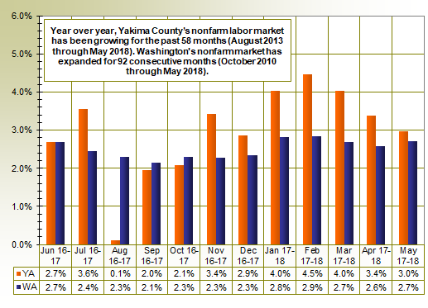
Nonfarm employment changes in Yakima County and Washington in the last twelve months
Notes:
The Yakima County nonfarm labor market added 1,700 jobs between 2016 and 2017, an average annual increase of 2.0 percent. Year over year, Yakima County’s nonfarm labor market has been growing for the past 58 months (August 2013 through May 2018). The local nonfarm market provided 89,900 jobs in May 2018 versus 87,300 in the corresponding month in 2017, a 2,600 job and 3.0 percent upturn.
Between 2016 and 2017, Washington's labor market provided 78,300 new nonfarm jobs, an annual average increase of 2.4 percent. In May 2018, businesses and government organizations across Washington supplied 3,421,700 nonfarm jobs (not seasonally adjusted), compared to 3,331,600 jobs in May 2017, a 2.7 percent year over year employment increase. The state’s economy has posted year over year nonfarm employment increases for the past 92 consecutive months (October 2010 through May 2018).
It is encouraging to note that the nonfarm job growth rate in Yakima County has been faster than the nonfarm job growth rate in Washington State for the past seven months (November 2017 through May 2018).

Slide 17
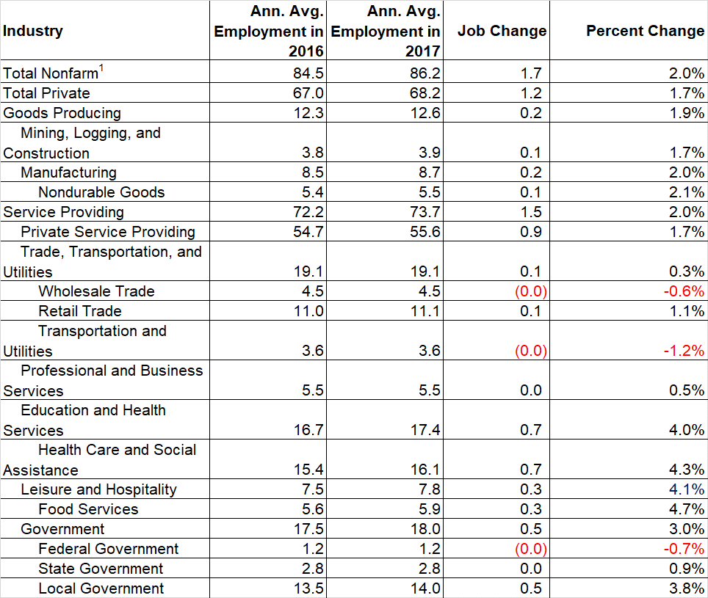
Yakima County - Nonfarm job growth in major industries from 2016 to 2017
Notes:
The 86,200 jobs provided in Yakima County in 2017 was a 1,700-job and 2.0-percent upturn over the 84,500 jobs tallied in 2016.
Since this table is a little hard to read, I graphed annual average gains and losses during 2017 for eight of Yakima County’s major industries in the chart on the next two slides. . .

Slide 18
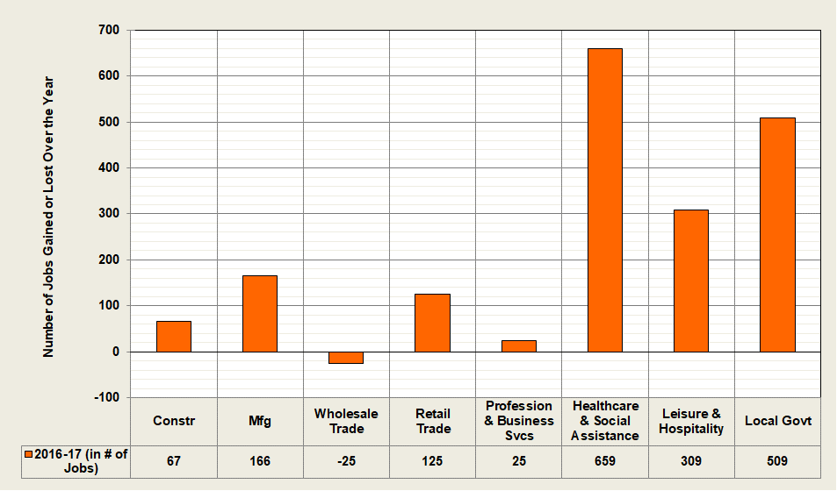
Summary of job gains/losses (in #) in Yakima County nonfarm industries from 2016 to 2017
Notes:
This figure summarizes annual average nonfarm employment changes in Yakima County between 2016 and 2017:
Only one major, local industry netted fewer jobs last year than in 2016 – wholesale trade. Fresh fruit packinghouses account for the lion’s share of jobs in this sector. It is possible that fresh fruit packinghouse automation is reducing the need for packers, sorters, and graders at these businesses.
Three local industries netted over 85 percent of the 1,700-job nonfarm gain in 2017; healthcare, leisure and hospitality (primarily hotels and restaurants), and local government (which includes tribal employment).

Slide 19
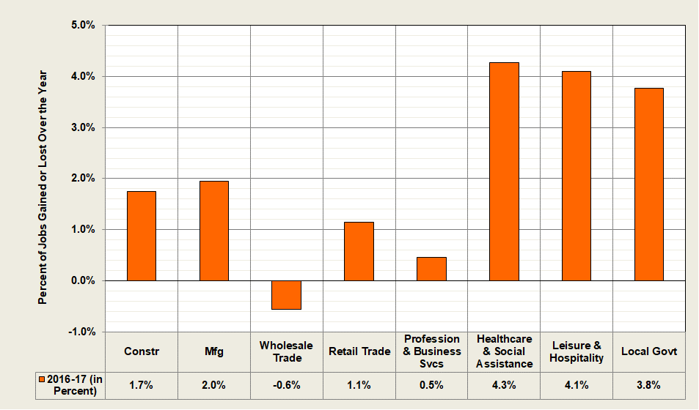
Summary of job gains/losses (in %) in Yakima County nonfarm industries from 2016 to 2017
Notes:
This graph is similar to the preceding graph, except that it depicts annual average employment changes during 2017, for these eight key sectors/industries, on a percentage basis.

Slide 20
In 2017: Agricultural employment declined by 3.6 percent while nonfarm rose by 2.0 percent
Yakima County’s unemployment rate dipped from 7.5 in 2016 to 6.8 percent in 2017. Monthly rates have stabilized or fallen for the past 15 months.
Yakima County’s Civilian Labor Force (CLF) grew from 125,834 residents in 2016 to 126,814 in 2017, up 0.8 percent. WA’s CLF grew at a 2.5 percent clip.
Nonfarm employment averaged 86,200 in 2017, up 1,700 jobs and 2.0 percent since 2016. (WA’s nonfarm growth was 2.4 percent.) Three local industries netted over 85 percent of these jobs: health care, local government, and leisure and hospitality.
Notes:
(Self explanatory)

Slide 21
“Yakima County Economic Update” Questions?
Donald W. Meseck
Regional Labor Economist for Adams, Chelan, Douglas, Grant, Kittitas, Okanogan, and Yakima Counties
Workforce Information and Technology Services (WITS)
Employment Security Department
Address: 1205 Ahtanum Ridge Drive, Union Gap, WA 98903
Phone: (509) 574-0176
Email: dmeseck@esd.wa.gov
Website: https://esd.wa.gov/labormarketinfo
Notes:
Would like to express my appreciation to:
The President of YVC, Dr. Linda Kaminski, for the use of this facility and YVC Community relations, IT and custodial staff for their support.
Fellow presenters for bringing a wealth of economic knowledge to this year’s symposium.
WITS coworkers Robert Haglund and Carmen Serrano for graphics support, posting this event on our agency’s homepage, preparing brochures, directions, organizing registration (Eventbrite), staffing the registration desk, taking photos, receiving and analyzing symposium evaluation forms, and performing all other duties “as assigned.”
ESD Communications Manager Bretta Beveridge for publicity (email “blasts”), media support, and especially for “emceeing” this event.
And, last but not least, to each guest/client for attending this symposium.
Are there any questions?

